Slide 1
HW13第3題
第一組

Slide 2
題目
Show that if HAM-CYCLE ∈P, then the problem of listing the vertices of a Hamiltonian cycle, in order, is polynomial-time solvable.
Note 1: HAM-CYCLE is defined as “ Does a graph G have a Hamiltonian cycle? ” (only return T or F)
Note 2: “ HAM-CYCLE ∈P ” means that HAM-CYCLE is polynomial-time solvable.

Slide 3
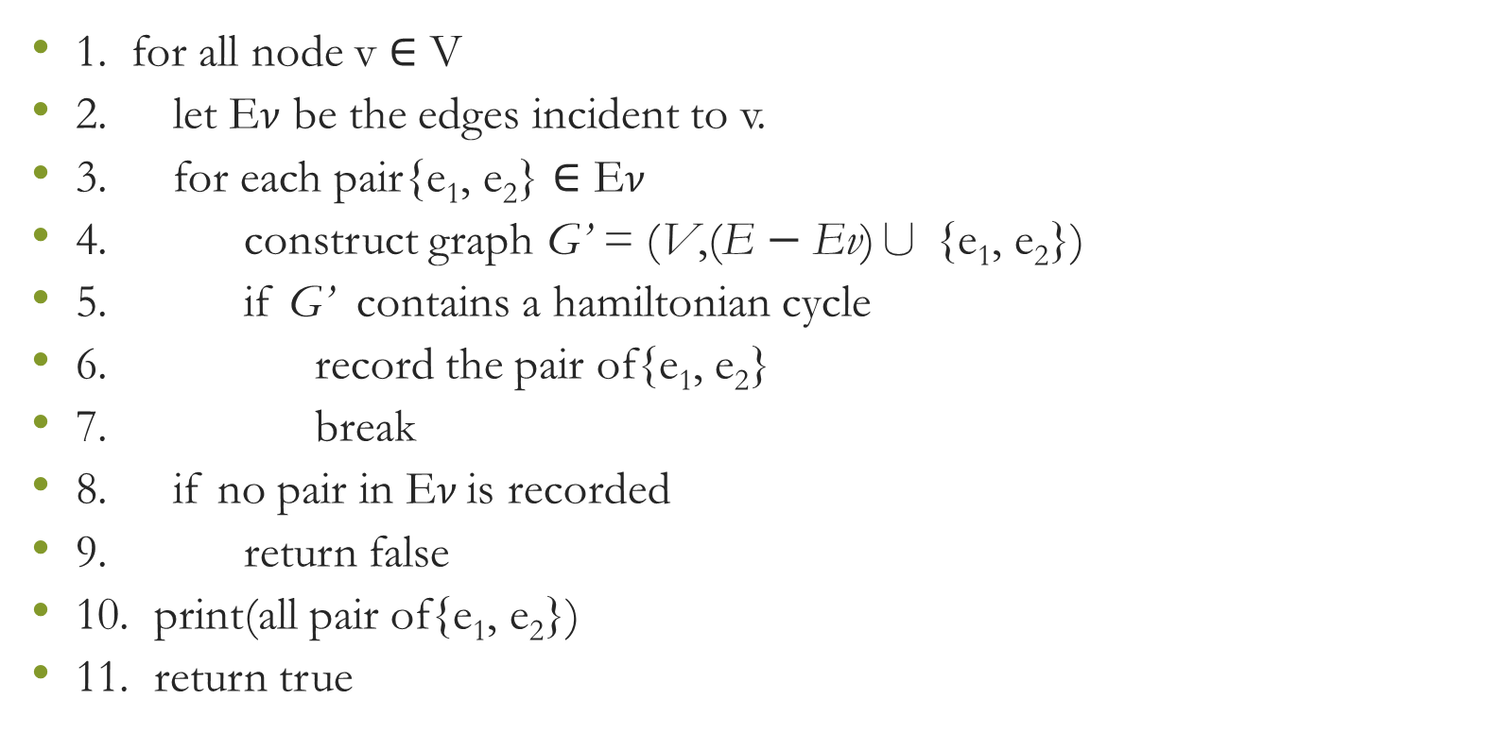
程式
1. for all node v ∈ V
2. let E$ν$ be the edges incident to v.
3. for each pair{e₁, e₂} ∈ E$ν$
4. construct graph G’ = (V,(E $−$ Ev)∪ {e₁, e₂})
5. if G’ contains a hamiltonian cycle
6. record the pair of{e₁, e₂}
7. break
8. if no pair in E$ν$ is recorded
9. return false
10. print(all pair of{e₁, e₂})
11. return true
https://www.coursehero.com/file/33916726/411-HW9pdf/

Slide 4
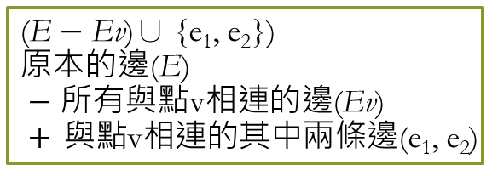
程式
1. for all node v ∈ V
2. let E$ν$ be the edges incident to v.
3. for each pair{e₁, e₂} ∈ E$ν$
4. construct graph G’ = (V,(E $−$ Ev)∪ {e₁, e₂})
5. if G’ contains a hamiltonian cycle
6. record the pair of{e₁, e₂}
7. break
8. if no pair in E$ν$ is recorded
9. return false
10. print(all pair of{e₁, e₂})
11. return true
(E $−$ Ev)∪ {e₁, e₂})
原本的邊(E)
$−$ 所有與點v相連的邊(Ev)
$+$ 與點v相連的其中兩條邊(e₁, e₂)

Slide 5
程式
1. for all node v ∈ V
2. let E$ν$ be the edges incident to v.
3. for each pair{e₁, e₂} ∈ E$ν$
4. construct graph G’ = (V,(E $−$ Ev)∪ {e₁, e₂})
5. if G’ contains a hamiltonian cycle
6. record the pair of{e₁, e₂}
7. break
8. if no pair in E$ν$ is recorded
9. return false
10. print(all pair of{e₁, e₂})
11. return true
if HAM-CYCLE ∈P 的假設
需花 polynomial time

Slide 6
程式
1. for all node v ∈ V
2. let E$ν$ be the edges incident to v.
3. for each pair{e₁, e₂} ∈ E$ν$
4. construct graph G’ = (V,(E $−$ Ev)∪ {e₁, e₂})
5. if G’ contains a hamiltonian cycle
6. record the pair of{e₁, e₂}
7. break
8. if no pair in E$ν$ is recorded
9. return false
10. print(all pair of{e₁, e₂})
11. return true
更新圖G為G’ (把多餘的邊刪掉)
下一個v為e₂連到的v

Slide 7
程式
1. for all node v ∈ V
2. let E$ν$ be the edges incident to v.
3. for each pair{e₁, e₂} ∈ E$ν$
4. construct graph G’ = (V,(E $−$ Ev)∪ {e₁, e₂})
5. if G’ contains a hamiltonian cycle
6. record the pair of{e₁, e₂}
7. break
8. if no pair in E$ν$ is recorded
9. return false
10. print(all pair of{e₁, e₂})
11. return true
只有第一次loop要看
因為如果此圖沒有hamiltonian cycle
第一次迴圈即可找出

Slide 8
程式
1. for all node v ∈ V
2. let E$ν$ be the edges incident to v.
3. for each pair{e₁, e₂} ∈ E$ν$
4. construct graph G’ = (V,(E $−$ Ev)∪ {e₁, e₂})
5. if G’ contains a hamiltonian cycle
6. record the pair of{e₁, e₂}
7. break
8. if no pair in E$ν$ is recorded
9. return false
10. print(all pair of{e₁, e₂})
11. return true
之後迴圈的e₁為前次迴圈的e₂
因此vertex會依序紀錄

Slide 9
複雜度分析
1. for all node v ∈ V
2. let E$ν$ be the edges incident to v.
3. for each pair{e₁, e₂} ∈ E$ν$
4. construct graph G’ = (V,(E $−$ Ev)∪ {e₁, e₂})
5. if G’ contains a hamiltonian cycle
6. record the pair of{e₁, e₂}
7. break
8. if no pair in E$ν$ is recorded
9. return false
10. print(all pair of{e₁, e₂})
11. return true
polynomial-time

Slide 10
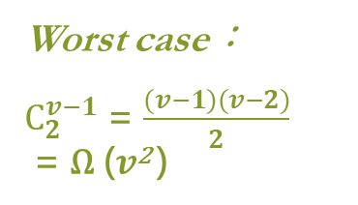
複雜度分析
1. for all node v ∈ V
2. let E$ν$ be the edges incident to v.
3. for each pair{e₁, e₂} ∈ E$ν$
4. construct graph G’ = (V,(E $−$ Ev)∪ {e₁, e₂})
5. if G’ contains a hamiltonian cycle
6. record the pair of{e₁, e₂}
7. break
8. if no pair in E$ν$ is recorded
9. return false
10. print(all pair of{e₁, e₂})
11. return true
Worst case：
$C_{2}^{v−1}$ = $\frac{(v−1)(v−2)}{2}$
= Ω ($v$² )

Slide 11

複雜度分析
1. for all node v ∈ V
2. let E$ν$ be the edges incident to v.
3. for each pair{e₁, e₂} ∈ E$ν$
4. construct graph G’ = (V,(E $−$ Ev)∪ {e₁, e₂})
5. if G’ contains a hamiltonian cycle
6. record the pair of{e₁, e₂}
7. break
8. if no pair in E$ν$ is recorded
9. return false
10. print(all pair of{e₁, e₂})
11. return true
Ω ($v$ )

Slide 12
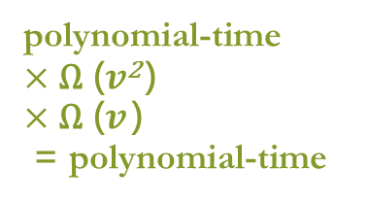
複雜度分析
1. for all node v ∈ V
2. let E$ν$ be the edges incident to v.
3. for each pair{e₁, e₂} ∈ E$ν$
4. construct graph G’ = (V,(E $−$ Ev)∪ {e₁, e₂})
5. if G’ contains a hamiltonian cycle
6. record the pair of{e₁, e₂}
7. break
8. if no pair in E$ν$ is recorded
9. return false
10. print(all pair of{e₁, e₂})
11. return true
polynomial-time
$×$ Ω ($v$² )
$×$ Ω ($v$ )
= polynomial-time

Slide 13


