Slide 1
Homewrok 13 - 6
組員：趙天佑、張立彥、洪仲杰、蔡沛宏、陳亮宇、曾思維、羅展釗

Slide 2
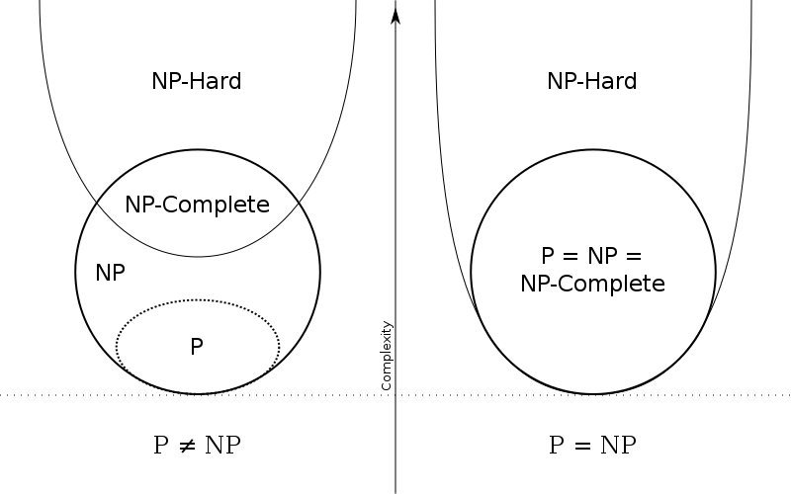


Prove that if $NP≠co−NP$, then $P≠NP$
$∵P∈NP$
$∵P=co−P$
$∵co−NP∈NP$
$∵if P=NP then co−NP=co−P=P$
$⇒P=NP=co−NP$
$∴if NP≠co−NP, then P≠NP$

Slide 3
End

