Slide 1
Algorithm 14-1
第六組

Slide 2
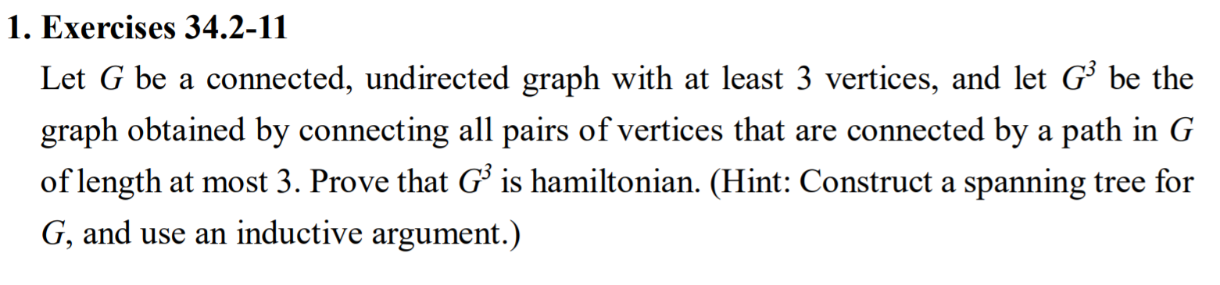

Slide 3
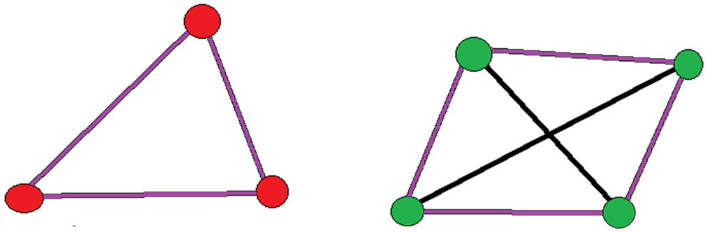
Prove any spanning tree of N >=3 has a H. cycle
(N = |V|)
N = 3
N = 4
=> True for all N > 4

Slide 4
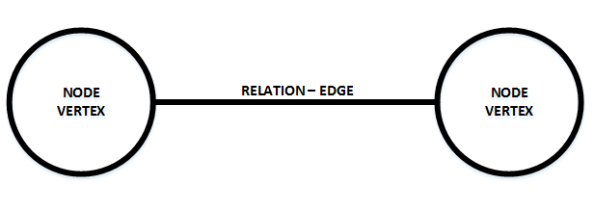
N = N + 1
e
- - - - - - - - -
u'
u
v
v'
H. cycle
u’ -> v -> u => d(u’, v ) = 2
2. u’ -> v’ -> v -> u => d(u’, v’) = 3
u’ -> v’-> … ->
-> v -> u
3.
=> d(u’, v’) = 3

