Slide 1
HW14_5 第十組

Slide 2
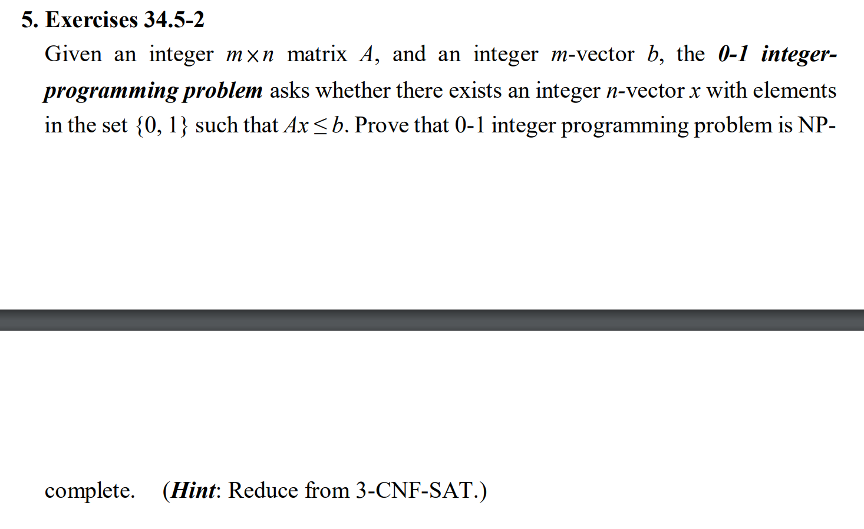

Slide 3
question
0-1 integerprogramming problem
給定A(m*n), b(m*1)，求是否有一個x(n*1)且 x’s elements ∈ {0, 1}，滿足
Ax ≦ b
證明找出此解的問題是NP-Complete

Slide 4
Sovle by example.1
Given a 3-CNF-SAT formula:
Φ = (x1 ∨ x2 ∨ x3) ∧ (x1 ∨ ~x3 ∨ ~x4) for n=4 elements and m=2 clauses
We can transmit it to equation format by [xn ➔ xn], [~xn ➔ 1-xn]:
(x1 ∨ x2 ∨ x3) ➔ (x1+x2+x3) ≧ 1 ➔ (-x1-x2-x3) ≦ -1
(x1 ∨ ~x3 ∨ ~x4) ➔ (x1+(1-x3)+(1-x4)) ≧ 1 ➔ (-x1+x3+x4) ≦ 1
PS.
對於每個變數，1就是true，0就是false，而 ≧ 1代表結果要為true。

Slide 5
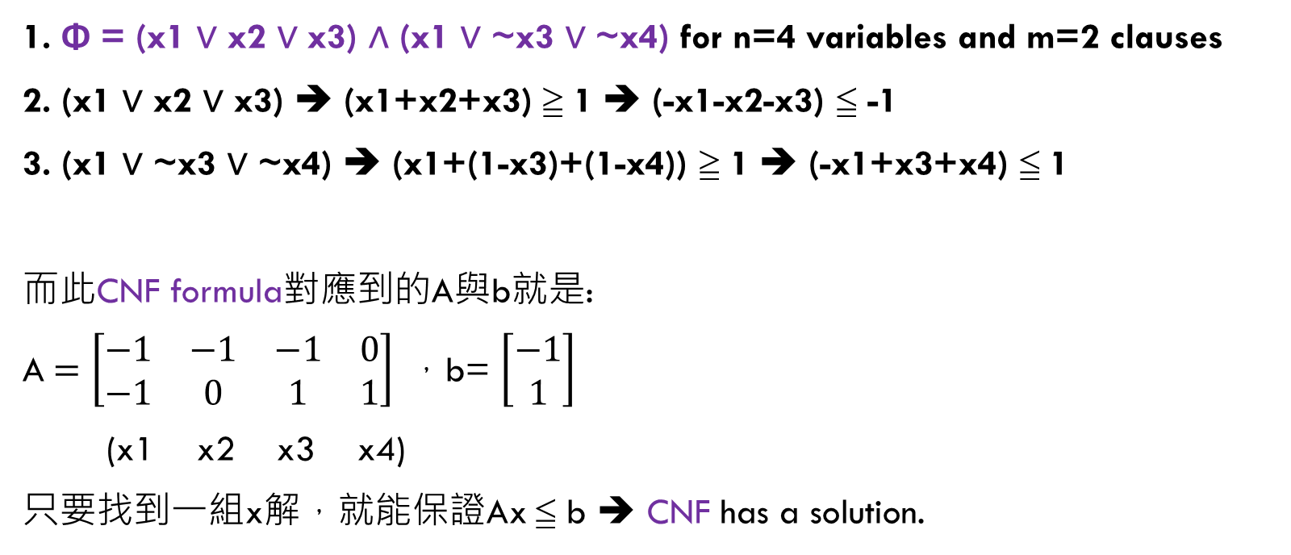
Sovle by example.2
1. Φ = (x1 ∨ x2 ∨ x3) ∧ (x1 ∨ ~x3 ∨ ~x4) for n=4 variables and m=2 clauses
2. (x1 ∨ x2 ∨ x3) ➔ (x1+x2+x3) ≧ 1 ➔ (-x1-x2-x3) ≦ -1
3. (x1 ∨ ~x3 ∨ ~x4) ➔ (x1+(1-x3)+(1-x4)) ≧ 1 ➔ (-x1+x3+x4) ≦ 1
而此CNF formula對應到的A與b就是:
A $=\left[\begin{matrix}−1 & −1 & −1 & 0 \\ −1 & 0 & 1 & 1\end{matrix}\right] ，$b= $\left[\begin{aligned}−1 \\ 1\end{aligned}\right]$
(x1 x2 x3 x4)
只要找到一組x解，就能保證Ax ≦ b ➔ CNF has a solution.

Slide 6
End
根據上述，我們可以將3-CNF-SAT的problem reduce to 0-1 integer-programming problem。
Successfully proving that 0-1 integer programming problem is
1. NP-complete
2. Ax ≦ b判斷對錯只需做矩陣相乘，可以在polynomial time求得解 ➔ NP

Slide 7
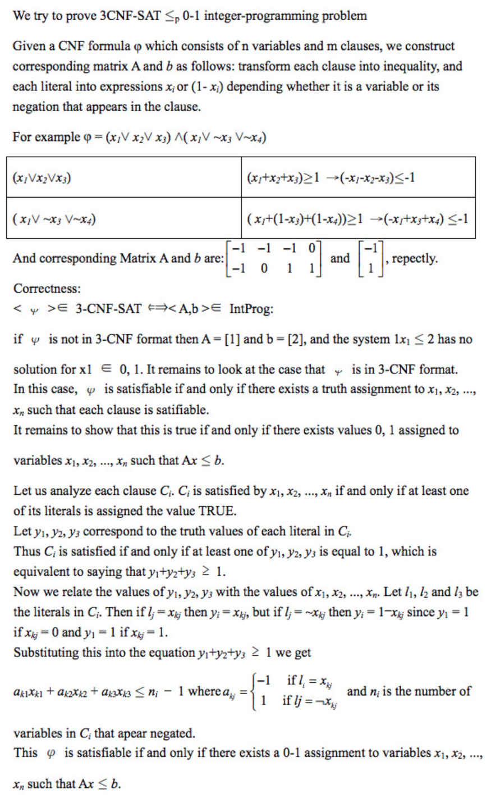
參考資料
1. Need help to understand the solution for NP-completness proof (3CNF <= 0-1 integer-programming problem)
https://math.stackexchange.com/questions/1247005/need-help-to-understand-the-solution-for-np-completness-proof-3cnf-0-1-integ

