Slide 1
HW14第6題
第一組

Slide 2
題目
The longest-simple-cycle problem (LSC) is the problem of determining a simple cycle (no repeated vertices) of maximum length in a graph.
Formulate a related decision problem, and Show that the decision problem is NP-complete.
https://www.coursehero.com/file/p1kq7fq/Hence-Hamiltonian-path-NPC-Saket-Ati-CSCE-629-Algorithms-125004084-Homework-13/

Slide 3
The decision problem
Instance:
An undirected graph G = (V, E) and a positive integer k ≤ |V|.
Question:
Is there a simple cycle in G which contains at least k vertices?

Slide 4
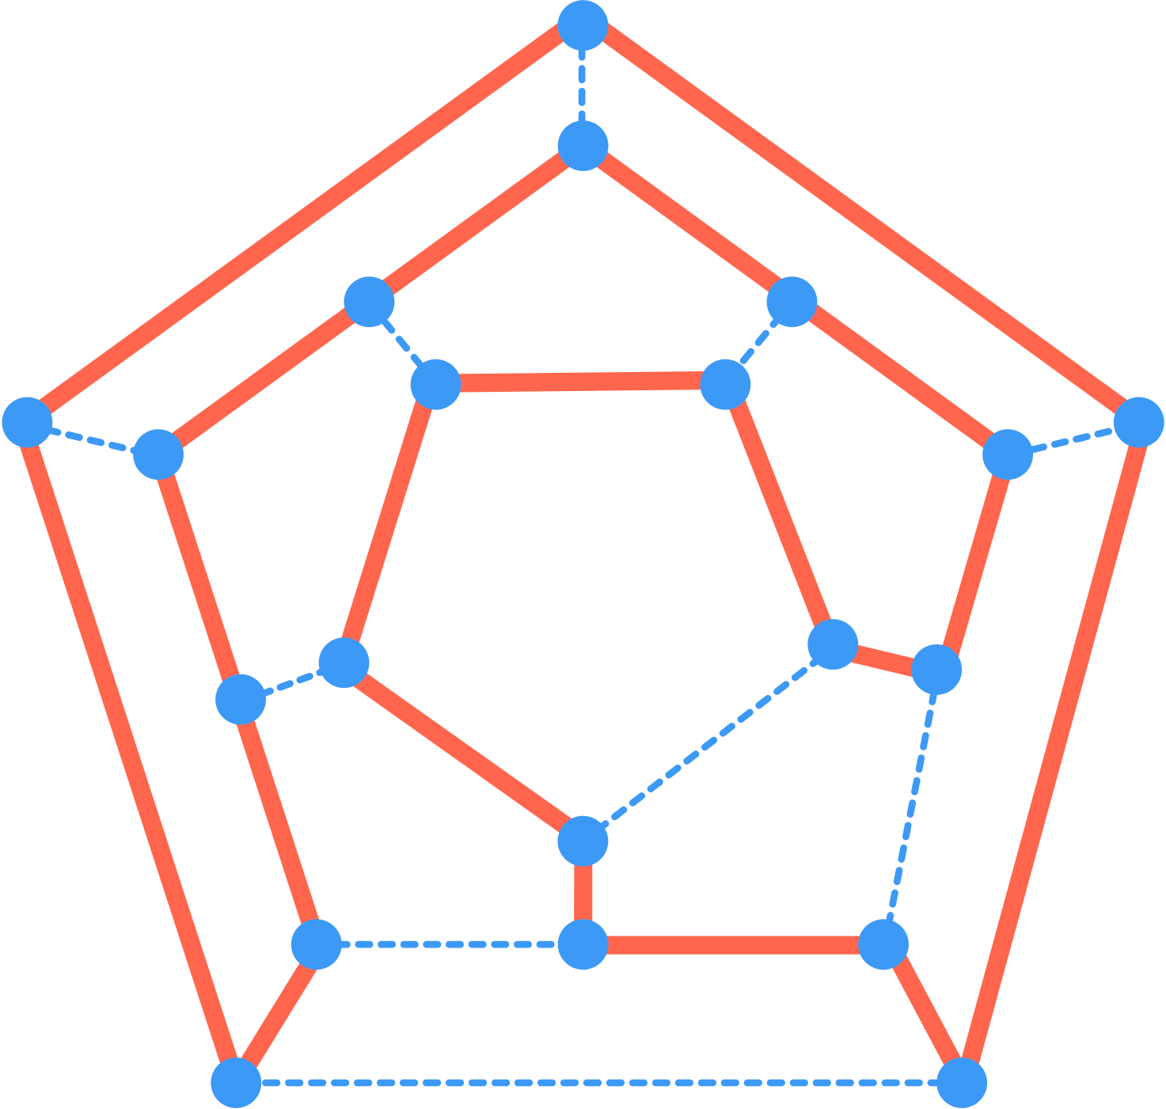
NP-Completeness
A problem L is NP-complete if
L ∈ NP, and
L' ≤_{P} L for every L' ∈ NP
Unit11 p24

Slide 5
1) L ∈ NP
Given a Yes-certificate, a list of vertices that form the LSC
Traverse the list and verify that no vertex is repeated. (polynomial time)
There exists an edge between each vertex in the certificate and the next one, and there is an edge from the last vertex in the certificate to the first vertex thereby forming the cycle. (linear time)

Slide 6
2) L' ≤_{P} L for every L' ∈ NP HAM-CYCLE ≤_{P} LSC
The Hamiltonian cycle problem is the special case of the LSC problem
=>: If a graph contains a Hamiltonian-cycle, then the LSC is just this cycle with k = |V|.
<=: If a graph contains a LSC with k = |V|, then this cycle must be a Hamiltonian-cycle as it contains all the vertices.

Slide 7


