Slide 1

Algorithm Group 6

Slide 2
Question:
Modify the BK algorithm to branch-and-bound version to solve the maximum clique.

Slide 3

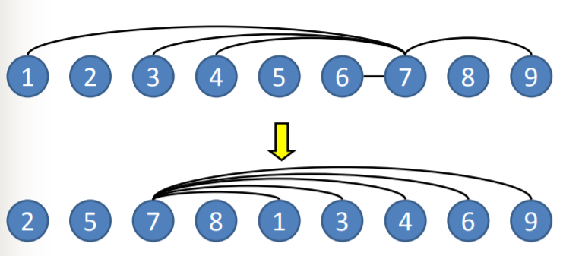
BK-1 algorithm:

Slide 4
Solution:
Step 1: Calculate the upper bound of the maximum clique of the given graph.
*(Use Greedy coloring)
Step 2: Add the circumstances into BK-1 algorithm.

Slide 5
Greedy coloring
Given the graph G = (V, E)
For each vertices vi in a row, selected the lowest numbered color that does not result in coloring is not valid.
(ie, such that no other vertices to vi’s adjacency previously colored with the same color).

Slide 6
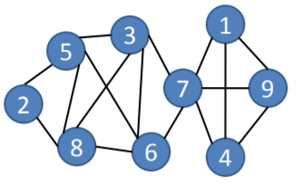
Greedy coloring(conti.)
計算各點degree 以下將以Ch12.1 P.6圖為例
依degree由大到小排序
依順序替各點塗色

Slide 7
Step 1: Calculate the upper bound
計算各個點的degree &
依degree由大到小排序
Vertex | Degree
7 | 5
3 | 4
5 | 4
6 | 4
8 | 4
1 | 3
4 | 3
9 | 3
2 | 2
Vertex | Degree
1 | 3
2 | 2
3 | 4
4 | 3
5 | 4
6 | 4
7 | 5
8 | 4
9 | 3

Slide 8
Step 1: Calculate the upper bound
依順序替各點上色
C2
C2
C1
C1
C4
C2
C4
C3
C3
Upper Bound = 4

Slide 9
Step 2: Add the circumstance into BK-1
Procedure BK-1_modif (P, R, X, UB)
If R∪X = Ø then report R as a maximum clique
Choose u ∈ P∪X that maximize |P∩N(u)|
for each vertex v ∈ P \ N(u) do
if | (P∩N(v)) ∪ (R∪{v}) | ≧ UB The Bound
BK-1_modif (P∩N(v), R∪{v}, X∩N(v))
P <- P \ {v}
X <- X∪{v}

Slide 10
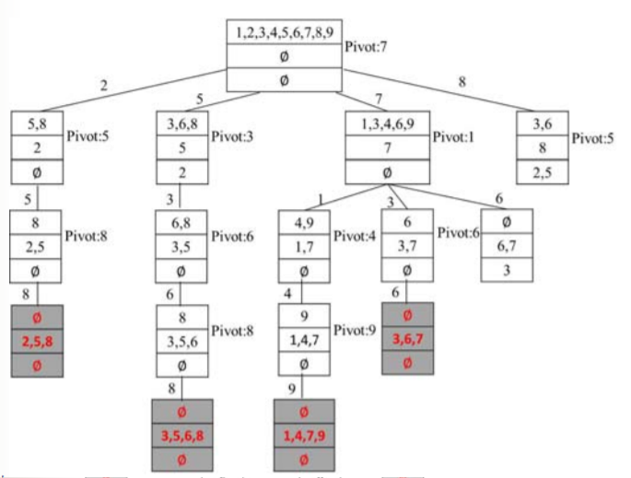
BK-1_modif 執行
Graph:

Slide 11
~Thank you~

