Slide 1
Algorithms HW9 - 4
第三組

Slide 2
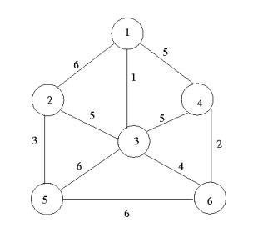
4. Perform the following algorithms to the figure below. ➢ Kruskal's algorithm ➢ Prim's algorithm

Slide 3
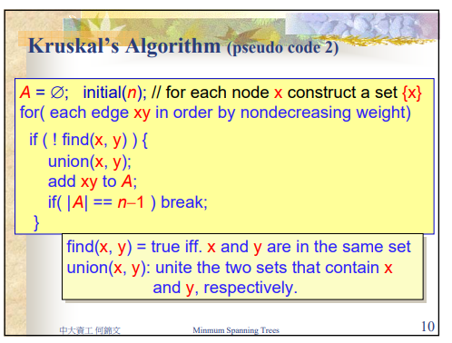
Kruskal's algorithm

Slide 4
Kruskal's algorithm
S= { 1 ,3 }
A = { 13 }
S= { 1 ,3 ,4 ,6}
A = { 13 ,46}
S= { 1 ,3 ,4 ,6 ,2 ,5}
A = { 13 ,46 ,25}
S= { 1 ,3 ,4 ,6 ,2 ,5} A = { 13 ,46 ,25 ,36}
S= { 1 ,3 ,4 ,6 ,2 ,5} A = { 13 ,46 ,25 ,36 ,23}

Slide 5
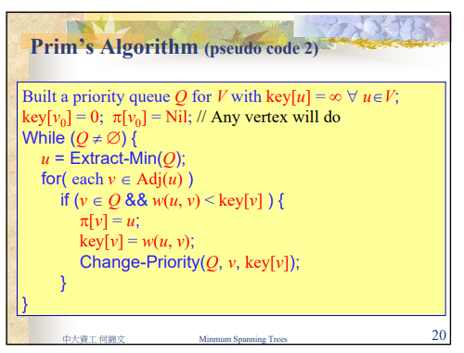
Prim's algorithm

Slide 6
Prim's algorithm
v | key[v]
1 | 0
2 | ∞
3 | ∞
4 | ∞
5 | ∞
6 | ∞
v | key[v]
2 | 6
3 | 1
4 | 5
5 | ∞
6 | ∞
V₀ = 1
v | key[v]
2 | 5
4 | 5
5 | 6
6 | 4
v | key[v]
2 | 5
4 | 2
5 | 6
v | key[v]
2 | 5
5 | 6
v | key[v]
5 | 6
v | key[v]

