Slide 1
HW9第二題
第一組

Slide 2
題目
Suppose that all edge weights in a graph are integers in the range from 1 to |V|. How fast can you make Prim's algorithm run?
What if the edge weights are integers in the range from 1 to W for some constant W ?

Slide 3
from 1 to W
Implementing the queue as an array Q[0..W+1]
(using the W + 1 slot for key=∞)
Each slot holds a doubly linked list of vertices with that weight as their key.

Slide 4
from 1 to W
EXTRACT-MIN takes only O(W) = O(1) time
(just scan for the first nonempty slot)
DECREASE-KEY takes only O(1) time
(just remove the vertex from the list it's in and insert it at the front of the list indexed by the new key)
Total running time: O(E)

Slide 5
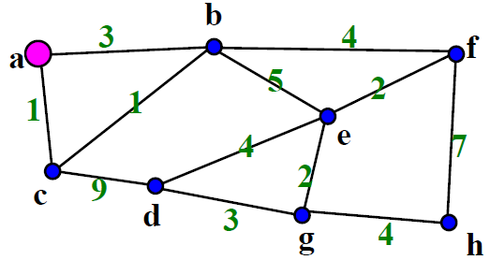

Slide 6
0
1
2
3
…
w
W+1
0
1
2
3
…
w
W+1
c
NULL
b
a
b
…
h
a
…
h

Slide 7
from 1 to |V| (1)
EXTRACT-MIN takes Θ(V) time with this data structure.
So the total time spent doing EXTRACT-MIN is Θ(V^2), slowing the algorithm to Θ (E + V^2) = Θ (V^2)
In this case, it is better to keep the Fibonacci-heap priority queue, which gave the Θ(E+VlgV) time.

Slide 8
from 1 to |V| (2)
If the edges are in the range 1, . . . , |V|
The Van Emde Boas priority queue can speed up EXTRACT- MIN and DECREASE-KEY to O(lg lg V) thus yielding a total running time of O(V lg lg V +E lg lg V) = O(E lg lg V )

Slide 9
