Slide 1
Algorithmics
Group 2
104201015 張昭德 105201518 林育愷
105201004 張宜榛 105201529 王顥鈞
105201032 吳冠軒 105201537 邱仲緯

Slide 2
Question 2
Suppose that a graph G has a minimum spanning tree already computed. How quickly can we update the minimum spanning tree if we add a new vertex and incident edges to G ?

Slide 3
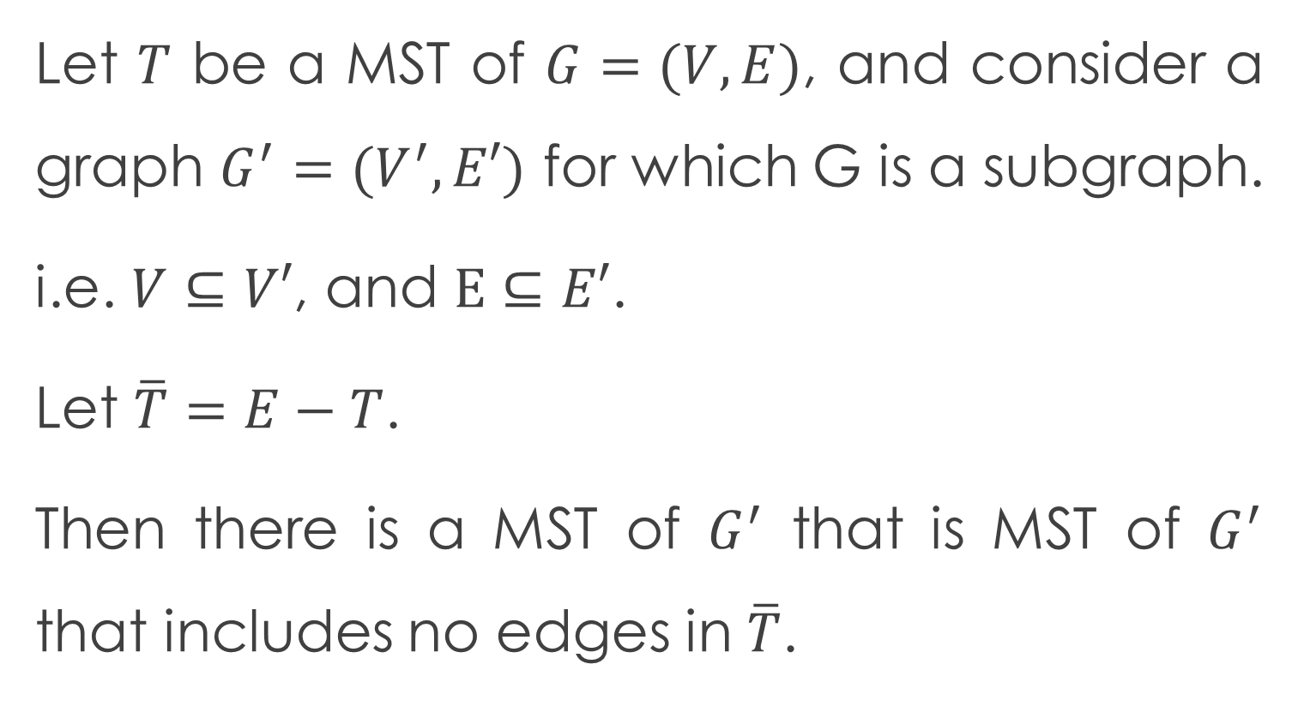
Lemma
Let $T$ be a MST of $G=(V,E)$, and consider a graph $G^{′}=(V^{′},E′)$ for which G is a subgraph.
i.e. $V⊆V′$, and $E⊆E′$.
Let $\overline{T}=E−T$.
Then there is a MST of $G^{′}$ that is MST of $G^{′}$ that includes no edges in $\overline{T}$.

Slide 4
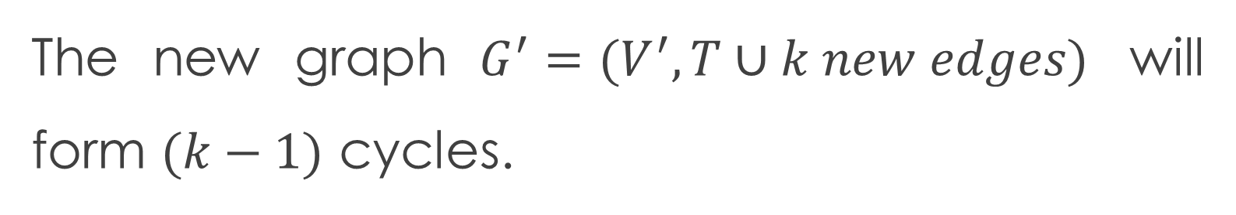
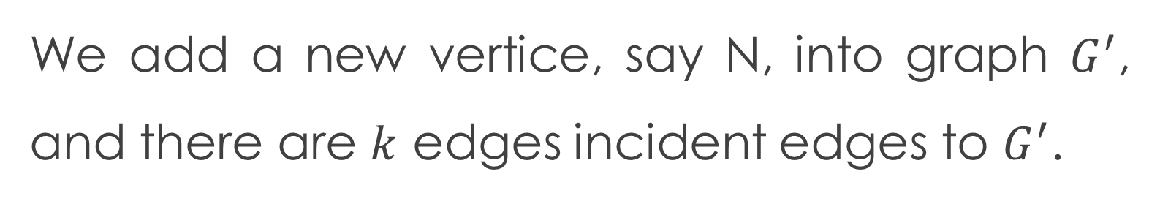
Asumption
We add a new vertice, say N, into graph $G^{′}$, and there are $k$ edges incident edges to $G^{′}$.
Inference
The new graph $G^{′}=(V^{′},T∪k new edges)$ will form $(k−1)$ cycles.

Slide 5
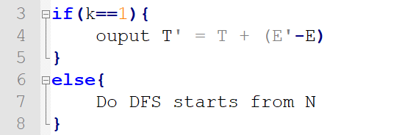
Algorithm

Slide 6
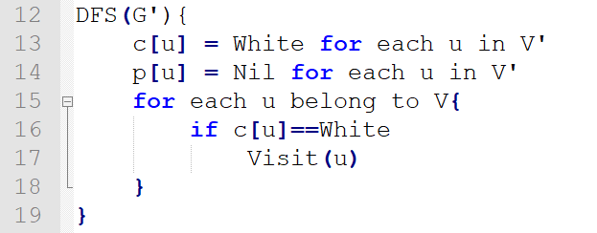
Algorithm
Do DFS start from N.
Record the weight and two vertices we walked by.

Slide 7
Algorithm
If we are going to back edges, i.e. we the path we walked is a cycle, then we remove the largest edges on that cycle.
And then continue DFS from the vertice has back edges with N.
Since there are (k-1) cycles, after we remove (k-1) edges, the remain edges will form the MST of G’.

Slide 8
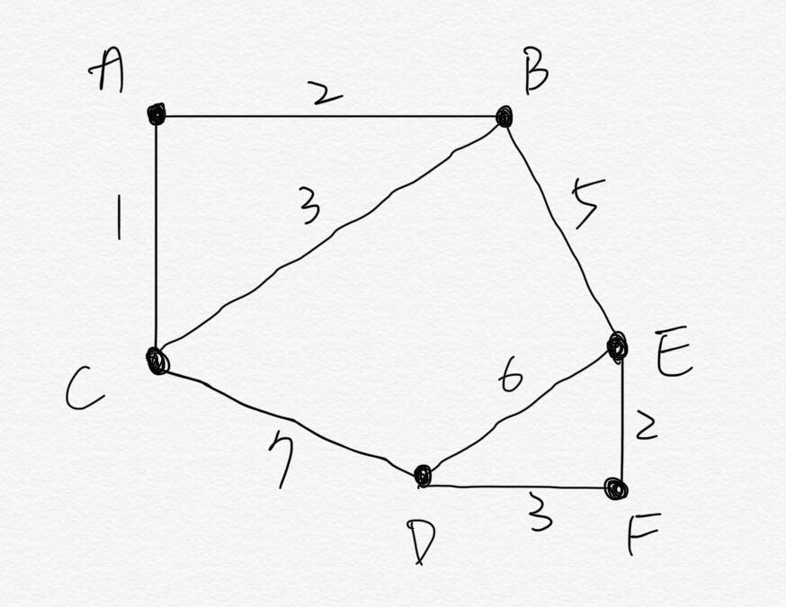
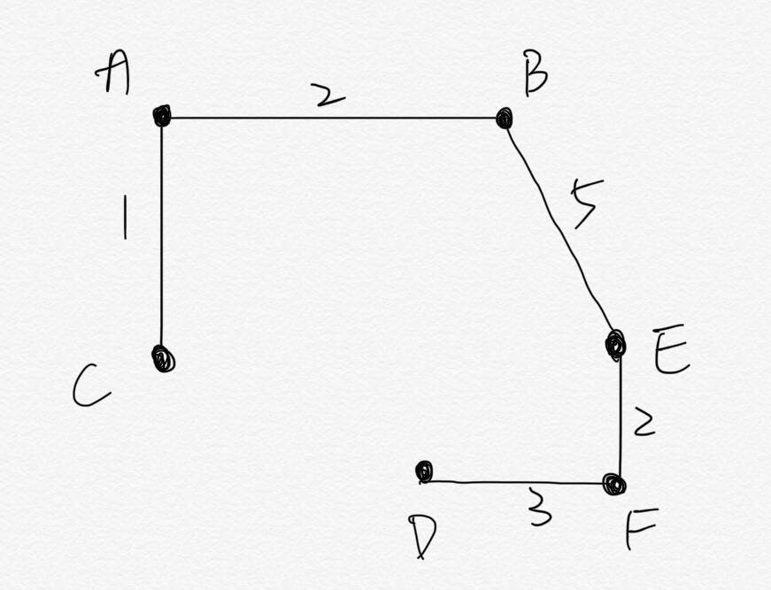
Example-1

Slide 9
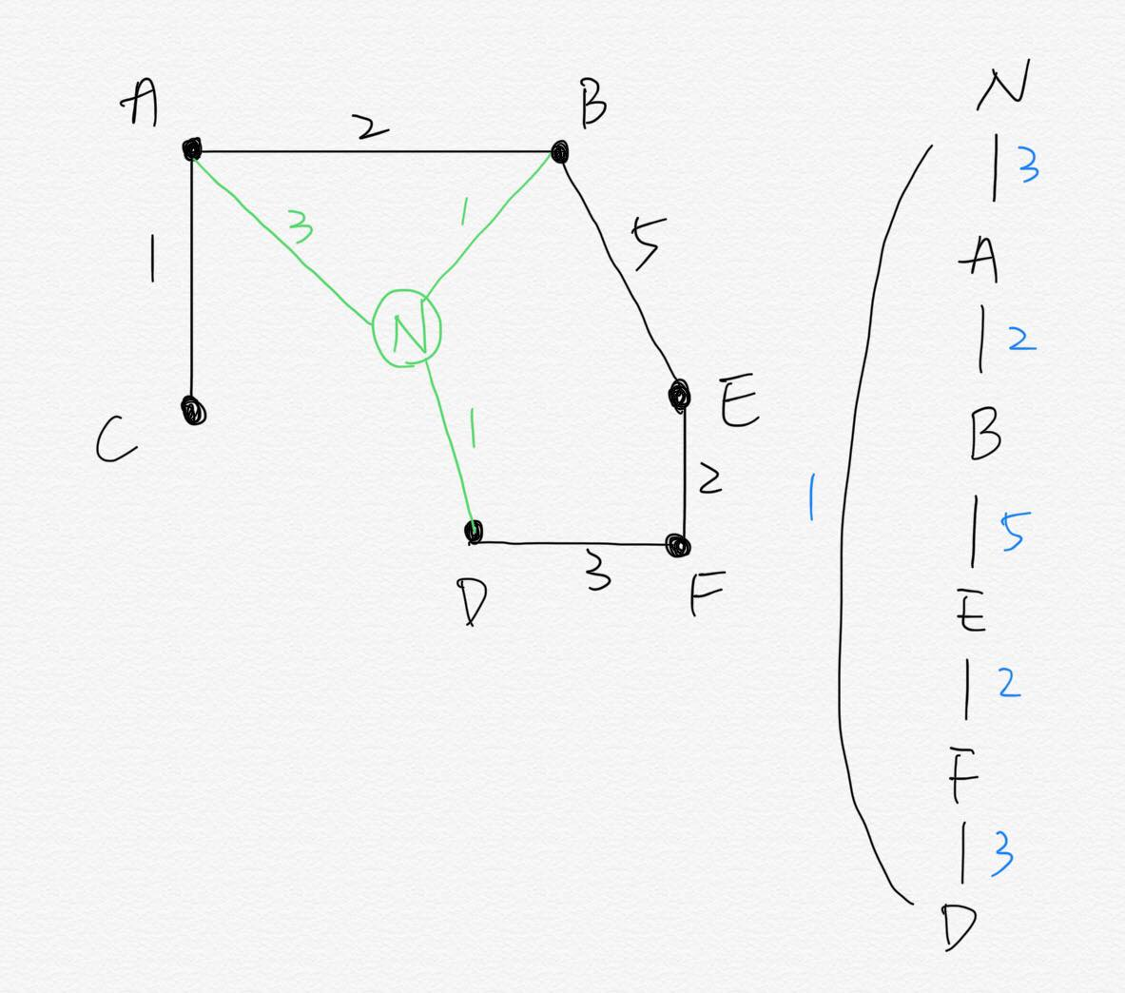
Example-2

Slide 10
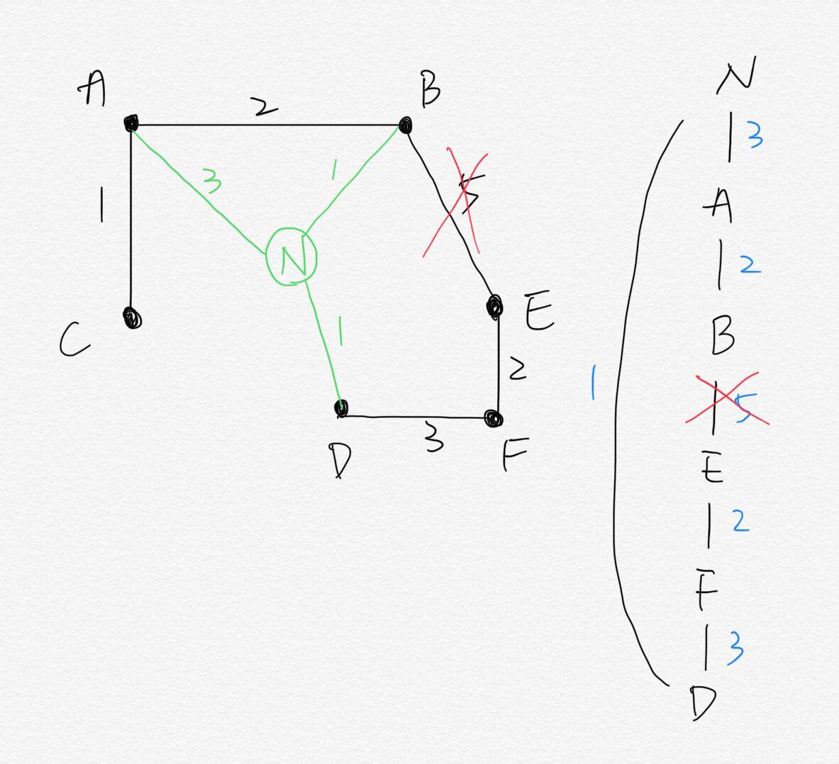
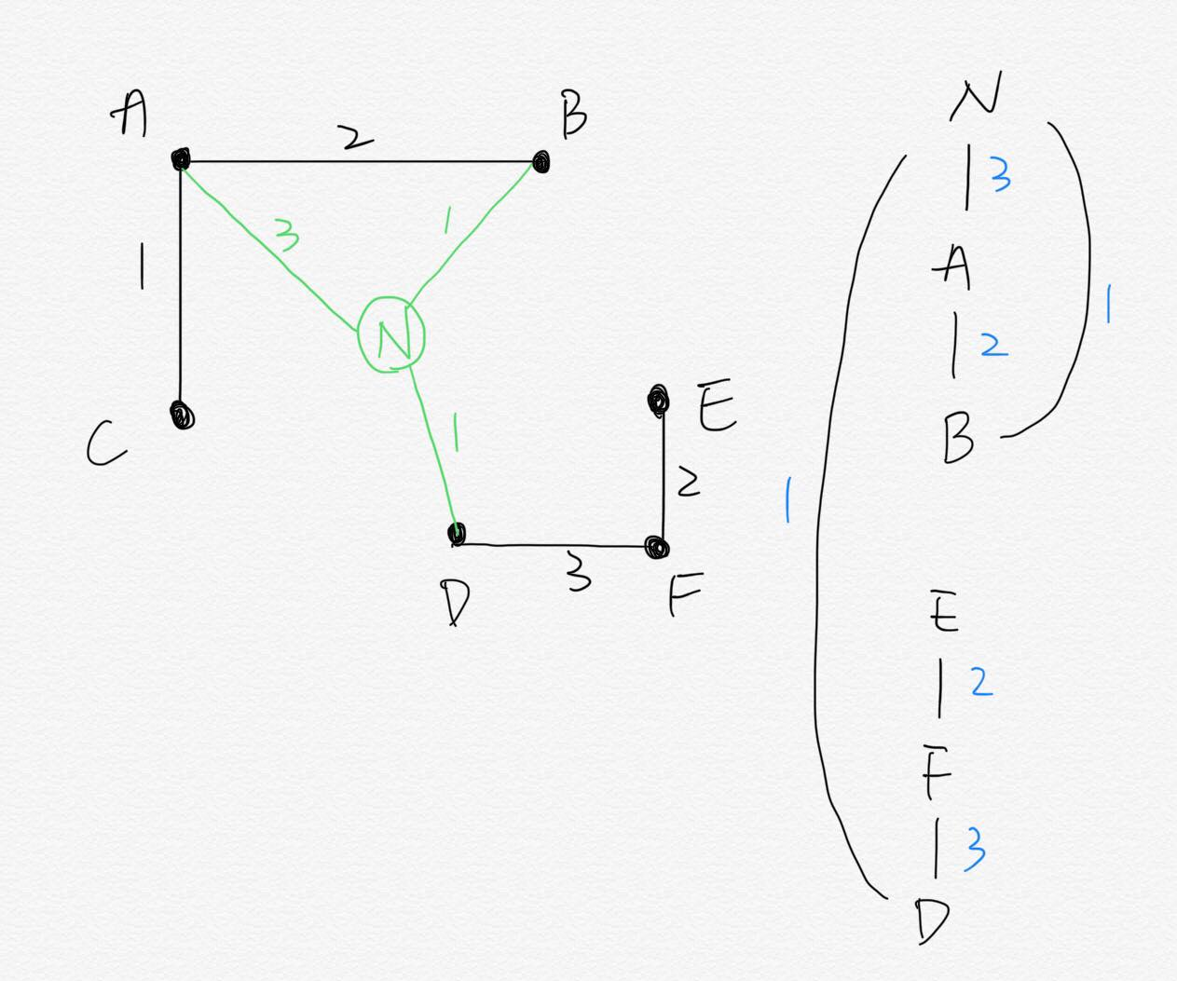
Example-3

Slide 11
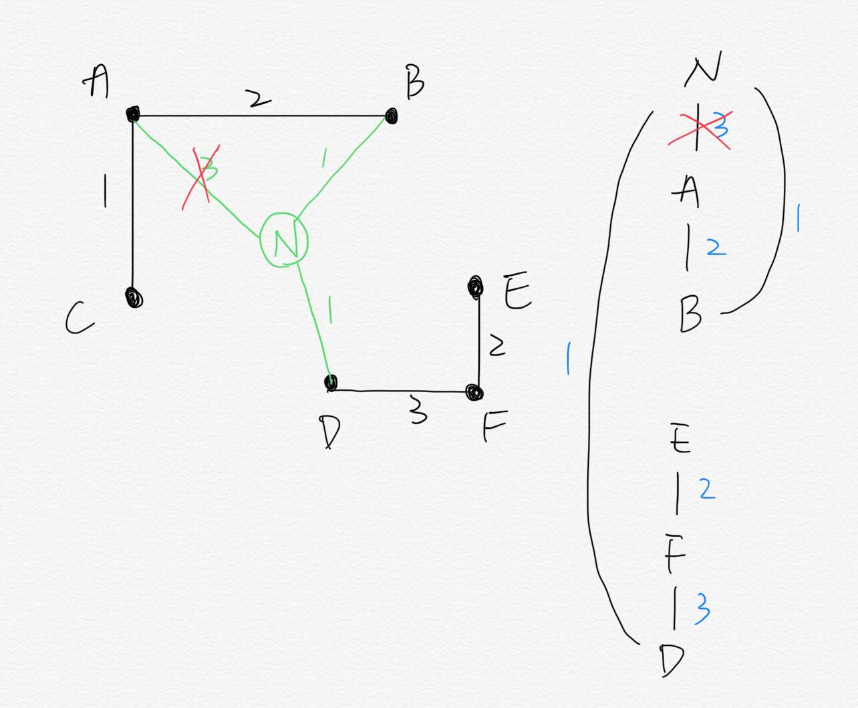
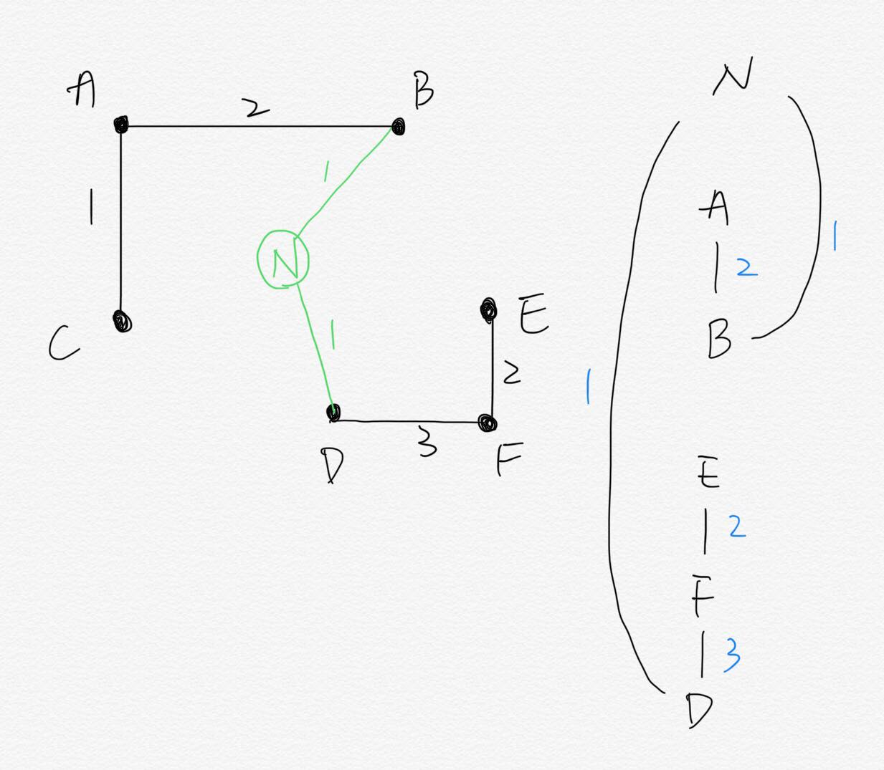
Example-4

Slide 12
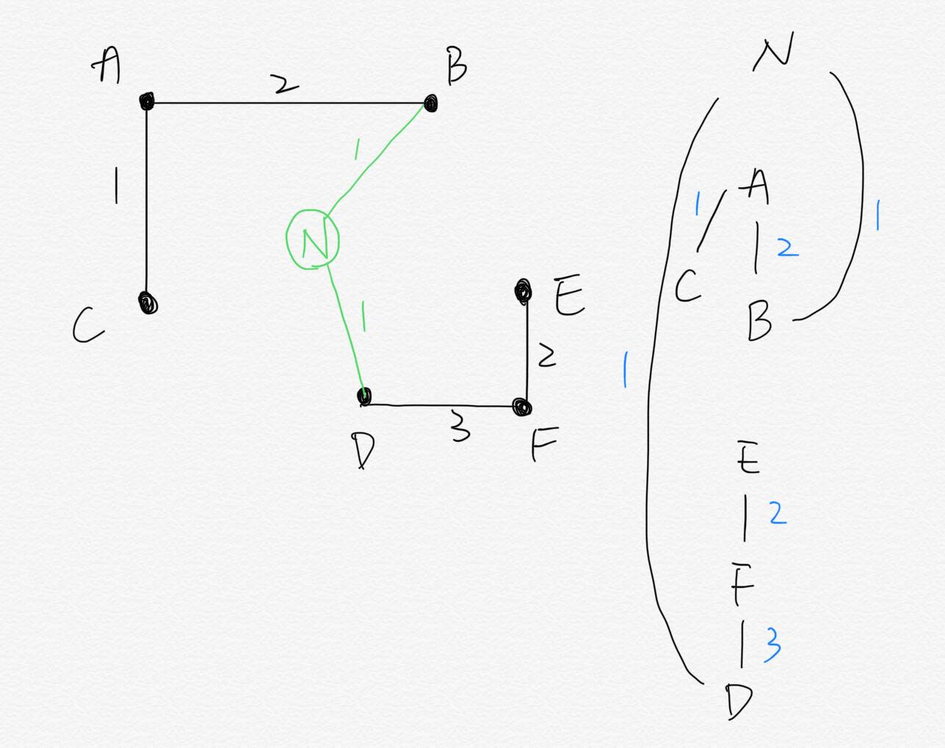
Example-5

Slide 13
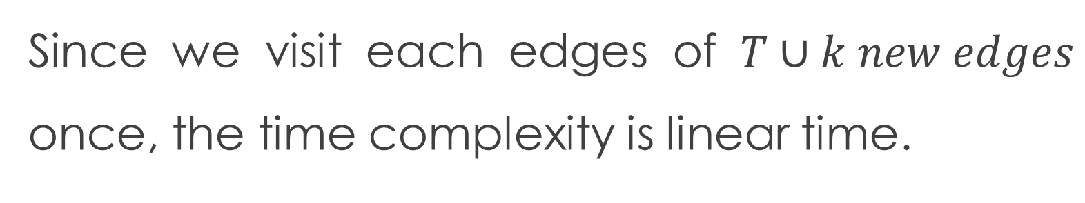
Analysis
Since we visit each edges of $T∪k new edges$ once, the time complexity is linear time.

Slide 14
Thanks.

