Slide 1
Algorithmics
Group 2
104201015 張昭德 105201518 林育愷
105201004 張宜榛 105201529 王顥鈞
105201032 吳冠軒 105201537 邱仲緯

Slide 2
Question 2
Suppose that a graph G has a minimum spanning tree already computed. How quickly can we update the minimum spanning tree if we add a new vertex and incident edges to G ?

Slide 3
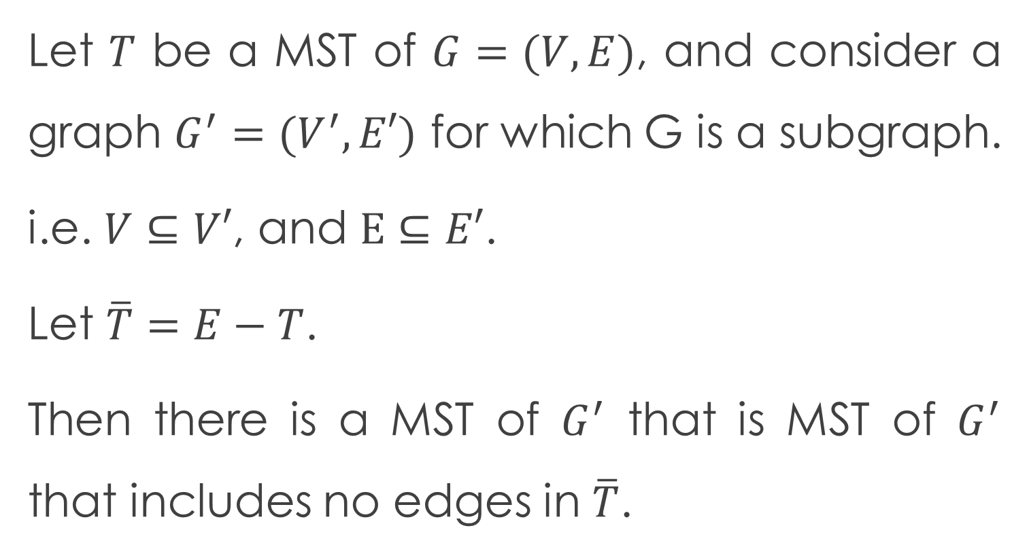
Lemma
Let $T$ be a MST of $G=(V,E)$, and consider a graph $G^{′}=(V^{′},E′)$ for which G is a subgraph.
i.e. $V⊆V′$, and $E⊆E′$.
Let $\overline{T}=E−T$.
Then there is a MST of $G^{′}$ that is MST of $G^{′}$ that includes no edges in $\overline{T}$.

Slide 4

Asumption
We add a new vertice, say N, into graph $G^{′}$, and there are $k$ edges incident edges to $G^{′}$.

Slide 5
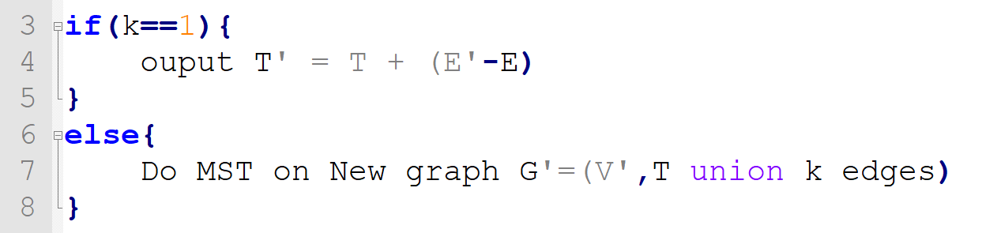
Algorithm

Slide 6

Analysis
Original MST:
#vertices = V, #edges = V-1
New graph:
#vertices = V+1, #edges = 2V+1 (worst)
Time complexity is $O\left(\left[\left(V+1\right)+\left(2V+1\right)\right]∗\lg{V}\right)=O(V∗\lg{V})$

Slide 7
Thanks.

