Slide 1
HW9-Question7
第6組

Slide 2
題目
7.
有關Minimum Spanning Tree，除了Kruskal's Algorithm和Prim's Algorithm外， 還有第三種演算法；此演算法第一步是先將圖中每個點當作一棵樹，然後從 各點分別尋找與其連接的最小權重(Weight)邊加入樹中，接著……。 請完成所有步驟（須寫出Pseudo-code）並分析此演算法。

Slide 3
Pseudo-code
1 Begin with T as the set of vertices, each regarded as a single component.
2 While T has more than one component:
3 For each component C of T:
4 Begin with an empty set of edges S
5 For each vertex v in C:
6 Find the cheapest edge from v to a vertex outside of C , and add it to S
7 Add the cheapest edge in S to T
8 T is the minimum spanning tree of G

Slide 4
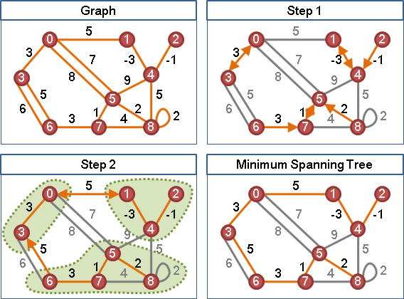

Slide 5
Complexity
This algorithm can be shown to take O(log V) iterations of the outer loop until it terminates, and therefore to run in time O(E log V)

