Slide 1
Algorithm hw7-1
第六組

Slide 2
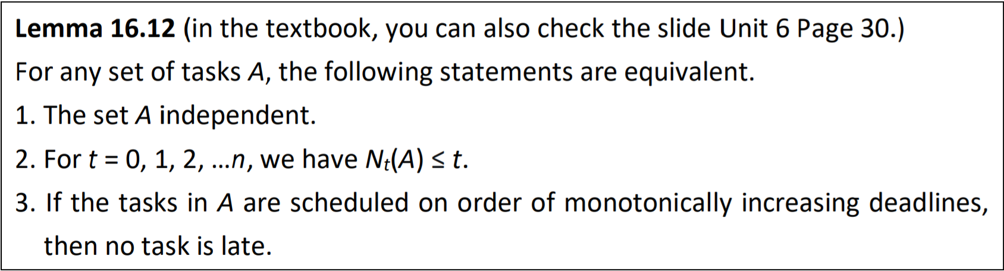
1. Exercises 15.2-1
Show how to use property 2 of Lemma 16.12 to determine in time O(|A|) whether or not a given set A of tasks is independent.
2. For t = 0, 1, 2, …n, we have $N_{t}\left(A\right)$ ≤ t.

Slide 3
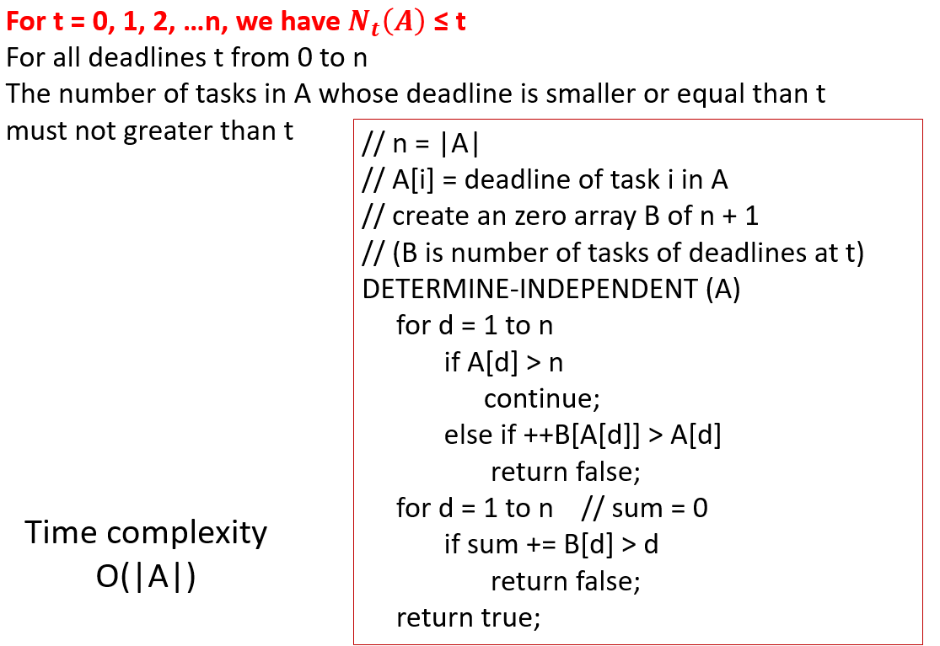
Sol.

