Slide 1
第六題
第一組

Slide 2
The square of a directed graph G = (V, E) is the graph G 2 = (V, E 2 ) such that (u, v)  E 2 if and only if G contains a path with at most two edges between u and v. Describe efficient algorithms for computing G 2 from G for both the adjacency-list and adjacency-matrix representations of G. Analyze the running times of your algorithms

Slide 3
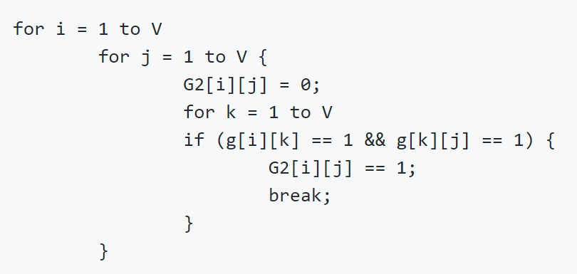
Matrix solved complexity: O(V^3)
*如果想要更快可以用Strassen!!

Slide 4
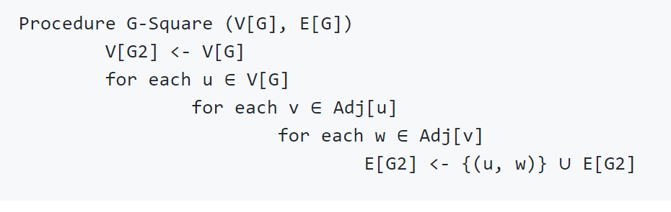
Adjacency List complexity: (V+E)*(V-1) = O(V*E)

