Slide 1
Algorithms HW8-1
第三組

Slide 2
Problem
Give a linear-time algorithm that takes as input a directed acyclic graph G = (V, E) and two vertices s and t, and returns the number of simple paths from s to t in G. For example, the directed acyclic graph of following figure contains exactly four simple paths from vertex p to vertex v: pov, poryv, posryv, and psryv. (Your algorithm needs only to count the simple paths, not list them.)

Slide 3
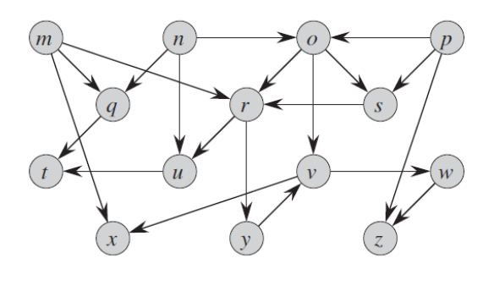

Topological Sorting
p
o
s
r
y
v

Slide 4
p
o
s
r
y
v
vertex | adjacency
p | o , s
o | s , r , v
s | r
r | y
y | v
v
p | o | s | r | y | v
 |  |  |  |  | 1
 |  |  |  | 1 | 1
 |  |  | 1 | 1 | 1
 |  | 1 | 1 | 1 | 1
 | 3 | 1 | 1 | 1 | 1
4 | 3 | 1 | 1 | 1 | 1

Slide 5
Pseudocode
SIMPLE-PATHS(G, u, v) TOPO-SORT(G) let {v[1], v[2]..v[k - 1]} be the vertex between u and v v[0] = u & v[k] = v for j = 0 to k – 1 DP[j] = ∞ DP[k] = 1 return SIMPLE-PATHS-AID(G, DP, 0)

Slide 6
Pseudocode
SIMPLE-PATHS-AID(G, DP, i) if i > k return 0 else if DP[i] != ∞ return DP[i] else DP[i] = 0 for v[m] in G.adj[v[i]] and 0 < m ≤ k DP[i] += SIMPLE-PATHS-AID(G, DP, m) return DP[i]

Slide 7
Time Complexity
Topological Sorting -> O( V + E )
SIMPLE-PATHS-AID -> O( E )
O( V + E ) + O( E ) = O( V + E )

Slide 8
Thanks !

