Slide 1
HW8-3
GROUP 5

Slide 2
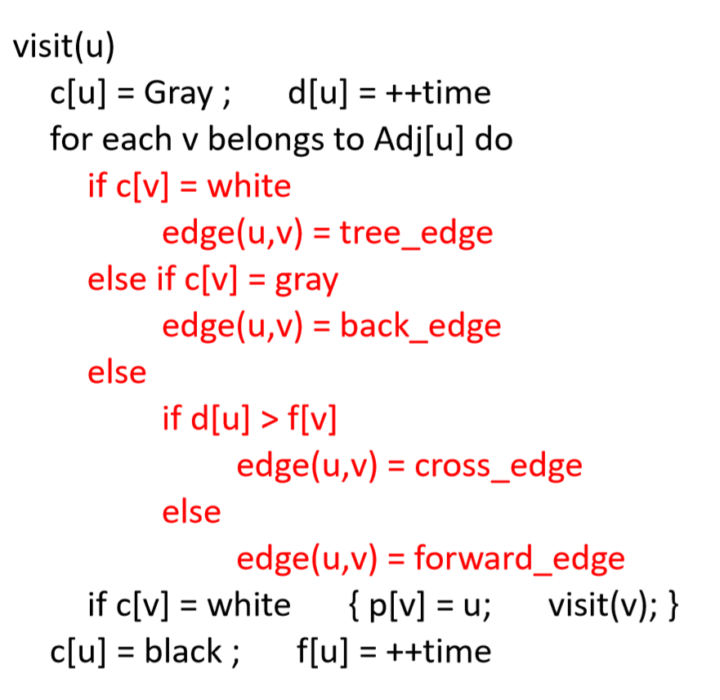
DFS forest: tree edge, forward edge, back edge, and cross edge

Slide 3
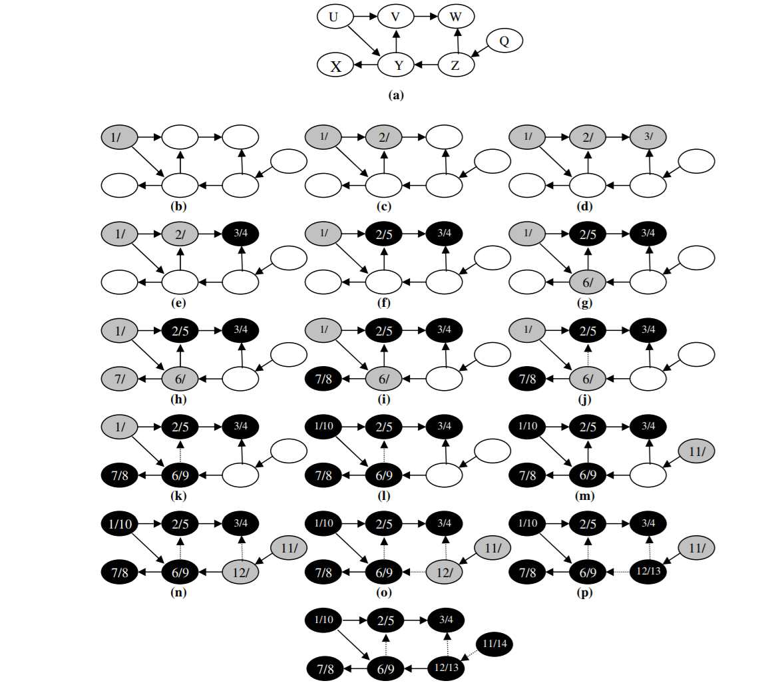
Example

