Slide 1
Algorithm hw8-4
第六組

Slide 2
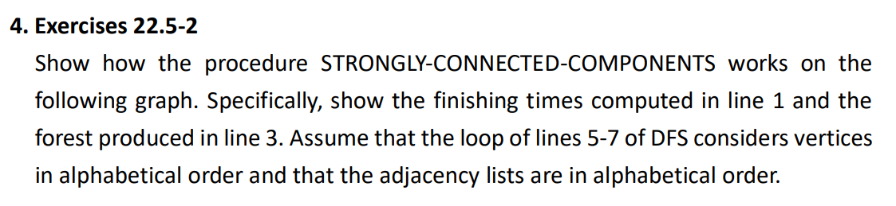
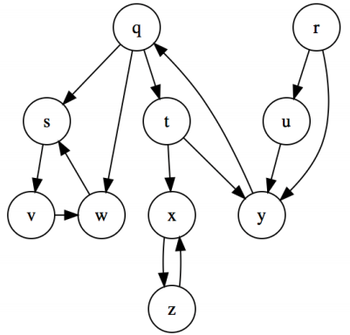

Slide 3
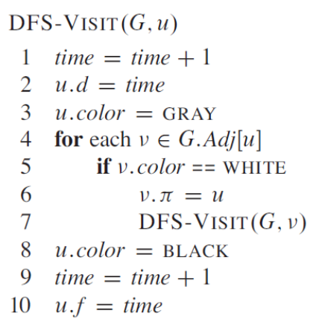
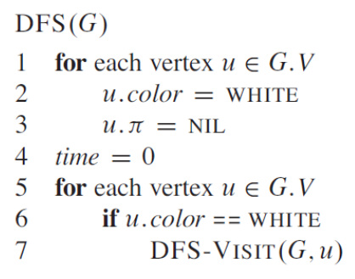
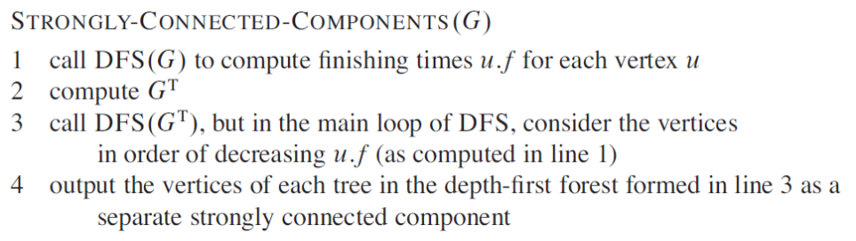

Slide 4
Adjacency list
q : s t w
r : u y
s : v
t : x y
u : y
w : s
x : z
y : q
z : x

Slide 5
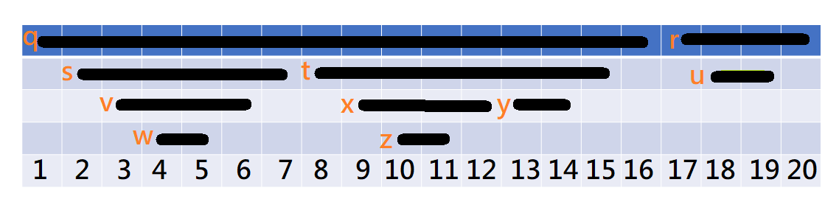
Solution-1
*Call DFS(G) to compute finishing times u.f for each vertex u
Finishing time:
r > u > q > t > y > x > z > s > v > w

Slide 6
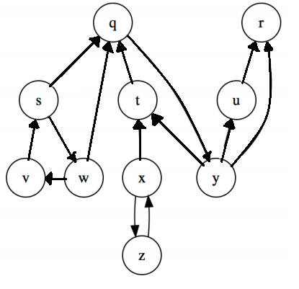
Solution-2
*Compute G^{T}
r :
u : r
q : y
w : q v
t : q
y : u t
x : t z
z : x
s : q w
v : s
w : q v

Slide 7
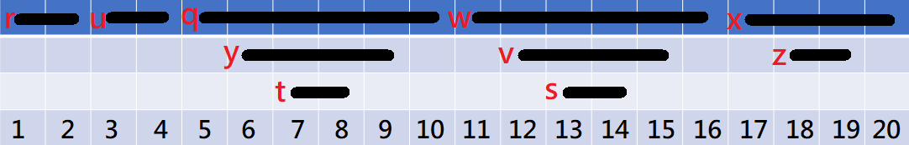
Solution-3
*Call DFS(G^{T}), but in the main loop of DFS, consider the vertices in order of decreasing u.f

Slide 8
Solution-4
*Output the vertices of each tree in the depth-first forest formed in line 3 as a separate strongly connected component

