Slide 1
HW1第1題-第1組
組員： 104403015 胡瑞麟、 104403521 蔡承延、104502050 黃翊銜、104502560 彭浩銘、 105403002 李美慧、105403516 張皓鈞、 106502203 林禹彤

Slide 2
1. Prove that each of the following sorting algorithms is stable or show that it is unstable by giving a counter example; moreover, determine whether it is in place: bubble sort, insertion sort, selection sort, quick sort, merge sort, heap-sort.
Stable: BubbleSort、InsertionSort、MergeSort
Unstable: SelectionSort、QuickSort、HeapSort
In-place: BubbleSort、InsertionSort、SelectionSort、 QuickSort、HeapSort
Not in-place: MergeSort

Slide 3
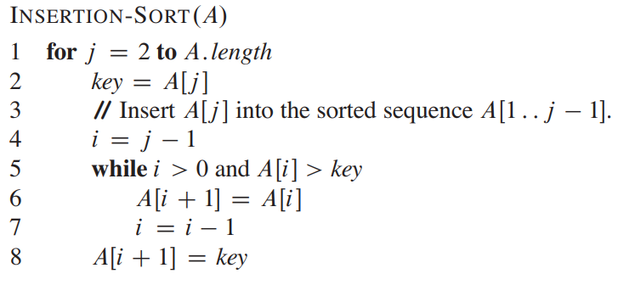

Slide 4
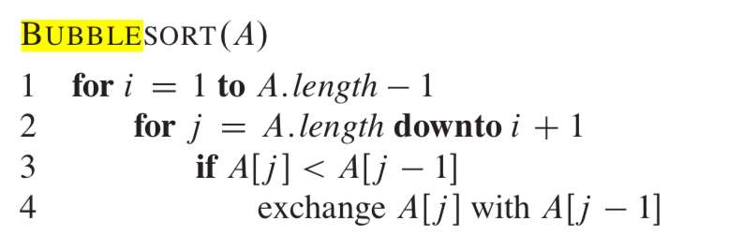

Slide 5
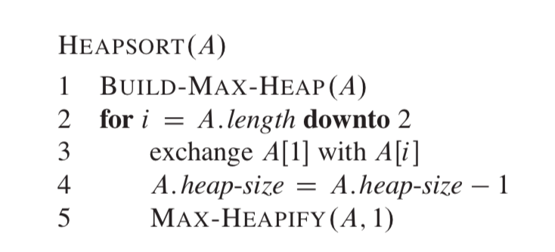

Slide 6
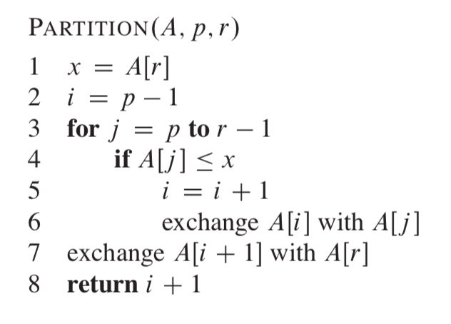
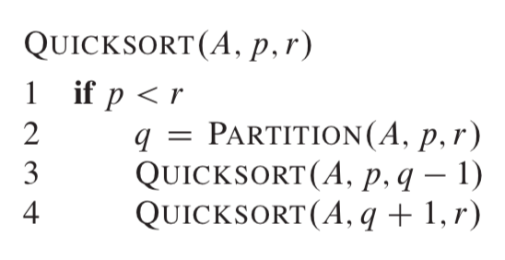

Slide 7
Unstable counter example (1/2)
SelectionSort initial: 5a 5b 1 → 1 5b 5a
QuickSort initial: 5[pivot] 1a 1b 7 → 1b 1a 5 7

Slide 8
Unstable counter example (2/2)
HeapSort initial: 21 17a 17b 12 11 8 7 (已為max-heap) 做deleteMax n-1次: → 17a 12 17b 7 11 8 | 21 → 17b 12 8 7 11 | 17a 21 → 12 11 8 7 | 17b 17a 21 → 11 7 8 | 12 17b 17a 21 → 8 7 | 11 12 17b 17a 21 → 7 | 8 11 12 17b 17a 21

Slide 9
Any Questions?

