Slide 1
Algorithm
Group 3

Slide 2
Question
How to implement merge-sort such that the extra space used is about n/2 where n is the number of input elements?

Slide 3
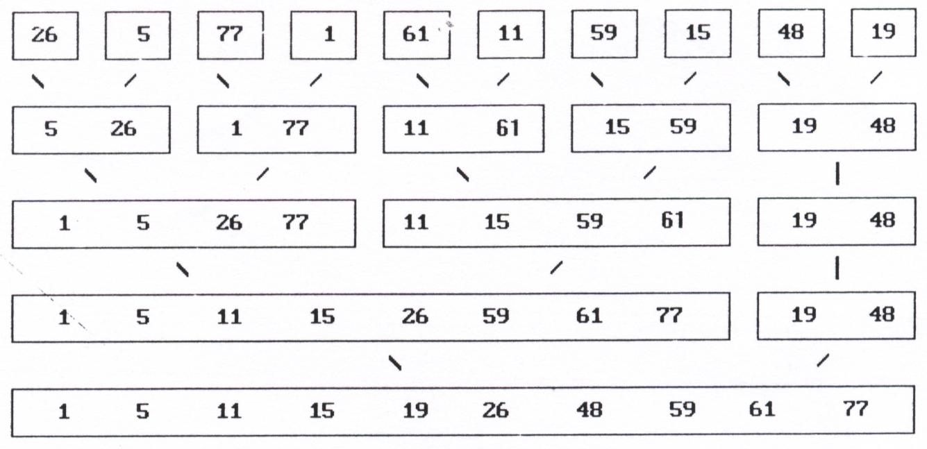
Original merge sort
Space complexity is O(n)

Slide 4
New merge sort
1 | 4 | 7
2 | 3 | 8
1 | 2 | 3

Slide 5
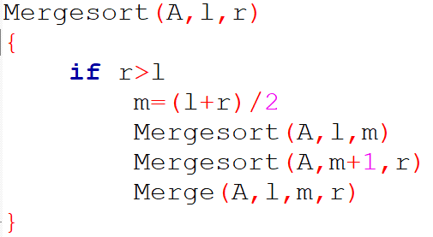
Merge sort

Slide 6
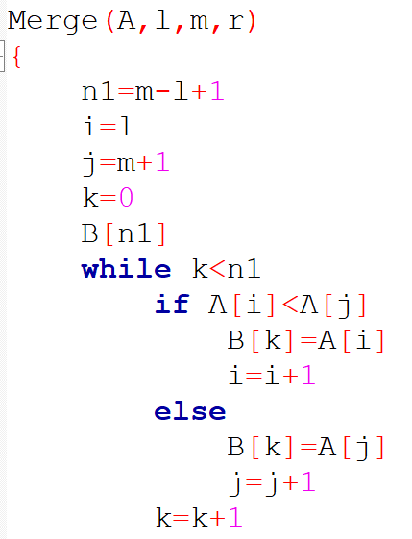
Extra space is n/2
長度為n的陣列A中選出n/2個最小的元素，依序排至長度為n/2陣列B中。

Slide 7
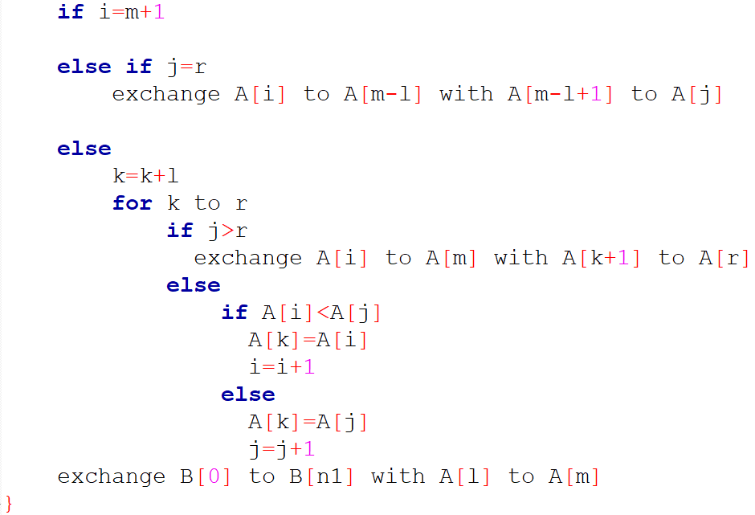
Extra space is n/2
將剩餘未被選取的元素排序在陣列A的後半部。
將陣列B的元素覆蓋陣列A的前半部。

Slide 8
Thanks

