Slide 1
演算法
Hw2 Promblem1
Group8
田敬暘
趙庭浩
莊峻琳
杜萬珩
鄧又晨
李信鋌

Slide 2
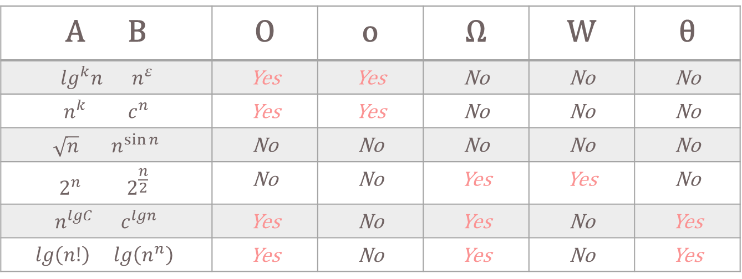
A B | O | o | Ω | W | θ
$\lg^{k}n$ $n^{ε}$ | Yes | Yes | No | No | No
$$n^{k} c^{n}$$ | Yes | Yes | No | No | No
$$\sqrt{n} { n}^{\sin{n}}$$ | No | No | No | No | No
$$2^{n } 2^{\frac{n}{2}}$$ | No | No | Yes | Yes | No
$n^{lgC} c^{lgn}$ | Yes | No | Yes | No | Yes
$$lg\left(n!\right) lg\left(n^{n}\right)$$ | Yes | No | Yes | No | Yes

Slide 3
Justify

Slide 4
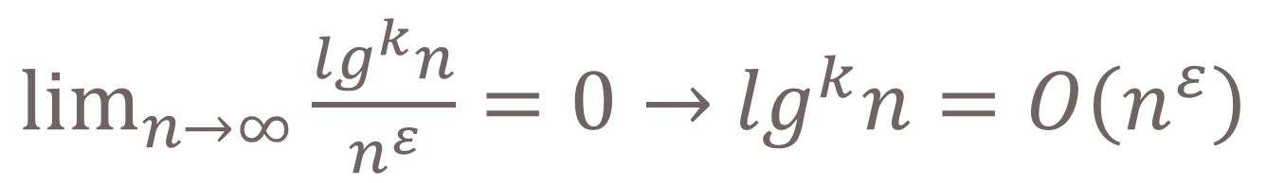


$$\lg^{k}n 、n^{ε}$$
$\lim_{n→∞}{\frac{\lg^{k}n}{n^{ε}}}=0→$ $\lg^{k}n=O\left(n^{ε}\right)$
$$Any positive polynominal function grows$$
$$faster than any polylogoarithmic function.$$

Slide 5

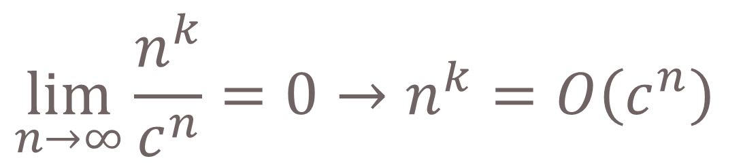
$$n^{k}、c^{n}$$
$$\lim_{n→∞}{\frac{n^{k}}{c^{n}}}=0→n^{k}=O\left(c^{n}\right)$$
$$for all real constant a and b such that a>1$$

Slide 6

$$\sqrt{n} 、n^{\sin{n}}$$
$$Neither \sqrt{n} nor n^{\sin{n}} is asympotically comparable.$$

Slide 7


$$2^{n }、2^{\frac{n}{2}}$$
$$\lim_{n→∞}{\frac{2^{n }}{2^{\frac{n}{2}}}}=\lim_{n→∞}{\frac{{n2}^{n−1 }}{{\frac{n}{2}2}^{\frac{n−2}{2}}}}=\lim_{n→∞}{2∙2^{\frac{n}{2}}}=∞$$
$$→2^{n }=w\left(2^{\frac{n}{2}}\right)$$
$$→2^{n }=Ω\left(2^{\frac{n}{2}}\right)$$

Slide 8
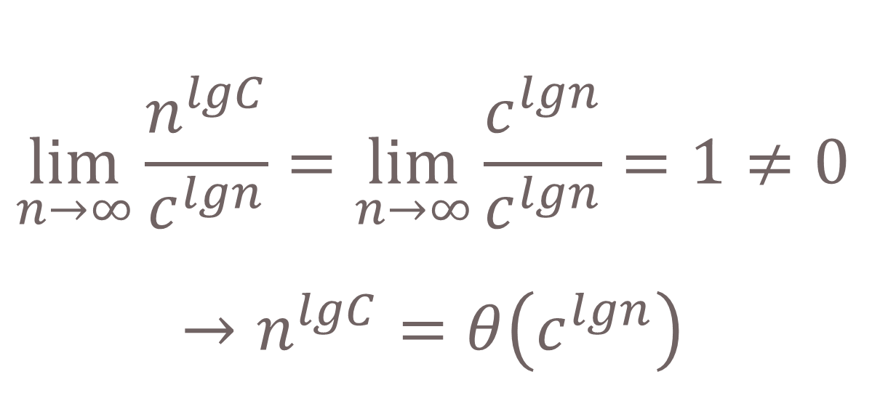

$$n^{lgC}、c^{lgn}$$
$$\lim_{n→∞}{\frac{n^{lgC}}{c^{lgn}}}=\lim_{n→∞}{\frac{c^{lgn}}{c^{lgn}}}=1≠0$$
$$→n^{lgC}=θ\left(c^{lgn}\right)$$

Slide 9
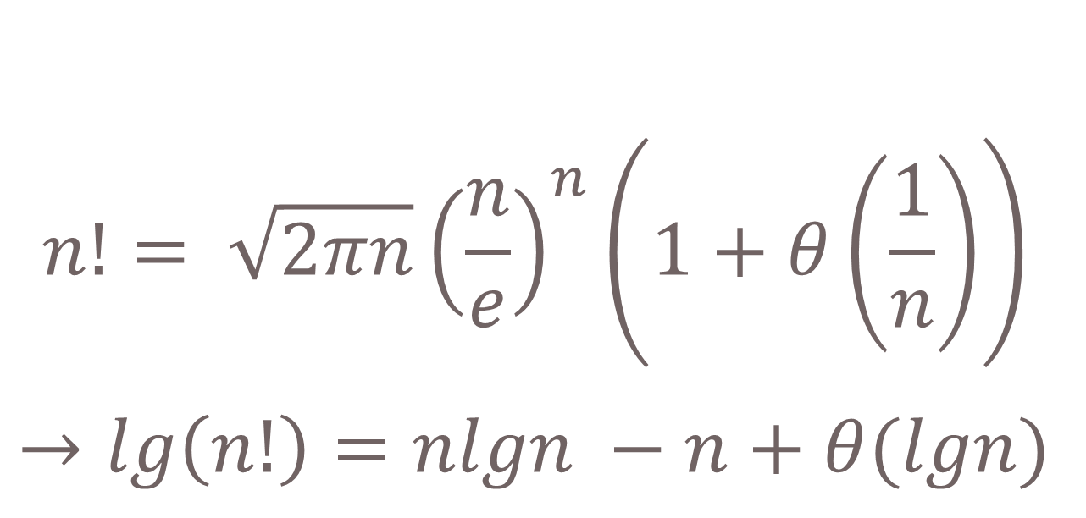


$$lg\left(n!\right)、lg\left(n^{n}\right)$$
$$n!= \sqrt{2πn}{\left(\frac{n}{e}\right)}^{n}\left(1+θ\left(\frac{1}{n}\right)\right)$$
$$→lg\left(n!\right)=nlgn −n+θ(lgn)$$
$$Stirling^{′}s approximation$$

Slide 10
Thanks

