Slide 1
HW2 第三題
第10組

Slide 2
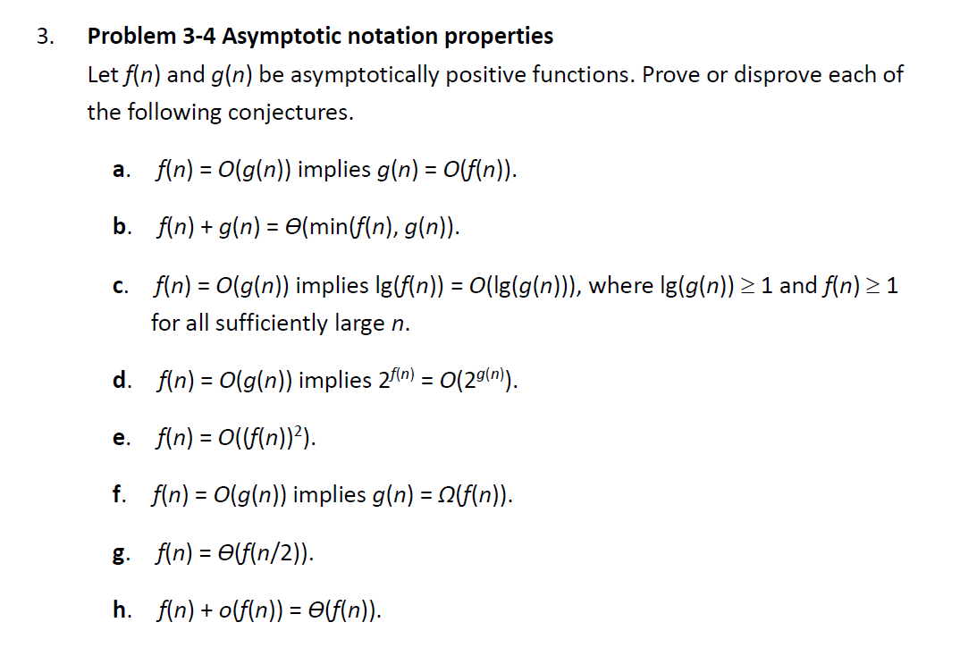
Problem

Slide 3

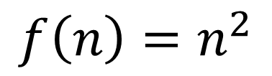
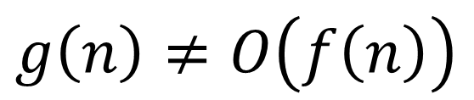
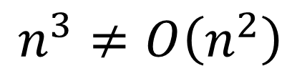
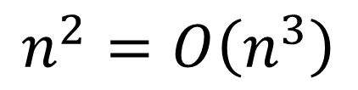
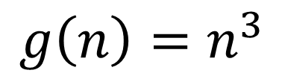
Disprove :
Let
$$f\left(n\right)=n^{2}$$
and
$$g\left(n\right)=n^{3}$$
$$n^{2}=O\left(n^{3}\right)$$
but
$$n^{3}≠O\left(n^{2}\right)$$
⇒
$$g\left(n\right)≠O\left(f\left(n\right)\right)$$

Slide 4

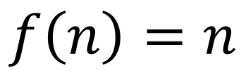
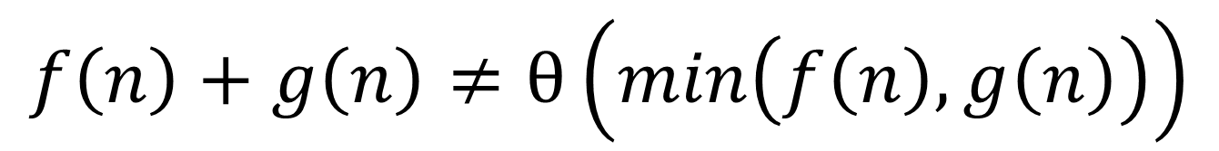
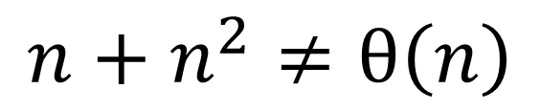
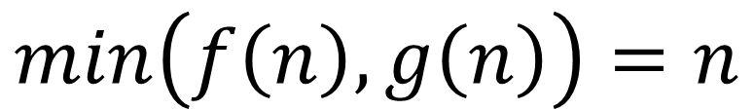
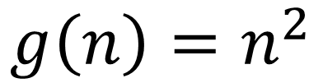
Disprove :
Let
$$f\left(n\right)=n$$
and
$$g\left(n\right)=n^{2}$$
$$min\left(f\left(n\right), g\left(n\right)\right)=n$$
but
$$n+n^{2}≠\text{θ}\left(n\right)$$
$$f\left(n\right)+g\left(n\right)≠\text{θ}\left(min\left(f\left(n\right), g\left(n\right)\right)\right)$$
⇒

Slide 5
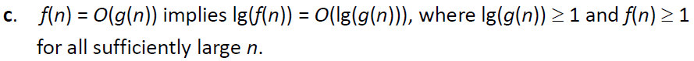
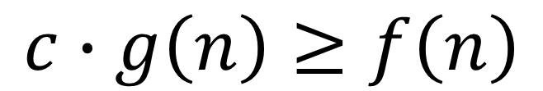
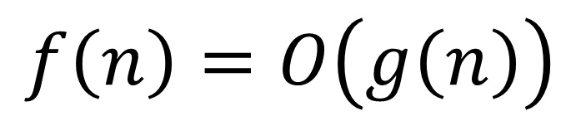
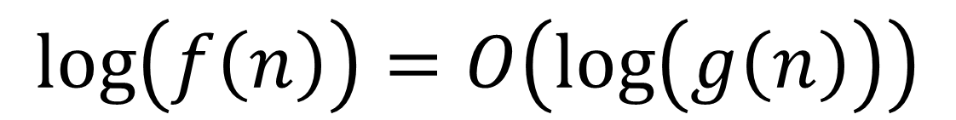
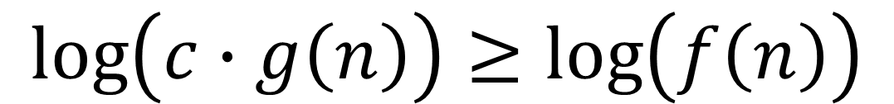
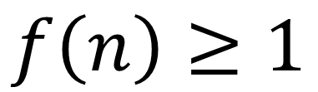
Prove :
$$f\left(n\right)=O\left(g\left(n\right)\right)$$
⇒
$$c∙g\left(n\right)≥f\left(n\right)$$
and
$$f\left(n\right)≥1$$
⇒
$$\log\left(c∙g\left(n\right)\right)≥\log\left(f\left(n\right)\right)$$
⇒
$$\log\left(f\left(n\right)\right)=O\left(\log\left(g\left(n\right)\right)\right)$$

Slide 6

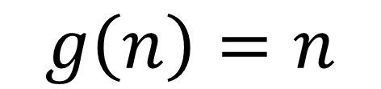
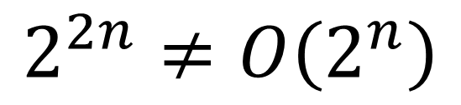
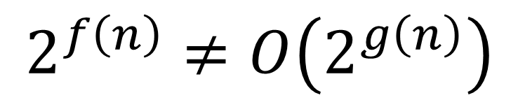
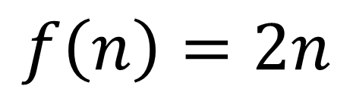
Disprove :
Let
$$f\left(n\right)=2n$$
and
$$g\left(n\right)=n$$
But
$$2^{2n}≠O\left(2^{n}\right)$$
⇒
$$2^{f\left(n\right)}≠O\left(2^{g\left(n\right)}\right)$$

Slide 7

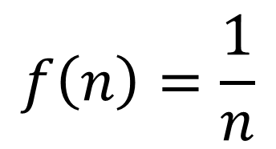
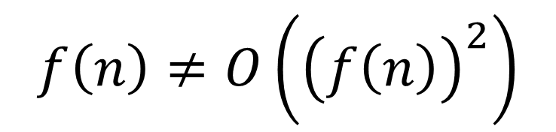
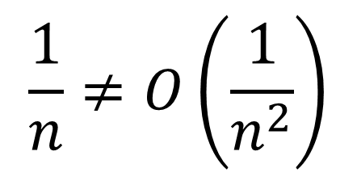
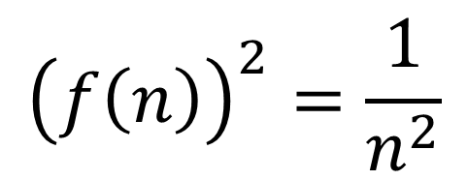
Disprove :
$$f\left(n\right)=\frac{1}{n}$$
$${\left(f\left(n\right)\right)}^{2}=\frac{1}{n^{2}}$$
Let
⇒
$$\frac{1}{n}≠O\left(\frac{1}{n^{2}}\right)$$
$$f\left(n\right)≠O\left({\left(f\left(n\right)\right)}^{2}\right)$$
But
⇒

Slide 8


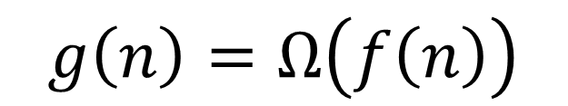

Prove :
$$g\left(n\right)≥f\left(n\right)$$
⇒
$$f\left(n\right)≤g\left(n\right)$$
⇒
$$g\left(n\right)=Ω\left(f\left(n\right)\right)$$

Slide 9

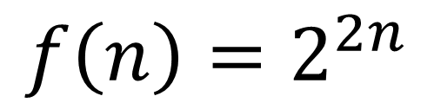
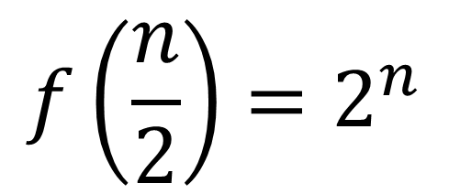
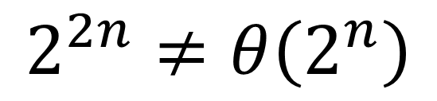
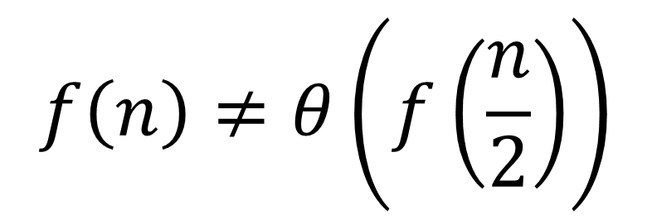
Disprove :
$$f\left(\frac{n}{2}\right)=2^{n}$$
Let
$$f\left(n\right)=2^{2n}$$
⇒
But
$$2^{2n}≠θ\left(2^{n}\right)$$
$$f\left(n\right)≠θ\left(f\left(\frac{n}{2}\right)\right)$$
⇒

Slide 10

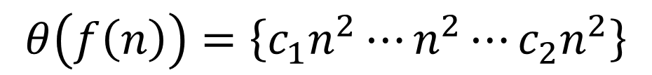

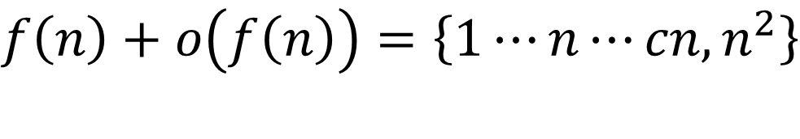



Prove :
Disprove :
Let
$$f\left(n\right)=n^{2}$$
$$ο\left(f\left(n\right)\right)<f\left(n\right)$$
$$ο\left(f\left(n\right)\right)=\left\{1⋯n⋯cn\right\}$$
⇒
$$f\left(n\right)+ο\left(f\left(n\right)\right)=θ\left(f\left(n\right)\right)$$
$$f\left(n\right)+ο\left(f\left(n\right)\right)=\left\{1⋯n⋯cn, n^{2}\right\}$$
$$θ\left(f\left(n\right)\right)=\left\{c_{1}n^{2}⋯n^{2}⋯c_{2}n^{2}\right\}$$
$$\left\{1⋯n⋯cn, n^{2}\right\}≠\left\{c_{1}n^{2}⋯n^{2}⋯c_{2}n^{2}\right\}$$

