Slide 1
Algorithmics HW2
Group 2
104201015 張昭德 105201518 林育愷
105201004 張宜榛 105201529 王顥鈞
105201032 吳冠軒 105201537 邱仲緯

Slide 2
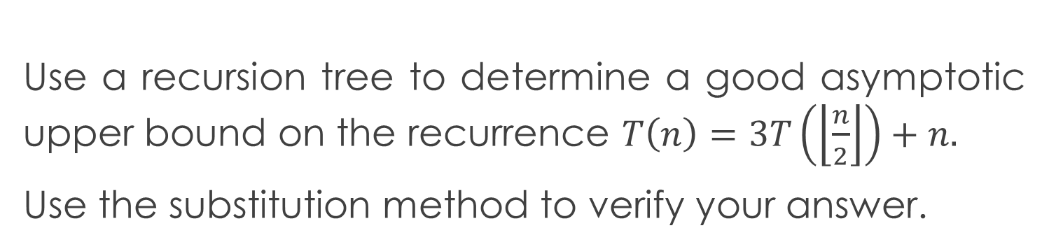
Question 2
Use a recursion tree to determine a good asymptotic upper bound on the recurrence $T\left(n\right)=3T\left(\left\lfloor \frac{n}{2}\right\rfloor \right)+n.$
Use the substitution method to verify your answer.

Slide 3
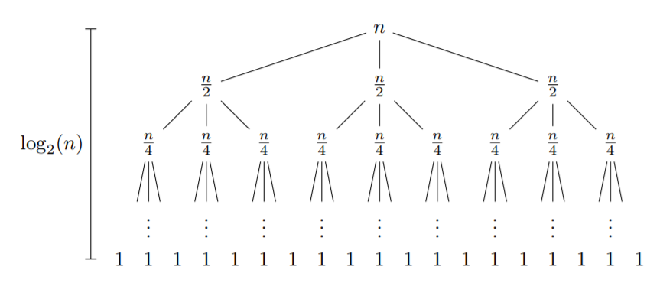


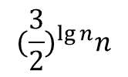
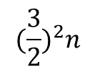
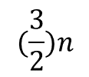
Recursion tree
$$n$$
$$(\frac{3}{2})n$$
$$\lg{n}$$
$${(\frac{3}{2})}^{2}n$$
$${(\frac{3}{2})}^{\lg{n}}n$$
$Height=\lg{n, }$ $Level=\lg{n}+1$

Slide 4
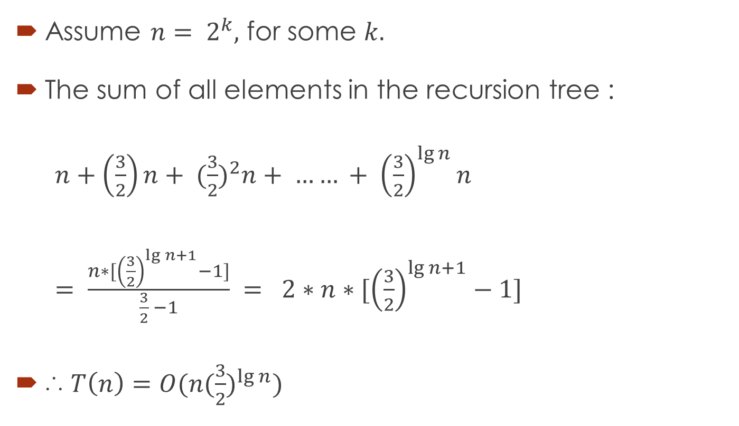
Process
Assume $n= 2^{k},$ for some $k.$
The sum of all elements in the recursion tree :
$n+\left(\frac{3}{2}\right)n+ {(\frac{3}{2})}^{2}n+ …… + {\left(\frac{3}{2}\right)}^{\lg{n}}n$
$= \frac{n∗[{\left(\frac{3}{2}\right)}^{\lg{n+1}}−1]}{\frac{3}{2} −1} = 2∗n∗[{\left(\frac{3}{2}\right)}^{\lg{n+1}}−1]$
∴ $T\left(n\right)=O(n{(\frac{3}{2})}^{\lg{n}})$

Slide 5

Note
$n∗{\left(\frac{3}{2}\right)}^{\lg{n}}$
$=n ∗n^{\lg\left(\frac{3}{2}\right)}$
$=n^{1+ lg{3 −\lg{2}}}$
$= n^{\lg{3}}$

Slide 6
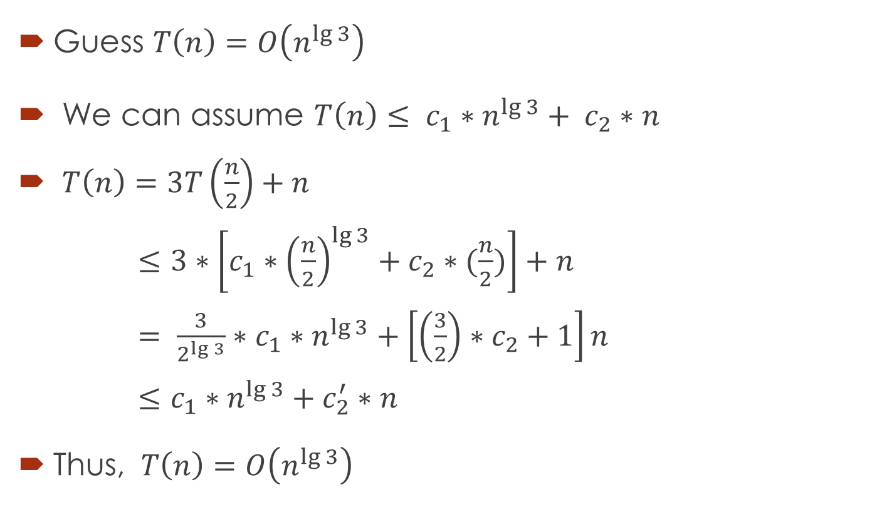
Check : By substitution method
Guess $T\left(n\right)=O\left(n^{\lg{3}}\right)$
We can assume $T\left(n\right)≤ c_{1}∗n^{\lg{3}}+ c_{2}∗n$
$T\left(n\right)=3T\left(\frac{n}{2}\right)+n$
$≤3∗\left[c_{1}∗{\left(\frac{n}{2}\right)}^{\lg{3}}+c_{2}∗(\frac{n}{2})\right]+n$
$= \frac{3}{2^{\lg{3}}}∗c_{1}∗n^{\lg{3}}+\left[\left(\frac{3}{2}\right)∗c_{2}+1\right]n$
$≤c_{1}∗n^{\lg{3}}+c_{2}^{′}∗n$
Thus, $T\left(n\right)=O\left(n^{\lg{3}}\right)$

Slide 7
Thanks

