Slide 1
Algorithmics
Group 3

Slide 2
Question
Give asymptotic upper and lower bounds for T(n) in each of the following recurrences.
Assume that T(n) is constant for n≦2. Make your bounds as tight as possible, and justify your answers.

Slide 3
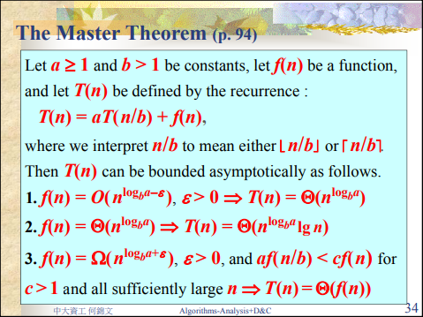
Master Theorem

Slide 4
Question
(a) T(n)=2T(n/2)+n³
By Master Theorem , a=2 , b=2 , f(n)=n³
n^{logba} = n , f(n)=Ω(n^{logba +ε}) , ε=2 ,
ε>0 and 2*f(n/2)<c*f(n) when c=1/3 , c<1
^{=> T(n)=θ(f(n))=θ(n³)}

Slide 5
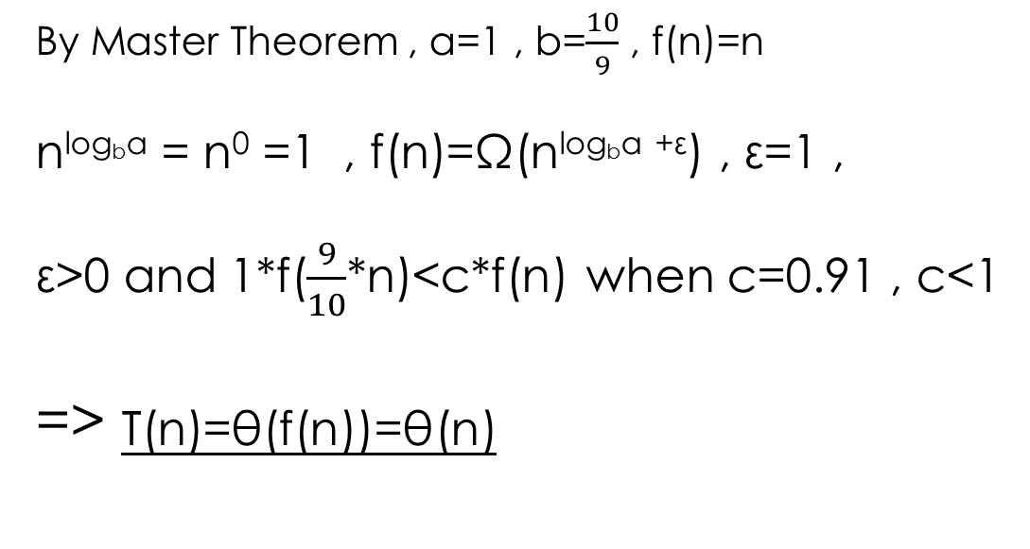
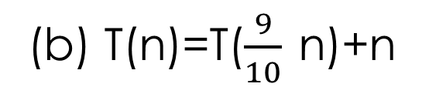
Question
(b) T(n)=T($\frac{9}{10}$ n)+n
By Master Theorem , a=1 , b=$\frac{10}{9}$ , f(n)=n
n^{logba} = n⁰ =1 , f(n)=Ω(n^{logba +ε}) , ε=1 ,
ε>0 and 1*f($\frac{9}{10}$*n)<c*f(n) when c=0.91 , c<1
^{=> T(n)=θ(f(n))=θ(n)}

Slide 6
Question
(c) T(n)=16T(n/4)+n²
By Master Theorem , a=16 , b=4 , f(n)=n²
n^{logba} = n² , f(n)=θ(n^{logba} ) ,
T(n)= θ(n^{logba} *log n )

Slide 7
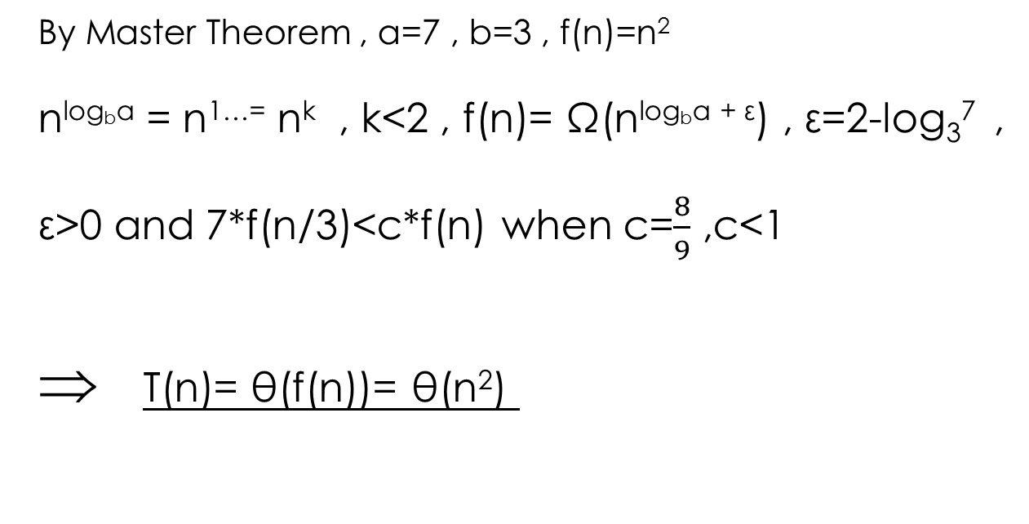
Question
(d) T(n)=7T(n/3)+n²
By Master Theorem , a=7 , b=3 , f(n)=n²
n^{logba} = n^{1…=} n^{k} , k<2 , f(n)= Ω(n^{logba + ε}) , ε=2-log₃⁷ ,
ε>0 and 7*f(n/3)<c*f(n) when c=$\frac{8}{9}$ ,c<1
T(n)= θ(f(n))= θ(n²)

Slide 8
Question
(e) T(n)=7T(n/2)+n²
By Master Theorem , a=7 , b=2 , f(n)=n²
n^{logba} = n^{2…} = n^{k} , k>2 , f(n)=O(n^{logba - ε}) , ε=log₂⁷ -2 ,
ε>0 and 2*f(n/2)<c*f(n)
T(n)= θ(n^{logba})= θ(n^{log27})

Slide 9
Question
(f) T(n)=2T(n/4)+√n
By Master Theorem , a=2 , b=4 , f(n)= √n
n^{logba} = √n , f(n)= θ(n^{logba})
T(n)= θ(n^{logba} *log n)= θ(√n *log n)

Slide 10
Question
(g) T(n)=T(n-1)+n
Let T(0)=c,c is constant
T(1)=T(0)+1 , T(2)=T(0)+1+2 ……
T(n)=T(0)+1+2+…+n
=c+(n*(n+1))/2
T(n)<=c+n+n+…n=c+n²
-> T(n)=O(n²)
T(n)>=(n*(n+1))/2
-> T(n)= Ω(n² )
Hence,T(n)= θ(n²)

Slide 11
Question
(h) T(n)=T(√ n)+1
Let n=2^{2^k} , T(2)=c , c is a constant
T(n)=2^{2^k-1}+1 , let a_{k} =2^{2^k}
a_{k} = a_{k-1} +1= a_{k-2} +2= a₀ +k=c+log(log n)
=> T(n)= θ(log(log n))

