Slide 1
Cutting rod with cost
第四組

Slide 2
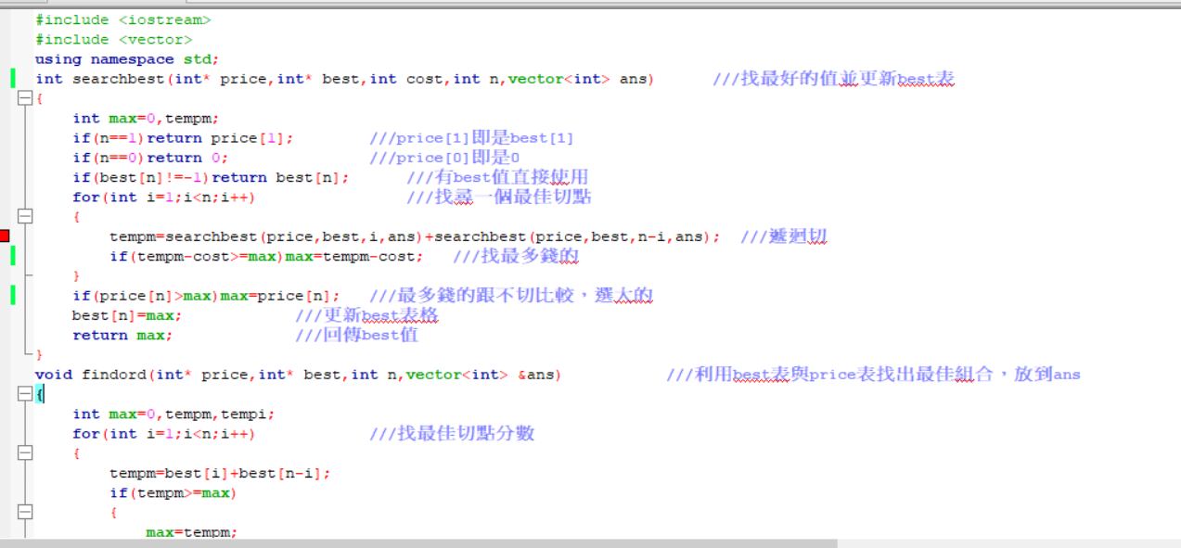

Slide 3
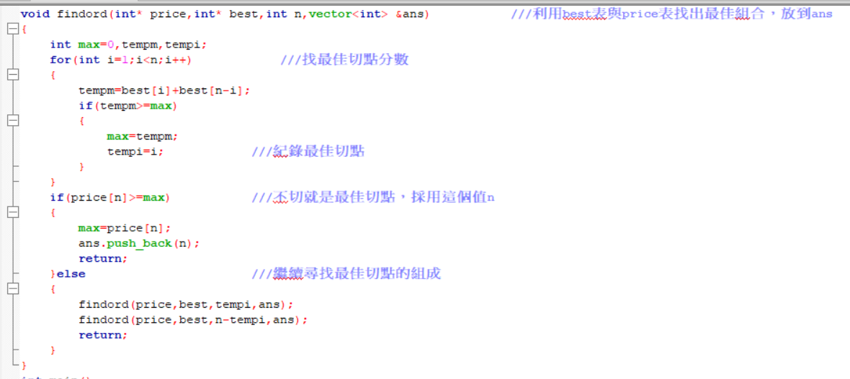

Slide 4


