Slide 1
Algorithm hw4-4
第六組

Slide 2
4. Exercises 15.2-1
Find an optimal parenthesization of a matrix-chain product whose sequence of dimensions is《5, 10, 3, 12, 5, 50, 6》.

Slide 3
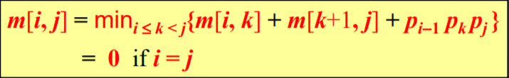
Sol.
《5, 10, 3, 12, 5, 50, 6》
A1_{5x10}, A2_{10x3}, A3_{3x12}, A4_{12x5}, A5_{5x50}, A6_{50x6}
P₀ = 5, P₁ = 10, P₂ = 3, P₃ = 12, P₄ = 5, P₅ = 50, P₆ = 6

Slide 4
m[1,1] = m[2,2] = m[3,3] = m[4,4] = m[5,5] = m[6,6] = 0
m[1,2] = m[1,1] + m[2,2] + P₀P₁P₂ = 5 x 10 x 3 =150
m[2,3] = m[2,2] + m[3,3] + P₁P₂P₃ = 10 x 3 x 12 =360
m[3,4] = m[3,3] + m[4,4] + P₂P₃P₄ = 3 x 12 x 5 =180
m[4,5] = m[4,4] + m[5,5] + P₃P₄P₅ = 12 x 5 x 50 =3000
m[5,6] = m[5,5] + m[6,6] + P₄P₅P₆ = 5 x 50 x 6 =1500

Slide 5
 | 1 | 2 | 3 | 4 | 5 | 6
1 | 0 | 150
2 |  | 0 | 360
3 |  |  | 0 | 180
4 |  |  |  | 0 | 3000
5 |  |  |  |  | 0 | 1500
6 |  |  |  |  |  | 0

Slide 6
min of m[1,3] :
at k = 1→m[1,3] = m[1,1] + m[2,3] + P₀P₁P₃ = 0 + 360 + 5 x 10 x 12 = 960
at k = 2→m[1,3] = m[1,2] + m[3,3] + P₀P₂P₃ = 150 + 0 + 5 x 3 x 12 = 330
min of m[2,4] :
at k = 2→m[2,4] = m[2,2] + m[3,4] + P₁P₂P₄ = 0 + 180 + 10 x 3 x 5 = 330
at k = 3→m[2,4] = m[2,3] + m[4,4] + P₁P₃P₄ = 360 + 0 + 10 x 12 x 5 = 960
min of m[3,5] :
at k = 3→m[3,5] = m[3,3] + m[4,5] + P₂P₃P₅ = 0 + 3000 + 3 x 12 x 50 = 4800
at k = 4→m[3,5] = m[3,4] + m[5,5] + P₂P₄P₅ = 180 + 0 + 3 x 5 x 50 = 930
min of m[4,6] :
at k = 4→m[4,6] = m[4,4] + m[5,6] + P₃P₄P₆ = 0 + 1500 + 12 x 5 x 6 = 1860
at k = 5→m[4,6] = m[4,5] + m[6,6] + P₃P₅P₆ = 3000 + 0 + 12 x 50 x 6 = 6600

Slide 7
 | 1 | 2 | 3 | 4 | 5 | 6
1 | 0 | 150 | 330
2 |  | 0 | 360 | 330
3 |  |  | 0 | 180 | 930
4 |  |  |  | 0 | 3000 | 1860
5 |  |  |  |  | 0 | 1500
6 |  |  |  |  |  | 0

Slide 8
min of m[1,4] :
at k = 1→m[1,4] = m[1,1] + m[2,4] + P₀P₁P₄ = 0 + 330 + 5 x 10 x 5 = 580
at k = 2→m[1,4] = m[1,2] + m[3,4] + P₀P₂P₄ = 150 + 180 + 5 x 3 x 5 = 405
at k = 3→m[1,4] = m[1,3] + m[4,4] + P₀P₃P₄ = 330 + 0 + 5 x 12 x 5 = 630
min of m[2,5] :
at k = 2→m[2,5] = m[2,2] + m[3,5] + P₁P₂P₅ = 0 + 930 + 10 x 3 x 50 = 2430
at k = 3→m[2,5] = m[2,3] + m[4,5] + P₁P₃P₅ = 360 + 3000 + 10 x 12 x 50 = 9360
at k = 4→m[2,5] = m[2,4] + m[5,5] + P₁P₄P₅ = 330 + 0 + 10 x 5 x 50 = 2830
min of m[3,6] :
at k = 3→m[3,6] = m[3,3] + m[4,6] + P₂P₃P₆ = 0 + 1860 + 3 x 12 x 6 = 2076
at k = 4→m[3,6] = m[3,4] + m[5,6] + P₂P₄P₆ = 180 + 1500 + 3 x 5 x 6 = 1770
at k = 5→m[3,6] = m[3,5] + m[6,6] + P₂P₅P₆ = 930 + 0 + 3 x 50 x 6 = 1830

Slide 9
 | 1 | 2 | 3 | 4 | 5 | 6
1 | 0 | 150 | 330 | 405
2 |  | 0 | 360 | 330 | 2430
3 |  |  | 0 | 180 | 930 | 1770
4 |  |  |  | 0 | 3000 | 1860
5 |  |  |  |  | 0 | 1500
6 |  |  |  |  |  | 0

Slide 10
min of m[1,5] :
at k = 1→m[1,5] = m[1,1] + m[2,5] + P₀P₁P₅ = 0 + 2430 + 5 x 10 x 50 = 4930
at k = 2→m[1,5] = m[1,2] + m[3,5] + P₀P₂P₅ = 150 + 930 + 5 x 3 x 50 = 1830
at k = 3→m[1,5] = m[1,3] + m[4,5] + P₀P₃P₅ = 330 + 3000 + 5 x 12 x 50 = 6330
at k = 4→m[1,5] = m[1,4] + m[5,5] + P₀P₄P₅ = 405 + 0 + 5 x 5 x 50 = 1655
min of m[2,6] :
at k = 2→m[2,6] = m[2,2] + m[3,6] + P₁P₂P₆ = 0 + 1770 + 10 x 3 x 6 = 1950
at k = 3→m[2,6] = m[2,3] + m[4,6] + P₁P₃P₆ = 360 + 1860 + 10 x 12 x 6 = 2940
at k = 4→m[2,6] = m[2,4] + m[5,6] + P₁P₄P₆ = 330 + 1500 + 10 x 5 x 6 = 2130
at k = 5→m[2,6] = m[2,5] + m[6,6] + P₁P₅P₆ = 2430 + 0 + 10 x 50 x 6 = 5430

Slide 11
 | 1 | 2 | 3 | 4 | 5 | 6
1 | 0 | 150 | 330 | 405 | 1655
2 |  | 0 | 360 | 330 | 2430 | 1950
3 |  |  | 0 | 180 | 930 | 1770
4 |  |  |  | 0 | 3000 | 1860
5 |  |  |  |  | 0 | 1500
6 |  |  |  |  |  | 0

Slide 12
min of m[1,6] :
at k = 1→m[1,6] = m[1,1] + m[2,6] + P₀P₁P₆ = 0 + 1950 + 5 x 10 x 6 = 2250
at k = 2→m[1,6] = m[1,2] + m[3,6] + P₀P₂P₆ = 150 + 1770 + 5 x 3 x 6 = 2010
at k = 3→m[1,6] = m[1,3] + m[4,6] + P₀P₃P₆ = 330 + 1860 + 5 x 12 x 6 = 2550
at k = 4→m[1,6] = m[1,4] + m[5,6] + P₀P₄P₆ = 405 + 1500 + 5 x 5 x 6 = 2055
at k = 5→m[1,6] = m[1,5] + m[6,6] + P₀P₅P₆ = 1655 + 0 + 5 x 50 x 6 = 3155

Slide 13
 | 1 | 2 | 3 | 4 | 5 | 6
1 | 0 | 150 | 330 | 405 | 1655 | 2010
2 |  | 0 | 360 | 330 | 2430 | 1950
3 |  |  | 0 | 180 | 930 | 1770
4 |  |  |  | 0 | 3000 | 1860
5 |  |  |  |  | 0 | 1500
6 |  |  |  |  |  | 0

Slide 14

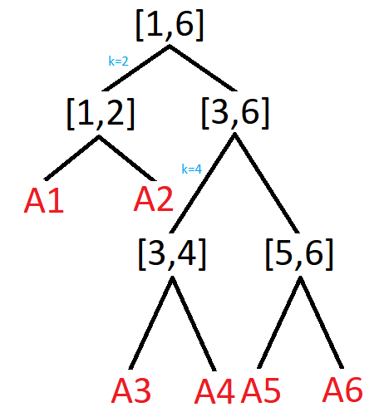
s[i,j] | 1 | 2 | 3 | 4 | 5 | 6
1 | 0 | 1 | 2 | 2 | 4 | 2
2 |  | 0 | 2 | 2 | 2 | 2
3 |  |  | 0 | 3 | 4 | 4
4 |  |  |  | 0 | 4 | 4
5 |  |  |  |  | 0 | 5
6 |  |  |  |  |  | 0
(A1A2)(A3A4)(A5A6)

