Slide 1
HW5 -第7題
第七組

Slide 2
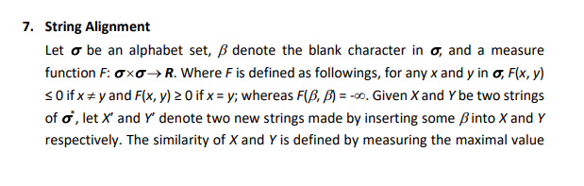
問題

Slide 3
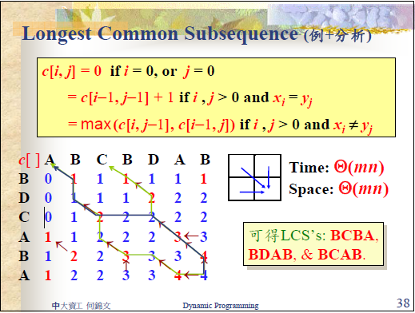
先做LCS
a. Design an algorithm to find the similarity of X and Y.
//假設X的長度為n，Y的長度為m，矩陣c[m+1][n+1]={0}為global
for i from 1 to n
for j from 1 to m
if(Xi!=Yj)
c[j][i]=max(c[j-1][i-1],c[j][i-1],c[j-1][i]);
else
c[j][i]=c[j-1][i-1]+1;

Slide 4
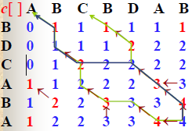
計算哪個路徑similarity最大
a. Design an algorithm to find the similarity of X and Y.
int cal(c,n,m,sum){
if(m or n <=0)
return sum;
if(上跟左皆可走) //有兩種可能 要補空白
return max(cal(c,n,m-1,sum+F(B,Ym)) , cal(c,n-1,m,sum+F(Xn,B)) );
else if(上or左)
return cal(c,n,m-1,sum+F(B,Ym)) or cal(c,n-1,m,sum+F(Xn,B))
else //有對到 走斜的 不用補空白
return cal(c,n-1,m-1,sum+F(Xn,Ym));
}

Slide 5
b. Design an algorithm to find that describe where the blank characters are inserted to get the similarity.
int cal(c,n,m,sum){
if(m or n <=0)
return sum;
if(上跟左皆可走) //兩種可能 要補空白
int temp=max(cal(c,n,m-1,sum+F(B,Ym)), cal(c,n-1,m,sum+F(Xn,B))) );
x[i++]=1 or y[j++]=1;
return temp;
else if(上or左)
x[i++]=1 or y[j++]=1;
return cal(c,n,m-1,sum+F(B,Ym)) or cal(c,n-1,m,sum+F(Xn,B))
else //有對到 走斜的 不用補空白
x[i++]=0 && y[j++]=0;
return cal(c,n-1,m-1,sum+F(Xn,Ym));
}

Slide 6
b. Design an algorithm to find that describe where the blank characters are inserted to get the similarity.
從Xn,Ym,x[i],y[j]開始往回
->x[i]/y[j]=1要補空白
->x[i]/y[j]=0就不用補

