Slide 1
Hw5-3 Group3

Slide 2
Longest palindrome subsequence
A palindrome is a nonempty string over some alphabet that reads the same forward and backward. Examples of palindromes are all strings of length 1, civic, racecar, and aibohphobia (fear of palindromes). Give an efficient algorithm to find the longest palindrome that is a subsequence of a given input string. For example, given the input character, your algorithm should return carac. How long is the running time of your algorithm?

Slide 3

Recurrence relation
s[] represents the string S of length n in the form of a character array, where s[i] is the i-th character in the string, 1$≤i≤n$
L(i,j) represents the length of the longest palindrome subsequence

Slide 4
Recurrence relation
L(i,j) = 0 , if i=j+1
= 1 , if i=j
= L(i+1,j-1)+2 , if i<j and s[i]=s[j]
=max{ L(i+1,j) , L(i,j-1) } , otherwise
r(i,j) records the reference value of L(i,j)
L(i+1,j-1)+2 ()
L(i+1,j) (⬆)
L(i,j-1) (➔)

Slide 5
Implementation
 | c | h | a | r | a | c | t | e | r
c | 1 | ⬆1 | ⬆1 | ⬆1 | ⬆3 | 5 | ➔ 5 | ➔5 | ➔5
h | 0 | 1 | ⬆1 | ⬆1 | ⬆3 | ⬆3 | ⬆3 | ⬆3 | ⬆3
a |  | 0 | 1 | ⬆1 | 3 | ➔3 | ➔3 | ➔3 | ⬆3
r |  |  | 0 | 1 | ⬆1 | ⬆1 | ⬆1 | ⬆1 | 3
a |  |  |  | 0 | 1 | ⬆1 | ⬆1 | ⬆1 | ⬆1
c |  |  |  |  | 0 | 1 | ⬆1 | ⬆1 | ⬆1
t |  |  |  |  |  | 0 | 1 | ⬆1 | ⬆1
e |  |  |  |  |  |  | 0 | 1 | ⬆1
r |  |  |  |  |  |  |  | 0 | 1
carac
c c
ca ac

Slide 6
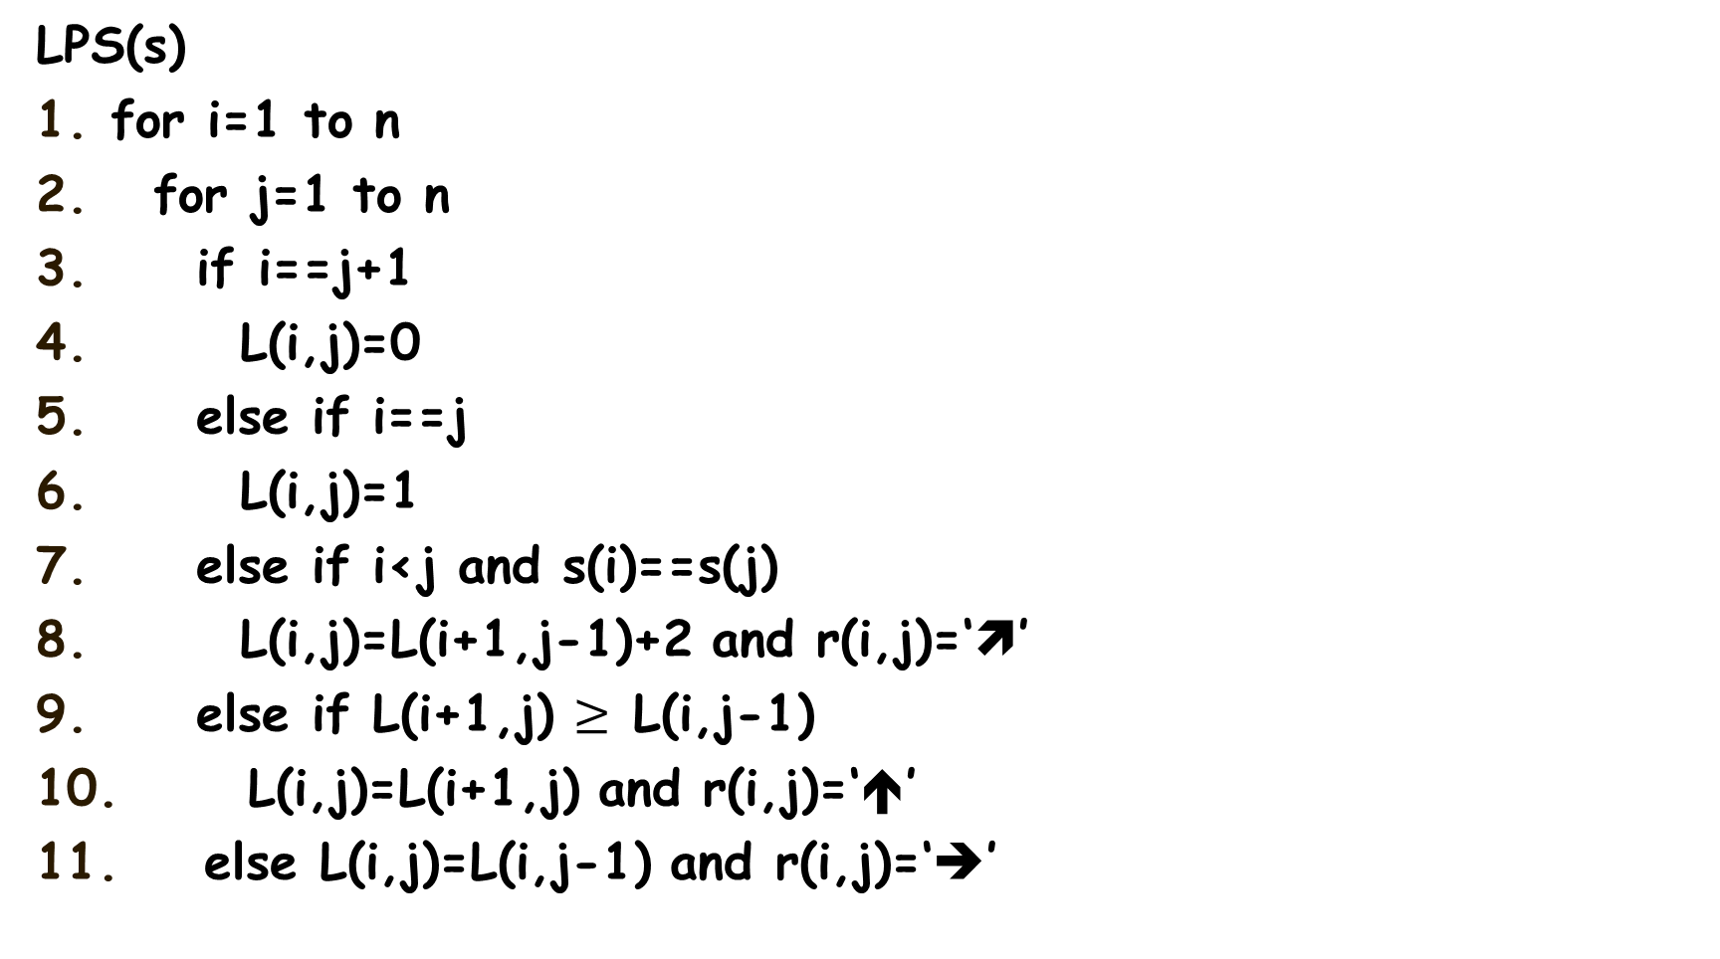
Pseudocode
LPS(s)
for i=1 to n
for j=1 to n
if i==j+1
L(i,j)=0
else if i==j
L(i,j)=1
else if i<j and s(i)==s(j)
L(i,j)=L(i+1,j-1)+2 and r(i,j)=‘’
else if L(i+1,j) $≥$ L(i,j-1)
L(i,j)=L(i+1,j) and r(i,j)=‘⬆’
else L(i,j)=L(i,j-1) and r(i,j)=‘➔’

Slide 7

Time complexity of LPS
Ans: T(n)=$θ(n^{2})$

Slide 8
Thanks

