Slide 1
第四組-HW5-4
曾思維、張立彥、洪仲杰、陳亮宇、羅展釗、蔡沛宏、趙天佑

Slide 2
Optimal substructure of Edit Distance
Let x=(α1,α2,α3,...,αm) and
Let y=(β1,β2,β3,...,βn)
And then we define:
c(i,j)c(i,j) for 0 ≤ i ≤ m and 0 ≤ j ≤ n
as the minimum edit distance to transform

Slide 3
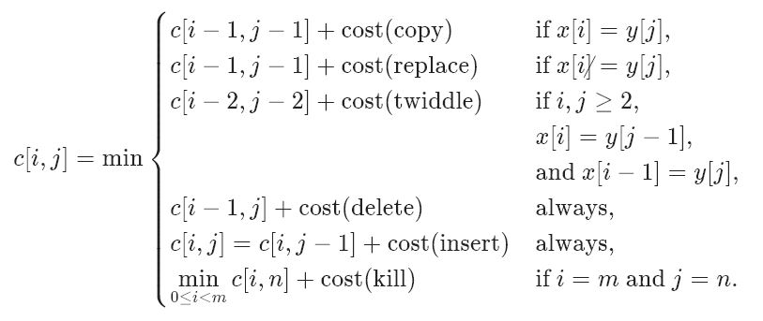
For i, j &gt; 0i,j>0, our recursive formulation for c[i, j]c[i,j] applies the above formulas in the situations in which they hold:

Slide 4
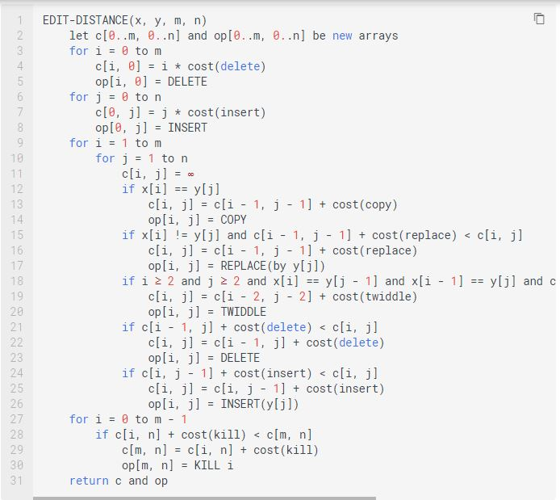
Time and space complexity
Θ(mn)

