Slide 1
HW5-6

Slide 2
Problem :
Solve LCS problem with space complexity :
2 * min(| X|, |Y|)
min(| X|, |Y|) + 1

Slide 3
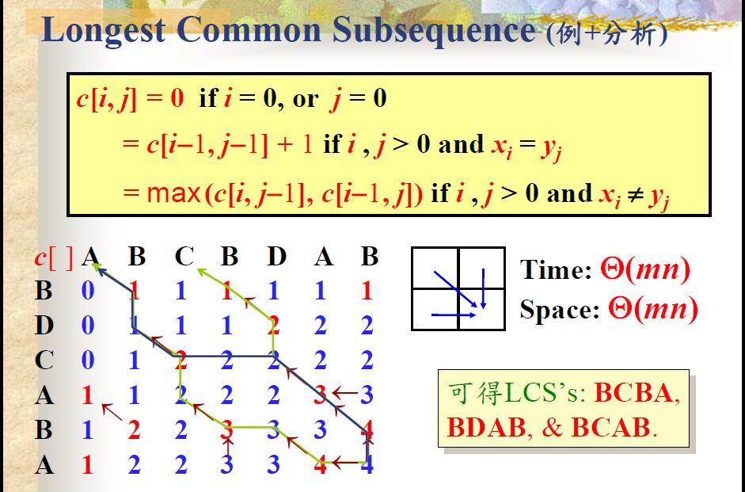
Original Solution:
只需要存
當前和前一個
陣列結果

Slide 4
2 * min(| X|, |Y|) :
a[ i ]
b[ i ]

Slide 5
2 * min(| X|, |Y|) :
a[ i ]
b[ i ]

Slide 6
2 * min(| X|, |Y|) :
a[ i ]
b[ i ]

Slide 7
2 * min(| X|, |Y|) :
a[ i ]
b[ i ]

Slide 8
2 * min(| X|, |Y|) :
a[ i ]
b[ i ]

Slide 9
2 * min(| X|, |Y|) :
a[ i ]
b[ i ]

Slide 10
2 * min(| X|, |Y|) :
b[ i ]
= a[ i -1 ] + 1 if xi = yi
= max(a[ i ], b[ i – 1 ]) if xi != yi

Slide 11
min(| X|, |Y|) + 1
想法 :
沒必要將前一列整排記下來，
空間可以重複使用

Slide 12
min(| X|, |Y|) + 1
C[i] = 0 if i = 0
= tmp + 1 if x[i] = y[j]
= max(c[i], c[i-1]) if x[i] != y[j]
tmp 為 c[i] 左上方的元素

Slide 13
min(| X|, |Y|) + 1
 | A | B | C | D | D | A | B
B | 0 | 1 | 1 | 1 | 1 | 1 | 1
D
C
A
B
A
1 | 2 | 3 | 4 | 5 | 6 | 7
0 | 1 | 1 | 1 | 1 | 1 | 1
tmp = 0

Slide 14
min(| X|, |Y|) + 1
C[i] = max(c[i], c[i - 1])
 | A | B | C | D | D | A | B
B | 0 | 1 | 1 | 1 | 1 | 1 | 1
D | 0
C
A
B
A
1 | 2 | 3 | 4 | 5 | 6 | 7
0 | 1 | 1 | 1 | 1 | 1 | 1
tmp = 0

Slide 15
min(| X|, |Y|) + 1
 | A | B | C | D | D | A | B
B | 0 | 1 | 1 | 1 | 1 | 1 | 1
D | 0
C
A
B
A
1 | 2 | 3 | 4 | 5 | 6 | 7
0 | 1 | 1 | 1 | 1 | 1 | 1
tmp = 1

Slide 16
min(| X|, |Y|) + 1
 | A | B | C | D | D | A | B
B | 0 | 1 | 1 | 1 | 1 | 1 | 1
D | 0 | 1
C
A
B
A
1 | 2 | 3 | 4 | 5 | 6 | 7
0 | 1 | 1 | 1 | 1 | 1 | 1
tmp = 1

Slide 17
min(| X|, |Y|) + 1
 | A | B | C | D | D | A | B
B | 0 | 1 | 1 | 1 | 1 | 1 | 1
D | 0 | 1 | 1
C
A
B
A
1 | 2 | 3 | 4 | 5 | 6 | 7
0 | 1 | 1 | 1 | 1 | 1 | 1
tmp = 1

Slide 18
min(| X|, |Y|) + 1
 | A | B | C | D | D | A | B
B | 0 | 1 | 1 | 1 | 1 | 1 | 1
D | 0 | 1 | 1 | 2
C
A
B
A
1 | 2 | 3 | 4 | 5 | 6 | 7
0 | 1 | 1 | 1 | 1 | 1 | 1
tmp = 1

Slide 19
min(| X|, |Y|) + 1
 | A | B | C | D | D | A | B
B | 0 | 1 | 1 | 1 | 1 | 1 | 1
D | 0 | 1 | 1 | 2 | 2
C
A
B
A
1 | 2 | 3 | 4 | 5 | 6 | 7
0 | 1 | 1 | 1 | 2 | 1 | 1
tmp = 1

Slide 20
min(| X|, |Y|) + 1
 | A | B | C | D | D | A | B
B | 0 | 1 | 1 | 1 | 1 | 1 | 1
D | 0 | 1 | 1 | 2 | 2 | 2
C
A
B
A
1 | 2 | 3 | 4 | 5 | 6 | 7
0 | 1 | 1 | 1 | 2 | 2 | 1
tmp = 1

Slide 21
min(| X|, |Y|) + 1
 | A | B | C | D | D | A | B
B | 0 | 1 | 1 | 1 | 1 | 1 | 1
D | 0 | 1 | 1 | 2 | 2 | 2 | 2
C
A
B
A
1 | 2 | 3 | 4 | 5 | 6 | 7
0 | 1 | 1 | 1 | 2 | 2 | 2
tmp = 1

