Slide 1

Algorithm Group 6

Slide 2
Inversion
Let A[1..n] be an array of n distinct numbers. If i < j and A[i] > A[j], then the pair (i, j) is called an inversion of A.

Slide 3
Question:
a. List the five inversions of the array
〈2, 3, 8, 6, 1〉.

Slide 4
Solution a.
<2,3,8,6,1>
① <2,1> <0,4>
② <3,1> <1,4>
③ <8,1> <2,4>
④ <8,6> <2,3>
⑤ <6,1> <3,4>
PS. inversion要以項數表示

Slide 5
Question:
b. What array with elements from the set {1, 2, ⋯, n} has the most inversions? How many does it have?

Slide 6
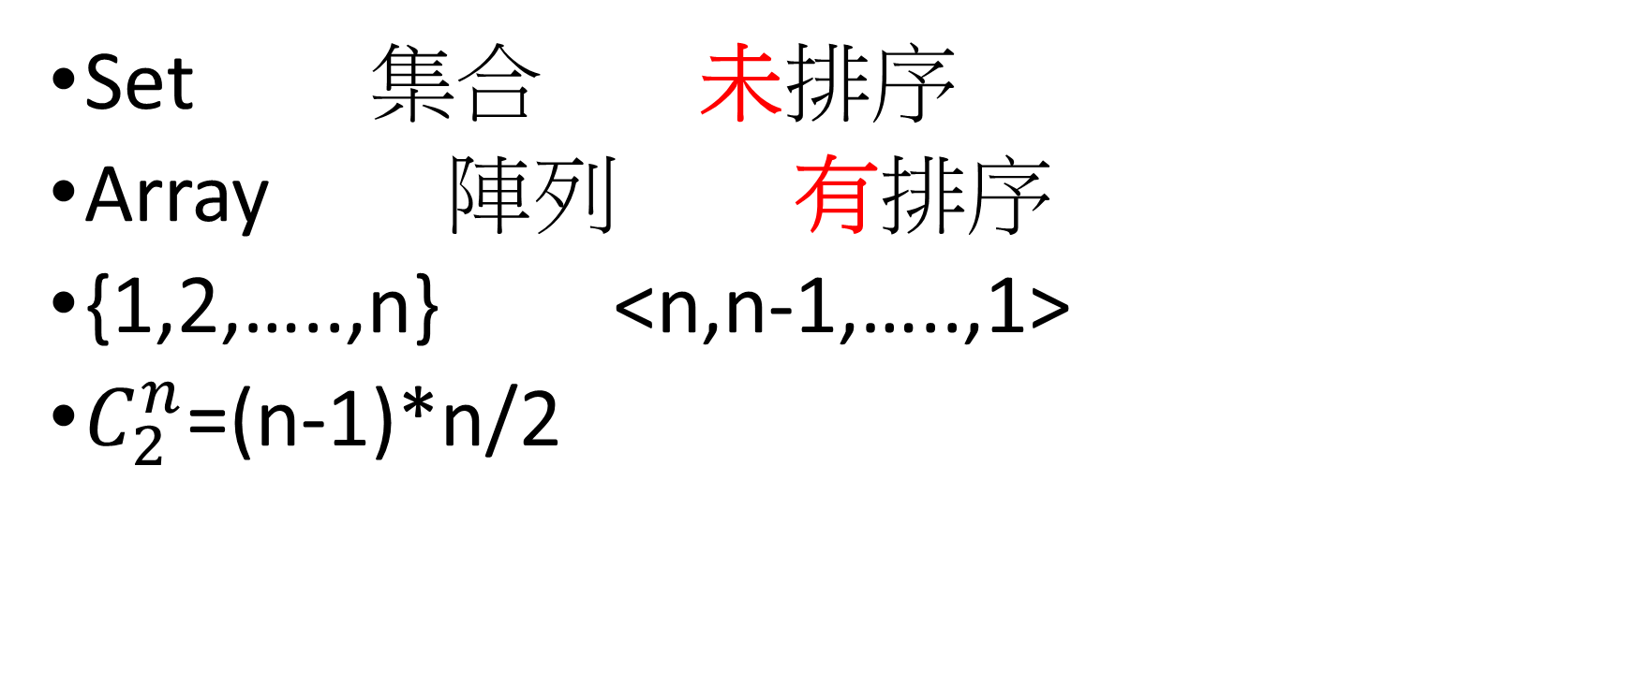
Solution b.
Set 集合 未排序
Array 陣列 有排序
{1,2,…..,n} <n,n-1,…..,1>
$C_{2}^{n}$=(n-1)*n/2

Slide 7
Question:
c. What is the relationship between the running time of the insertion sort and the number of inversions in the input array? Justify your answer.

Slide 8
Solution c. part1
set{1,2,3,4,5}
Array1 <1,2,3,4,5> has 0 inversions
Array2 <1,2,3,5,4> has 1 inversions

Slide 9
Solution c. part2
1 | 2 | 3 | 4 | 5
1 | 2 | 3 | 4 | 5
1 | 2 | 3 | 4 | 5
1 | 2 | 3 | 4 | 5
總共 4 steps

Slide 10
Solution c. part3
1 | 2 | 3 | 5 | 4
1 | 2 | 3 | 5 | 4
1 | 2 | 3 | 5 | 4
1 | 2 | 3 | 5 | 4
1 | 2 | 3 | 4 | 5
總共 5 steps

Slide 11
Conclusion c.
Array1 needs 4 steps by insertion sort , 0 inversions
Array2 needs 5 steps by insertion sort , 1 inversions
So, if an array has less inversions, the running time of the insertion sort is shorter.

Slide 12
Question:
d. Give an algorithm that determines the number of inversions in any permutation on n elements in θ(nlgn) worst-case time. (Hint: Modify merge sort.)

Slide 13
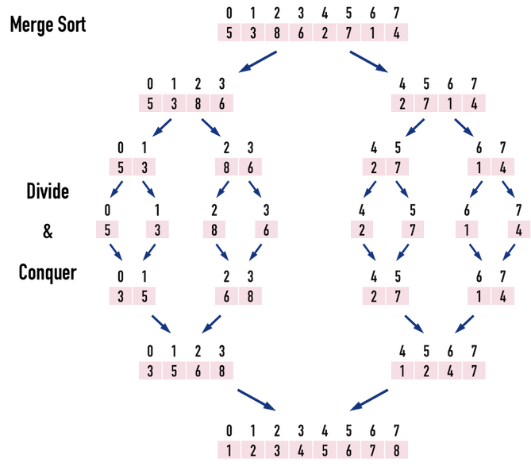
Solution d.

Slide 14
Solution d.
在左右兩個array合併時，若是right array的數字較小，計算invertion數的變數+左邊尚未檢驗的個數
T(n)=2T(n/2)+2(n-1)
T(n)=2T(n/2)+θ(n)
According to Master Theorem, time complexity is θ(nlgn)

Slide 15
Thank you for your listening.

