Slide 1
Algorithmics
第9組

Slide 2
Question
How would you modify Strassen’s algorithm to multiply n*n matrices in which n is not an exact power of 2? Show that the resulting algorithm runs in time θ(n lg7 ).

Slide 3
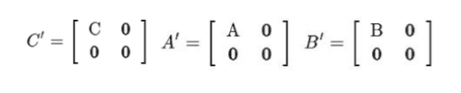

令 C = AB
因為A,B,C的行列數都不是$2^{k}，所以要補0$
令 m= $2^{k}$，m是A‘,B’,C‘的行列數

Slide 4

$2^{k−1}$ < n < $2^{k}$
lg $2^{k−1}$ < lgn < lg $2^{k}$
k-1 < lgn < k
=> $2^{k}>2^{lgn}$
m > $2^{lgn}$

Slide 5
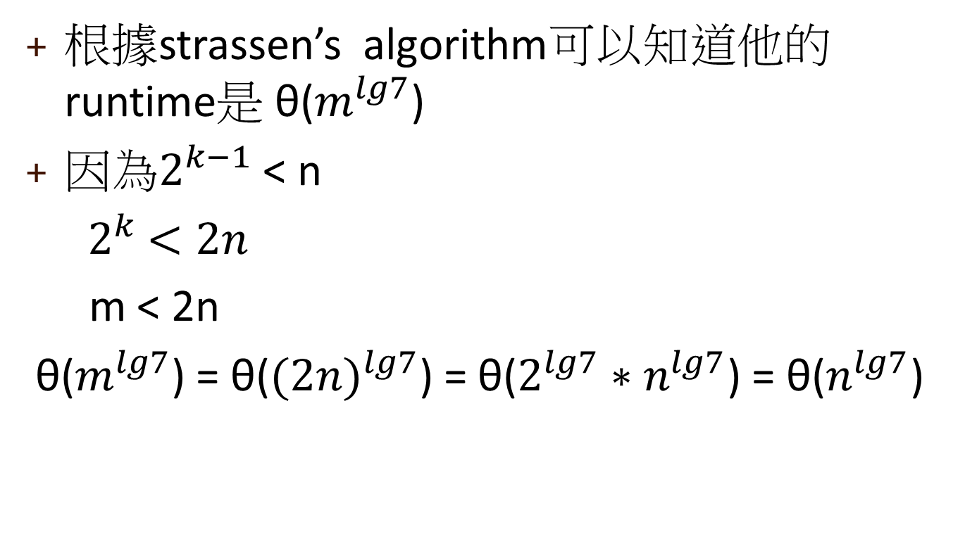
根據strassen’s algorithm可以知道他的runtime是 θ($m^{lg7}$)
因為$2^{k−1}$ < n
${ 2}^{k} <2n$
m < 2n
θ($m^{lg7}$) = θ(${(2n)}^{lg7}$) = θ(${2^{lg7}∗n}^{lg7}$) = θ($n^{lg7}$)

Slide 6
Thanks

