Slide 1
HW3 第三題
第七組

Slide 2
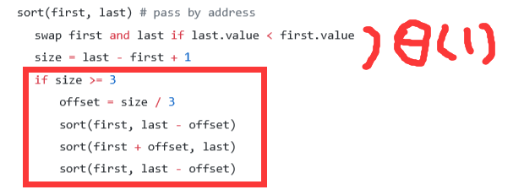

Slide 3
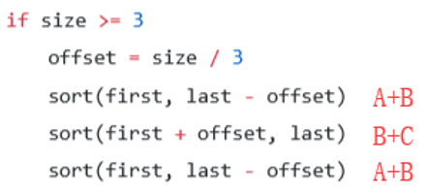
n
小
大
A
B
C

Slide 4
T(n) = 3T(2n/3)+Θ(1)
The Master Theorem:
a = 3, b = 3/2(1.5), f(n) = c
log(b)a = log(1.5)3 = log2.7xx
n^log2.7 > c
∴case1:
f(n) <= O(N^log(1.5)3)
∴T(n) = Θ(n^log(1.5)3) = Θ(n^2.7xx)
best-case, average-case, worst-case 是相同的

Slide 5
whether it is in place
YES
By address直接在原位置執行，swap也不會用到多餘的空間
whether it is stable
NO
例如：[3 1a 1b 2] →[2 1a 1b 3]→[1b 1a 2 3]

