Slide 1
HW6 - 8
第五組

Slide 2
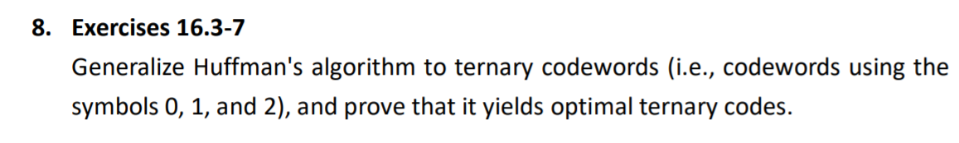

Slide 3
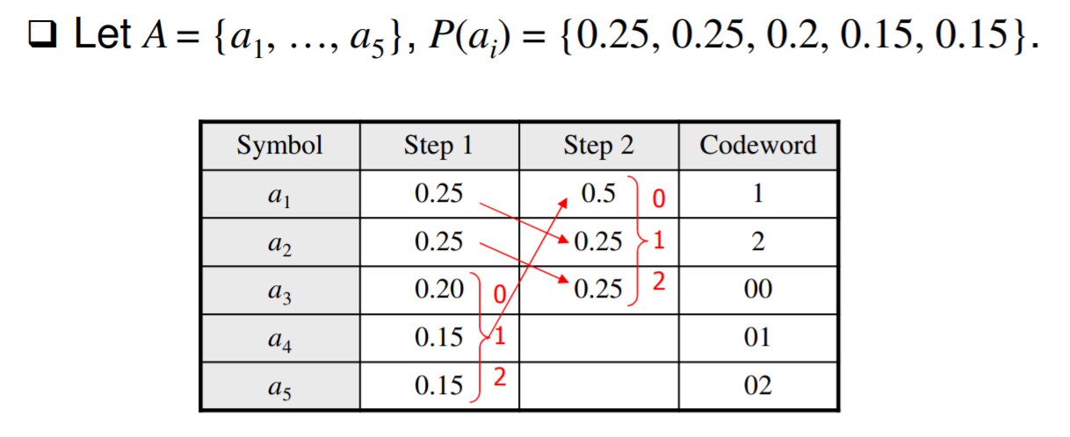
Ex.
2
0.25
0.25
0.15
0.15
0.2
1
2
1
1
0.5
0
0

Slide 4
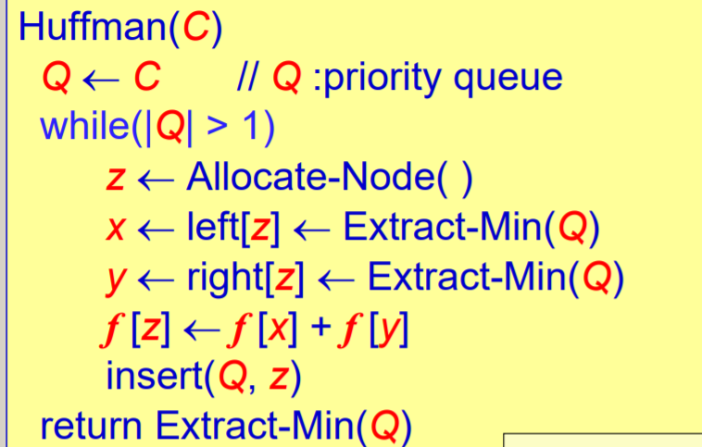
w ← middle[z]←Extract-Min(Q)
f[z] ← f[x] + f[y] + f[w]

Slide 5


Prove
Goal: Find minimum B(T)
Suppose A is input, x, y, z are three symbols with lowest frequency, and its corresponding coding tree T.
A’=A-{x,y,z}+{s}, f[s]=f[x]+f[y]+f[z], and its corresponding optimal coding tree is T’.
Every a in A-{x,y,z}, d_{T(a)}=d_{T’(a)}, so f[a]d_{T(a)}= f[a] d_{T’(a) .}
d_{T(x)}= d_{T(y)} = d_{T(z)} = d_{T’(s)} +1, so f[x]d_{T(x)}+f[y]d_{T(y)} +f[z]d_{T(z)} = (f[x]+f[y] +f[z]) (d_{T’(s)}+1) =f[s]d_{T’(s)}+(f[x]+f[y] +f[z])
Thus,
If T is not the optimal coding tree of A, there exist another tree T’’ with B(T’’)<B(T), and T’’’=T’’-x-y-z+s->B(T’’’)=B(T’’)-f[x]-f[y]-f[z]<B(T)=f[x]-f[y]-f[z]=B(T’), which is in contradiction to the hypothesis.

