Slide 1
第 9 組 : 第 2 題

Slide 2
題目 : 2. Exercises 16.1‐3
Not just any greedy approach to the activity‐selection problem produces a maximum‐size set of mutually compatible activities. Give an example to show that the approach of selecting the activity of least duration from among those that are compatible with previously selected activities does not work. Do the same for the approaches of always selecting the compatible activity that overlaps the fewest other remaining activities and always selecting the compatible remaining activity with the earliest start time.

Slide 3
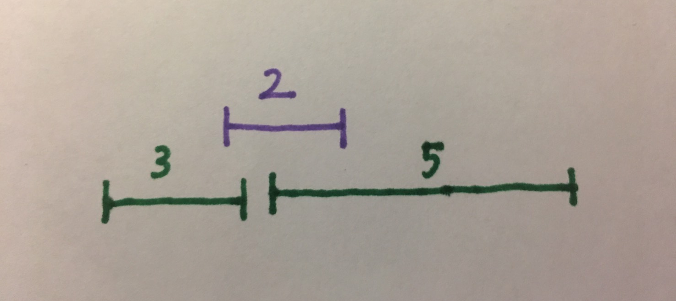
Sol :
1.selecting the compatible activity with least duration.
如果選擇時間最短的話，會選擇上面的，可是下面才是最佳解。

Slide 4
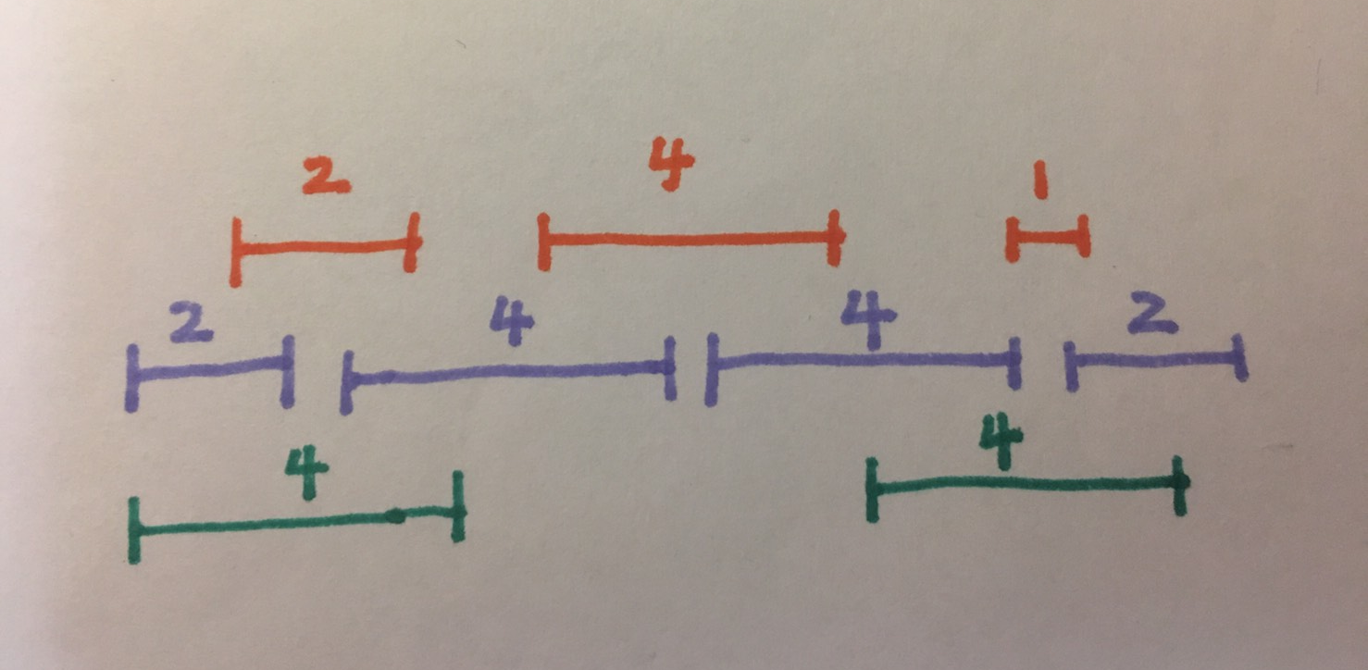
2. selecting the compatible activity that overlaps the fewest other remaining activities
一開始選最少重疊的會選上面的4，得到會是橘色的，可是最佳解是紫色的。

Slide 5
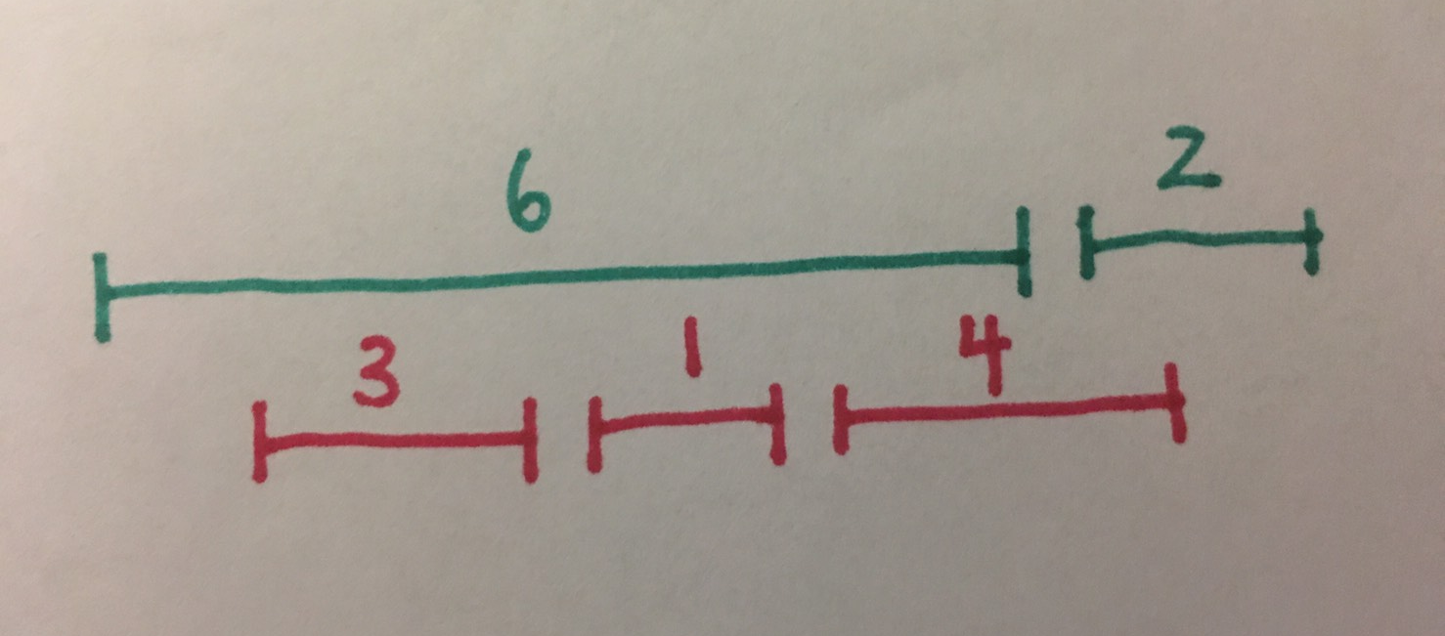
3. selecting the compatible remaining activity with earliest start time
如果要選會從6開始選，最終得到綠色的，可是紅色的才是最佳解，因為它有最多的活動

Slide 6
謝謝

