Slide 1
HW6 - 3
第十組

Slide 2
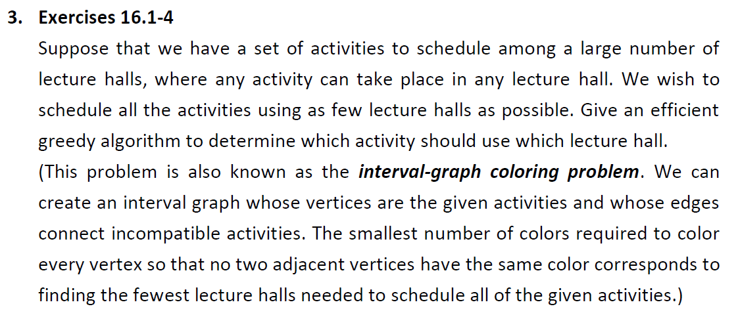
activity : 事件
The goal :
lecture halls : 空間
用最少的空間將所有事件都排入

Slide 3
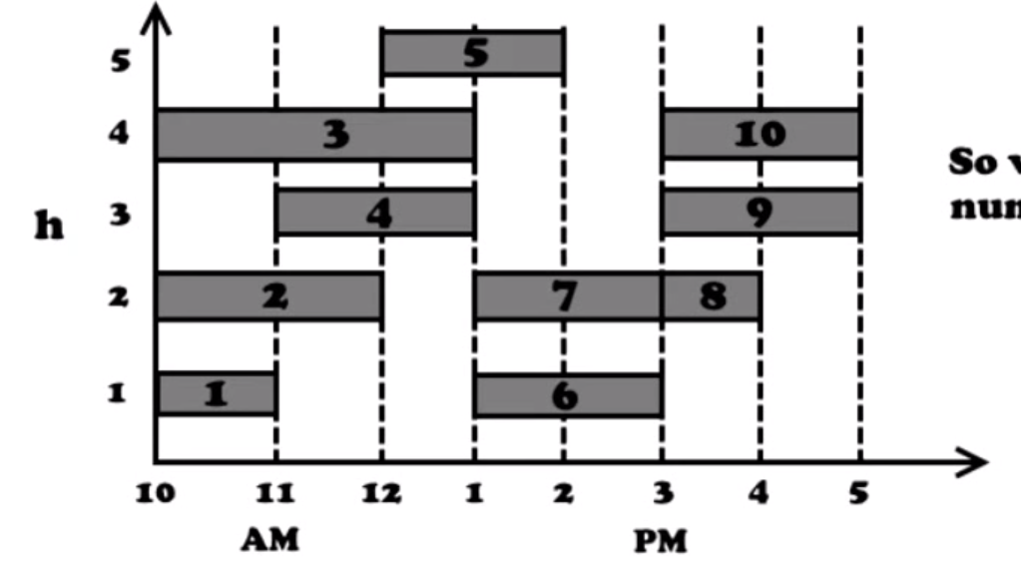
將事件依照 “開始” 時間排好
start_1 ≦ start_2 ≦ start_3 … ≦ start_n

Slide 4
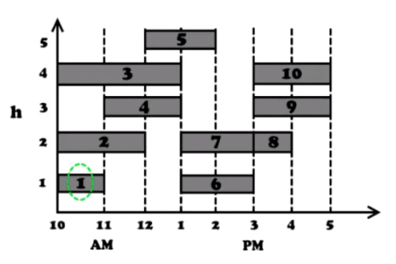
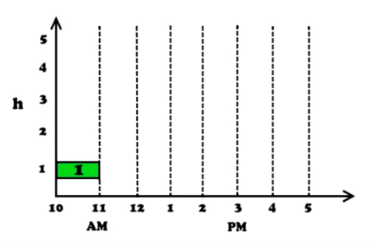
Solution

Slide 5
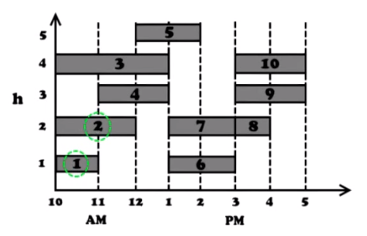
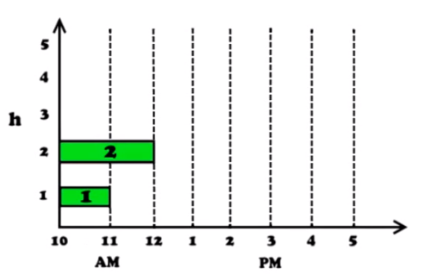
Solution

Slide 6
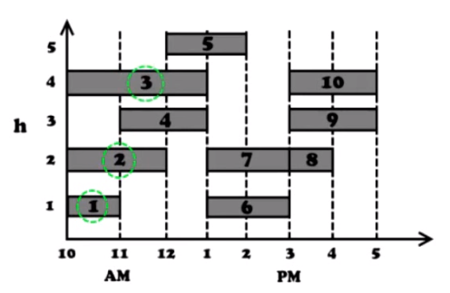
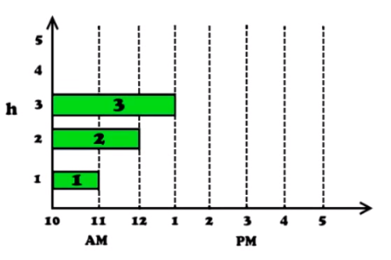
Solution

Slide 7
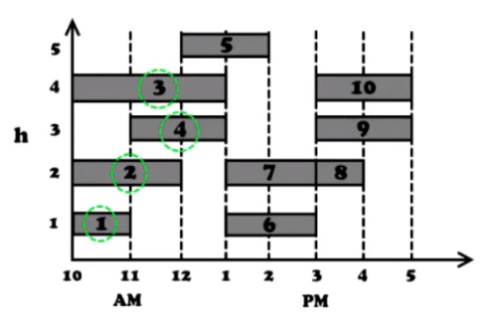
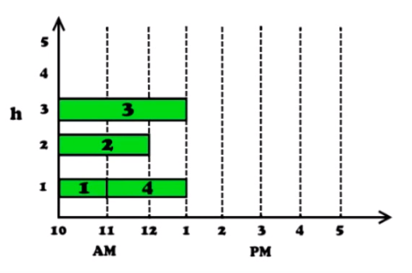
Solution

Slide 8
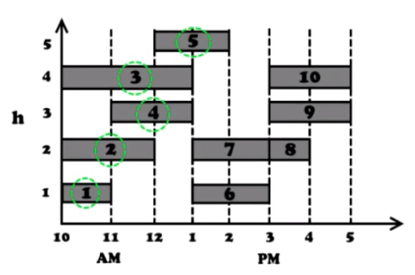
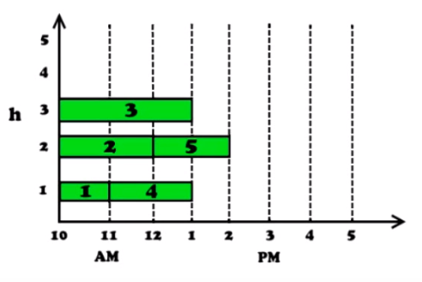
Solution

Slide 9
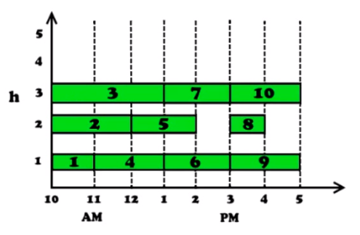
The solution

Slide 10
pseudo code
Sort activities by starting time so that s1 ≤ s2 ≤ ... ≤ sn.
d = 1
for i = 1 to n {
if (activity i is compatible with some lecture hall k)
schedule activity i in lecture hall k
else
allocate a new lecture hall d + 1
schedule activity i in lecture hall d + 1
d = d + 1
}

