Slide 1
Algorithmics - HW6
Group 2
104201015 張昭德 105201518 林育愷
105201004 張宜榛 105201529 王顥鈞
105201032 吳冠軒 105201537 邱仲緯

Slide 2
Question 5
(a) Design an algorithm to find the most valuable load of the items that fit into the knapsack.
(b) Design a pseudo‐polynomial time algorithm to determine the optimal solution that the total weight exactly equals to K.

Slide 3
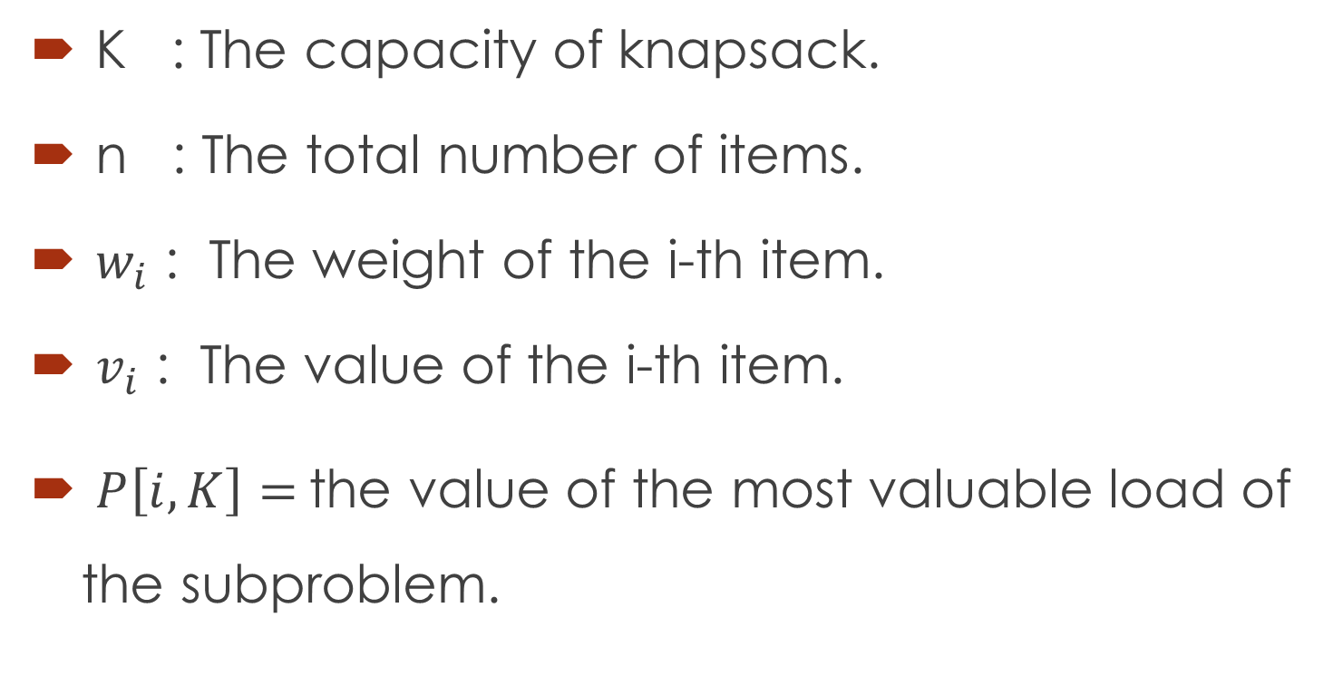
Definition
K : The capacity of knapsack.
n : The total number of items.
$w_{i}$ : The weight of the i-th item.
$v_{i}$ : The value of the i-th item.
$P\left[i,K\right]=$the value of the most valuable load of the subproblem.

Slide 4


(a)
Suppose
$P\left[0,k\right]=0$
$P\left[i,0\right]=0 , i≥0$
The recursive is
$P\left[i,k\right]=max\left\{\begin{aligned}P\left[i−1,K\right] \\ P\left[i−1,K−w_{i}\right]+v_{i}\end{aligned}\right.$
$$, where K≥w_{i}$$

Slide 5
(b) idea
Record the combination of weight for the maxima value.
If there are more than one combination, just keep all of them.
Finally, if there is a sum of any combination is exactly equals to K, then we return true, otherwise return false.

Slide 6
Example 1 :
 | 1 | 2 | 3 | 4 | 5
$10 / 1 | $10 / 1 | $10 / 1 | $10 / 1 | $10 / 1 | $10 / 1
$15 / 2 | $10 / 1 | $15 / 2 | $25 / 1+2 | $25 / 1+2 | $25 / 1+2
$60 / 3 | $10 / 1 | $15 / 2 | $60 / 3 | $70 / 1+3 | $75 / 2+3
$10 / 5 | $10 / 1 | $15 / 2 | $60 / 3 | $70 / 1+3 | $75 / 2+3

Slide 7
Example 2 :
 | 1 | 2 | 3 | 4 | 5
$60 / 1 | $60 / 1 | $60 / 1 | $60 / 1 | $60 / 1 | $60 / 1
$15 / 2 | $60 / 1 | $60 / 1 | $75 / 1+2 | $75 / 1+2 | $75 / 1+2
$60 / 3 | $60 / 1 | $60 / 1 | $60 / 1 $60 / 3 | $75 / 1+2 | $75 / 1+2 $75 / 2+3
$10 / 5 | $60 / 1 | $60 / 1 | $60 / 1 $60 / 3 | $75 / 1+2 | $75 / 1+2 $75 / 2+3

Slide 8
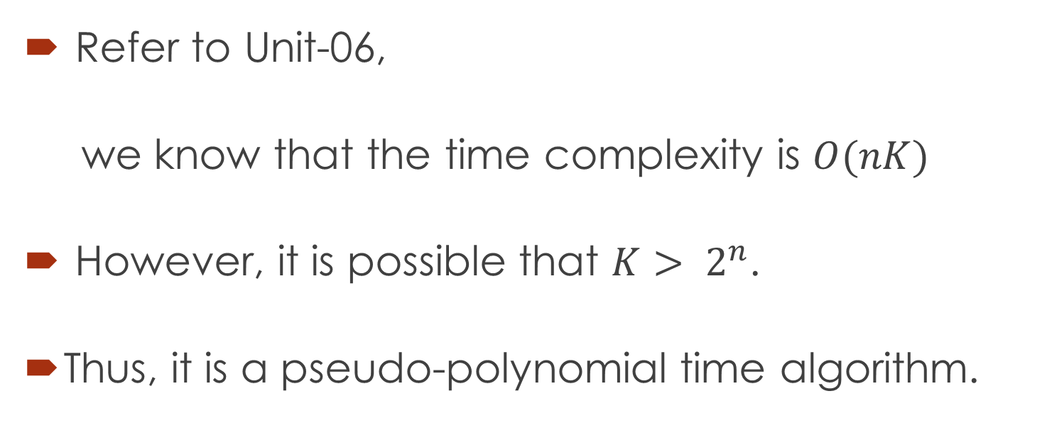
Analysis
Refer to Unit-06,
we know that the time complexity is $O(nK)$
However, it is possible that $K> 2^{n}$.
Thus, it is a pseudo-polynomial time algorithm.

Slide 9
Thanks

