Slide 1
problem
Show how to solve the fractional knapsack problem in O(n) time.

Slide 2
First step
Use a linear-time median algorithm to calculate the median m of the
v_i / w_i ratios.
v_i = value of item i
w_i = weight of item i

Slide 3
Second step
G = { i : v_i​/w_i​ >m}
E = { i : v_i / w_i = m}
L = {i : v_i / w_i <m}
//m = median

Slide 4
W_G = ∑​w_i​ in G
W_E = ∑​w_i in E
W = knapsack capacity
Solution part
Case 1
If W_G > W , then do not yet take any items in set G , and instead recurse on the set of items G and knapsack capacity W.

Slide 5
Solution part
Case 2
W_G​ ≤ W ≤W_G+W_E , take all items in set G, and take as much of the items in set E as will fit in the remaining capacity
(W - W_G​).

Slide 6
Solution part
Case 3
W_G​ + W_E​ < W, then after taking all the items in sets G and E, recurse on the set of items L and knapsack capacity
(W - W_G - W_E)​.

Slide 7
Solution part
Final
there is a recursive call, there is just one, and it's for a problem of at most half the size. Thus, the running time is given by the recurrence
T(n)≤T(n/2)+Θ(n) , so T(n) = O(n).

Slide 8
how to find median in O(n): Median of medians
此演算法可用於找出數列中第k小的值
1.把所有的點分成每五個一組
2.找出每組的中位數
3.找出所有中位數的中位數m
4.把比此數m小的數分成一堆L內有Ln個值，比此數m大的數分成另一堆R內有Rn個值
if (Ln==k-1) return m
if (Ln>k-1) return L中的第k小的值
if (Ln<k-1) return R中的第k-Ln-1小的值

Slide 9
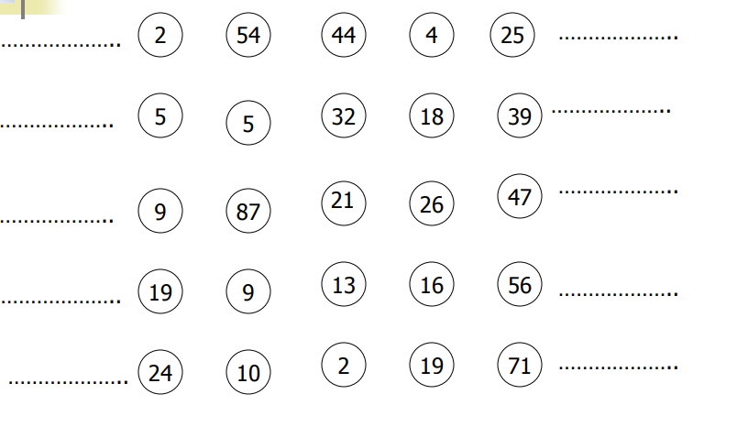


把所有的點分成每五個一組

Slide 10
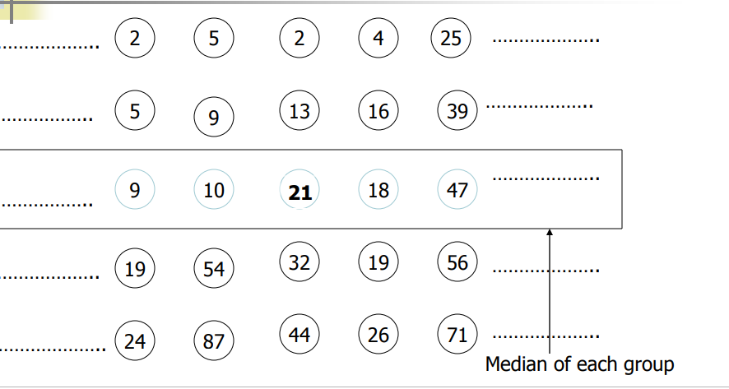


找出每組的中位數

Slide 11
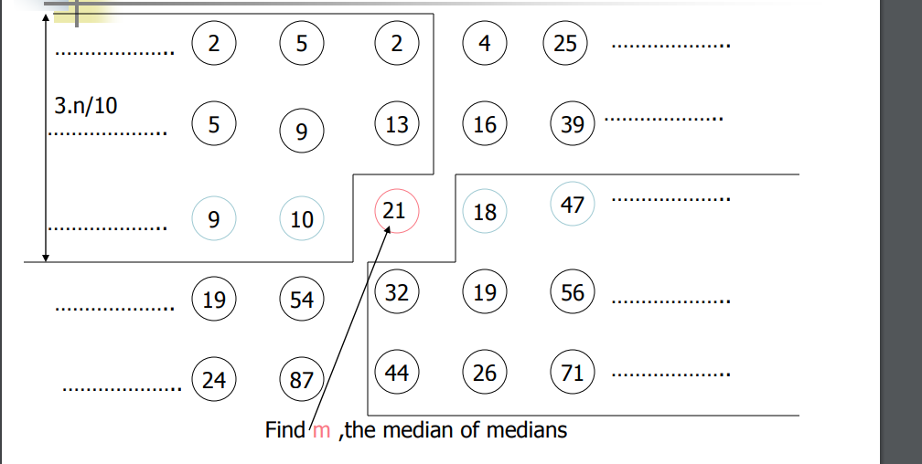
找出所有中位數的中位數m (18)

Slide 12
Find Median
如圖所示，L跟R最大的大小為1-3n/10=7n/10 (n為數字數量)
T(n)=T(7n/10)+T(n/5)+an (an為每次遞迴內部花費的時間)
假設T(m)<cm for 1<=m<n
T(n)<c*7n/10+c*n/5+an
T(n)<c*9n/10+an=(c*9/10+a)n
令a<c*1/10及c>10a
則T(n)<c*9n/10+an=(c*9/10+a)n<cn
T(1)=1<c*1
由數學歸納法得出T(n)<cn=O(n)

