Slide 1
Speed up DP: Knuth-Yao quadrangle inequality and SMAWK for TM matrices
dbu@ict.ac.cn

Slide 2

Quadrangle inequality speed up
Motivation:
Computing the optimal binary search trees (OBST)
Minimize $\sum_{i=1}^{n}{f_{i}d_{i}}$
Key | A | B | C | D | E | F
Frequency | 2 | 3 | 5 | 1 | 6 | 4
C
E
B
E
B
F
A
D
F
A
C
D

Slide 3
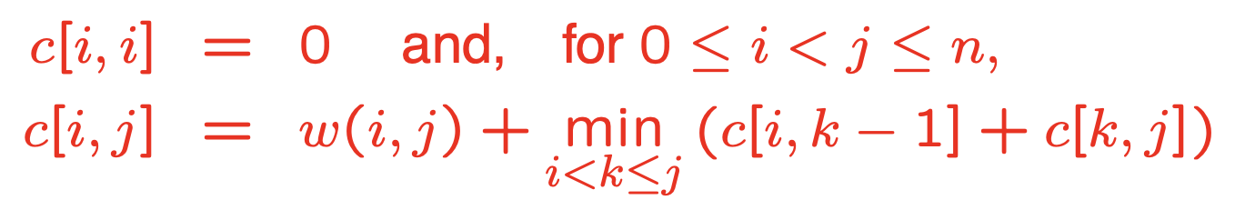
DP algorithm (Gilbert 1959)
DP recurrence:
Key | A | B | C | D | E | F
Frequency | 2 | 3 | 5 | 1 | 6 | 4
C
E
B
E
B
F
A
D
F
A
C
D

Slide 4
DP algorithm: an example
Key | A | B | C | D | E | F
Frequency | 2 | 3 | 5 | 1 | 6 | 4
 | A | B | C | D | E | F
A | 2 | 7 | 17 | 19 | 32 | 44
B | - | 3 | 11 | 13 | 26 | 36
C | - | - | 5 | 7 | 17 | 27
D | - | - | - | 1 | 8 | 16
E | - | - | - | - | 6 | 14
F | - | - | - | - | - | 4
 | A | B | C | D | E | F
A | A | B | B | C | C | C
B | - | B | C | C | C | E
C | - | - | C | C | E | E
D | - | - | - | D | E | E
E | - | - | - | - | E | E
F | - | - | - | - | - | F

Slide 5
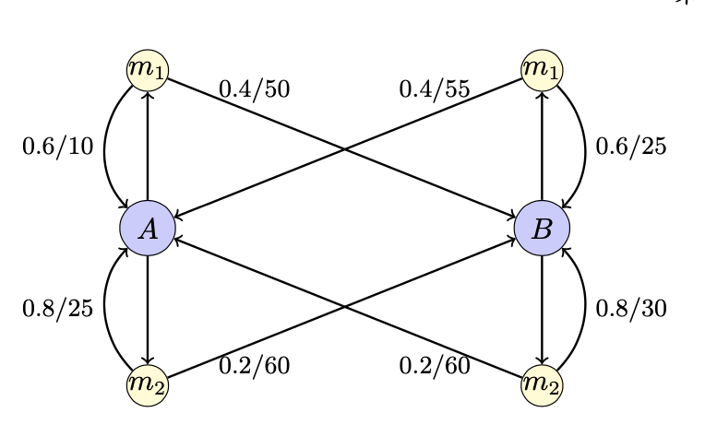
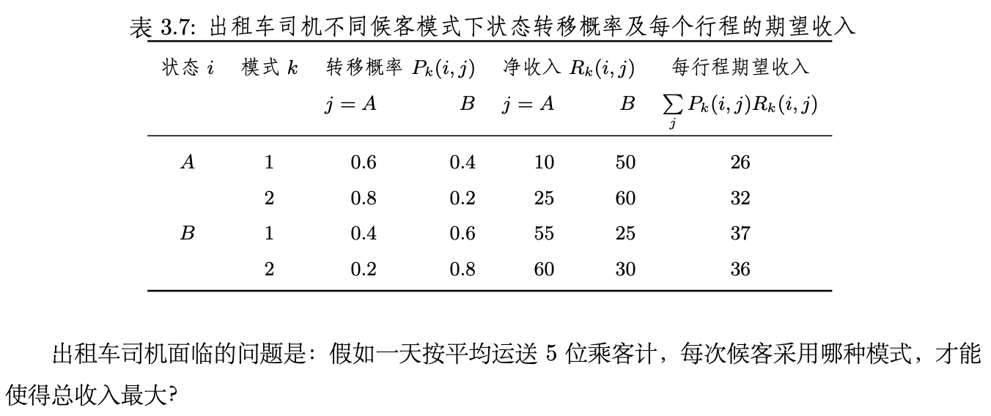
Markov决策过程：示例

Slide 6
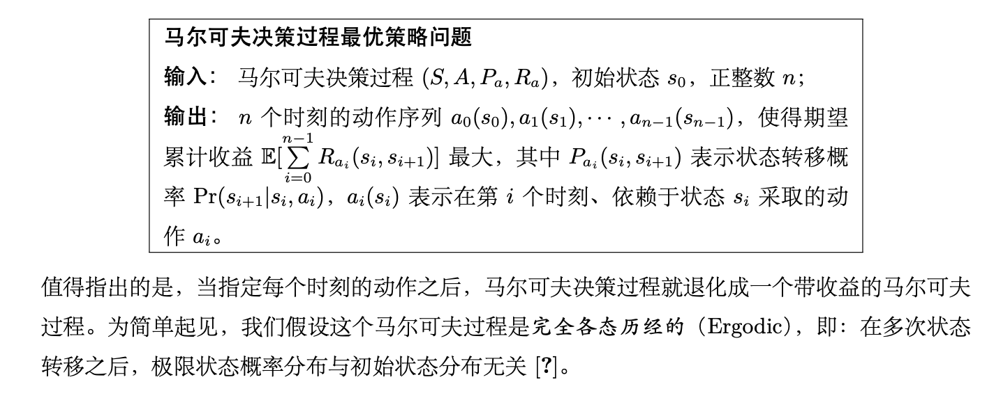
Markov决策过程：形式化定义

Slide 7
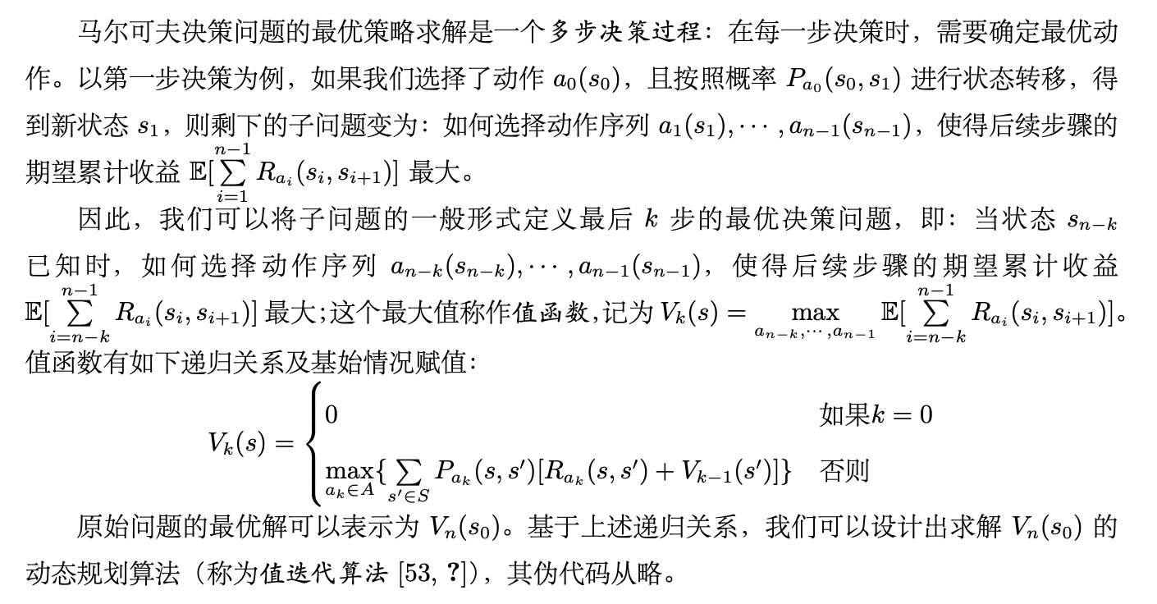
多步决策过程

Slide 8
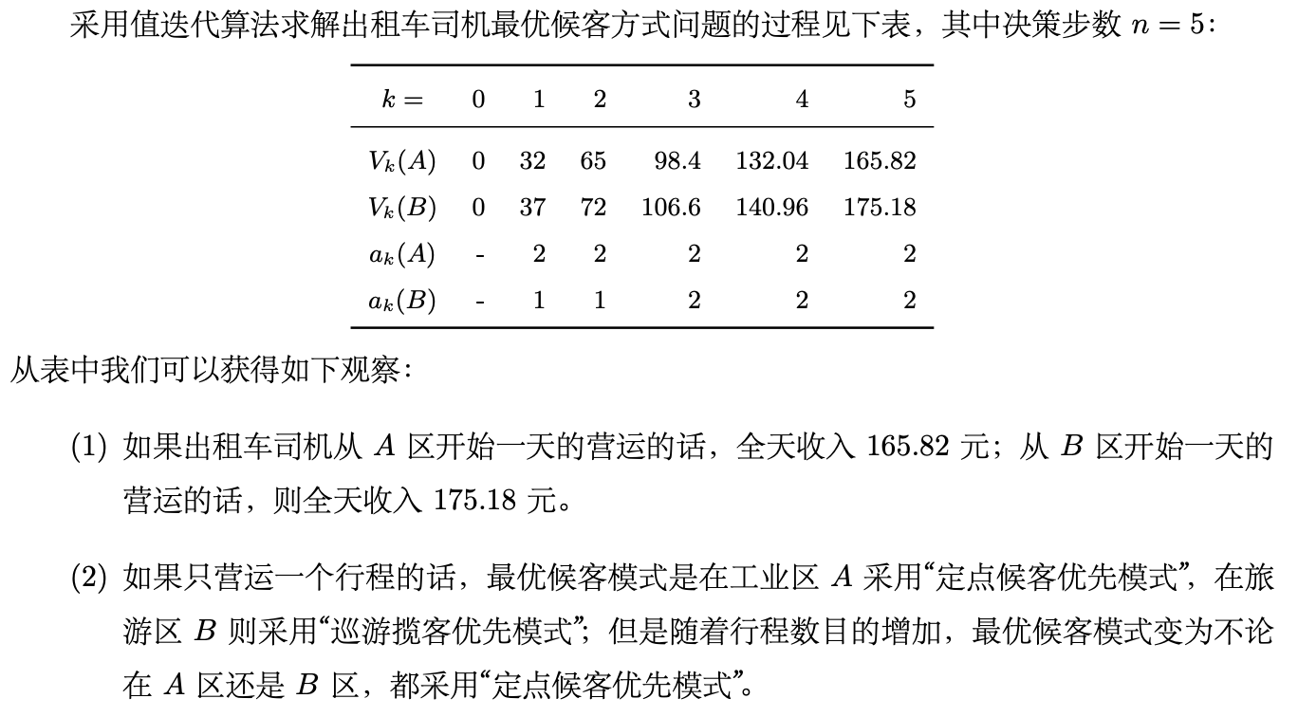
值迭代算法运行过程示例

Slide 9
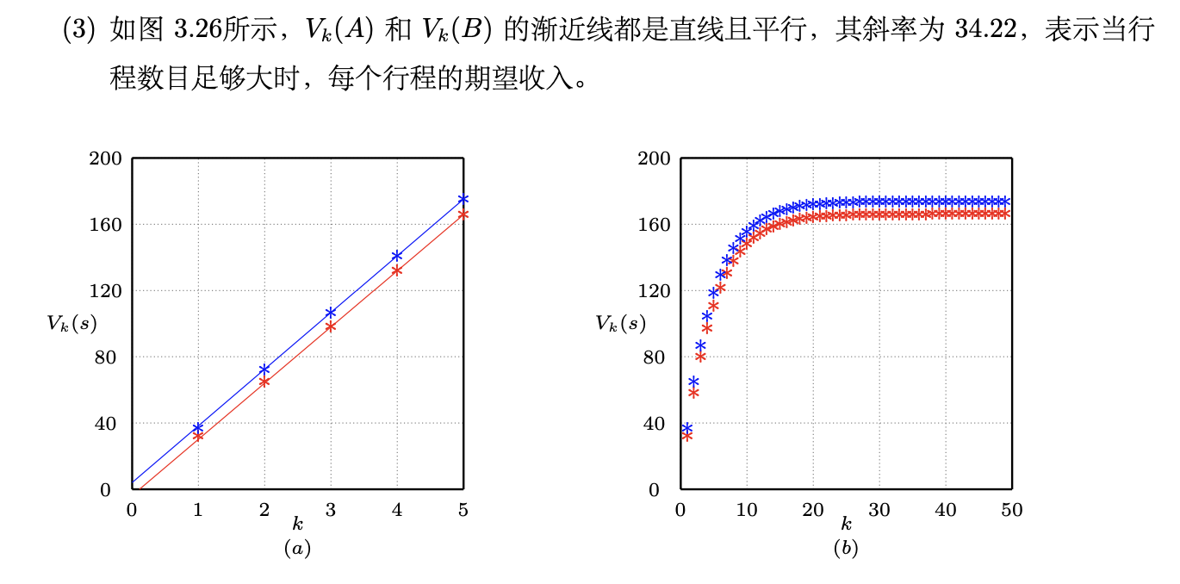
值迭代算法运行过程示例（续）

Slide 10
值迭代算法的缺陷

Slide 11
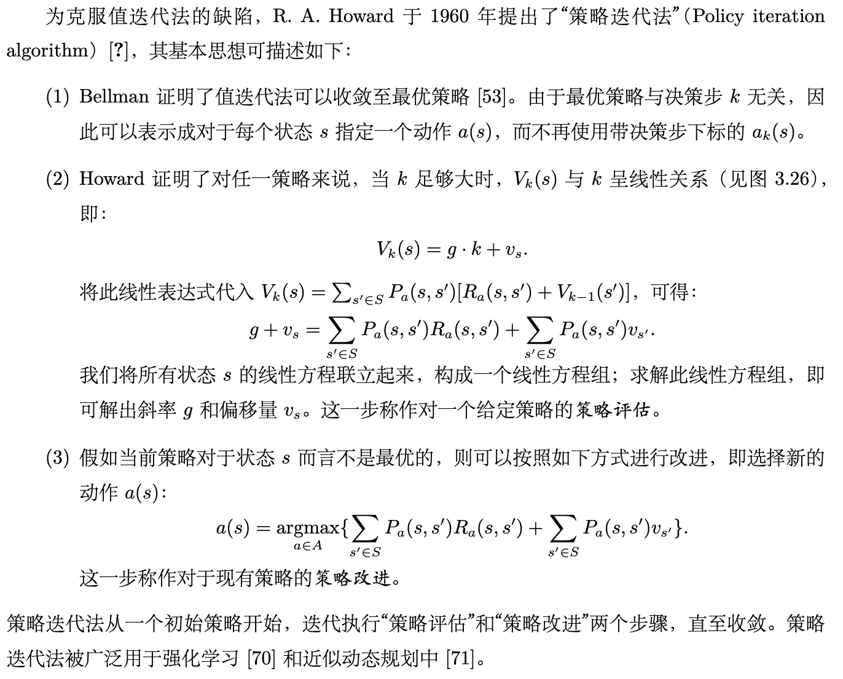
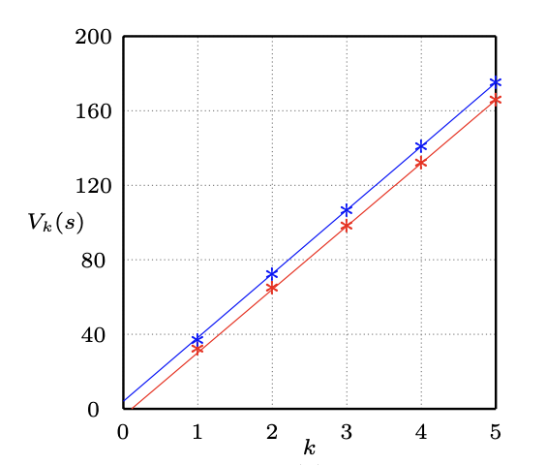
策略迭代算法

