Slide 1
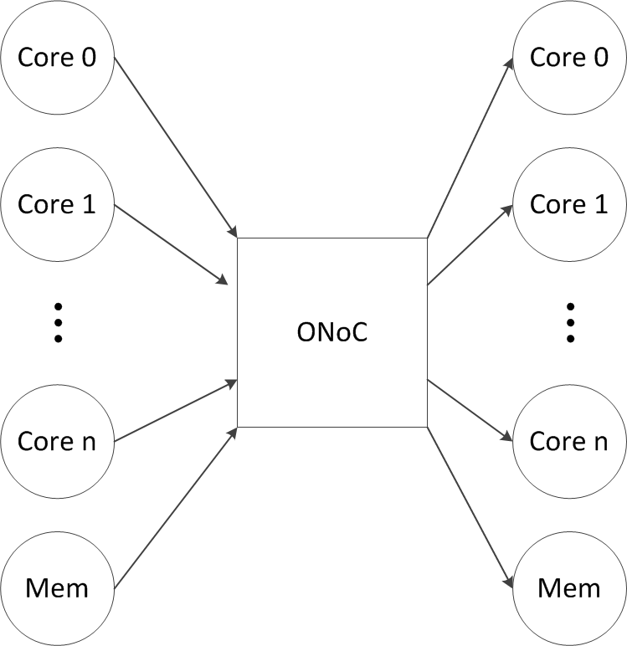
Background
Optical Network-on-Chip
Support the on-chip communication among the cores and the memory
Use optical signals to fulfill the communication rather than the electronic signal
Bandwidth can be dynamically adjusted

Slide 2
Background
Structure of a typical O-NoC link

Slide 3
Problem
The on-chip communication requirement is not always high
Significant busy phase and non-busy phases
The communication requirement pattern is determined by the core execution
Temporal behaviors of NoC and processor cores of the manycore system described in Section VI running benchmark fft. The system has an ideal NoC which has no bandwidth limit. The results are reported at 0.5μs granularity.

Slide 4
Problem
Bandwidth vs. Power Tradeoff in ONoC

Slide 5
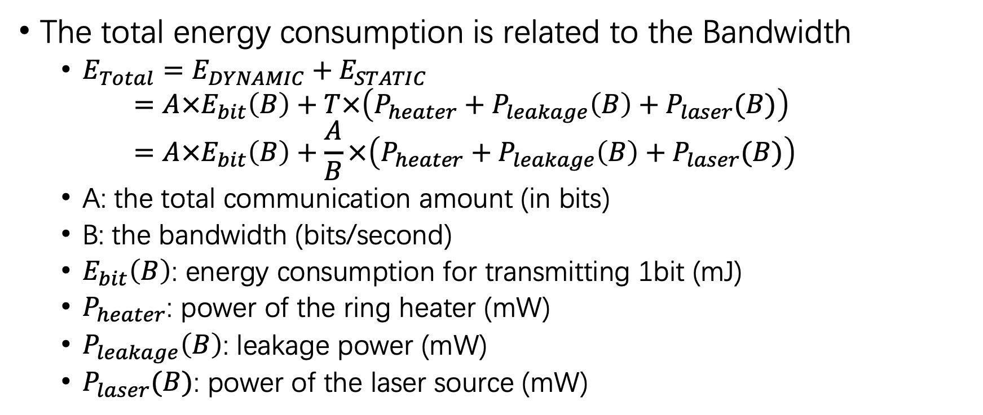
Problem
The total energy consumption is related to the Bandwidth
$E_{Total}=E_{DYNAMIC}+E_{STATIC}$ $=A×E_{bit}\left(B\right)+T×\left(P_{heater}+P_{leakage}\left(B\right)+P_{laser}(B)\right)$ $=A×E_{bit}\left(B\right)+\frac{A}{B}×\left(P_{heater}+P_{leakage}\left(B\right)+P_{laser}(B)\right)$
A: the total communication amount (in bits)
B: the bandwidth (bits/second)
$E_{bit}\left(B\right)$: energy consumption for transmitting 1bit (mJ)
$P_{heater}$: power of the ring heater (mW)
$P_{leakage}\left(B\right)$: leakage power (mW)
$P_{laser}(B)$: power of the laser source (mW)

Slide 6
Problem
Limitation
The total communication requirement is unknown
The near future communication requirement can be predicted with the latest requirement trace
The communication temporal distribution is uneven
Question: how to dynamically tune the Bandwidth, to achieve the best balance of performance and energy consumption?
If the bandwidth is too high, the energy consumption related to Bandwidth will be wasted when the communication requirement is low
If the bandwidth is too low, the total time will increase, leading to the increment of static energy consumption

Slide 7
DP Algorithm
Divide the whole runtime into a series of phases
Sets a series of bandwidth levels
In the start of each phase, predict the communication requirement to see whether the current bandwidth can meet the requirement

Slide 8
DP Algorithm
For case (a), the current bandwidth level is over high, then down-grade to next lower bandwidth level;
For case (b), the current bandwidth level is the proper one, remain current bandwidth in the phase
For case (c), the current bandwidth level is too low, the up-grade to next higher bandwidth level

Slide 9
Simulation Results
Energy Consumption
For static bandwidth configurations, the total energy consumption raises as the bandwidth increases
The dynamic bandwidth tuning mechanism (Shift Link) helps to reduce the energy consumption

Slide 10
Simulation Results
Performance
Comparing with Static- 32G, the Shift Link improves the performance with a geometric mean of 32.0% and up to 41.4% in barnes.
Shft Link bridges most of the performance gap between Static- 128G and Static-96G: as a geometric mean, the performance of Shift Link is only 5.7% inferior than the Static-128G.

