Slide 1
Minmax theorem and LP formulation

Slide 2



Zero-sum game: presidential election

Slide 3
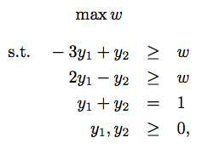
Zero-sum game: primal problem

Slide 4
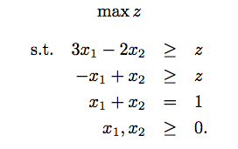
Zero-sum game: dual problem

