Slide 1
Acknowledgements

Slide 2
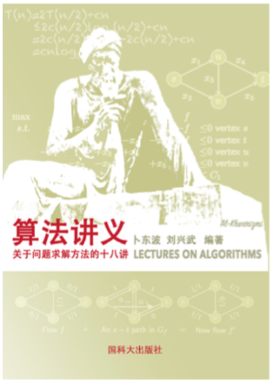
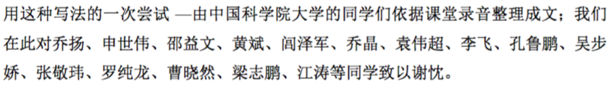
Thanks the scribes

Slide 3
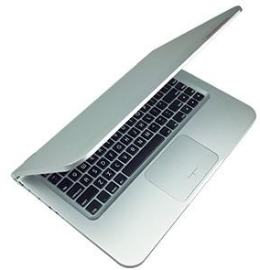
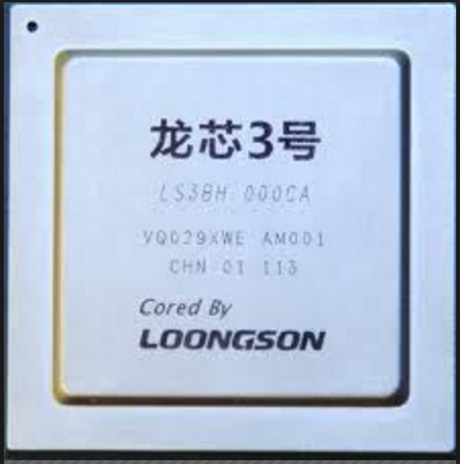
Thanks Loongson
These software run smoothly on Loongson!
Text processing:
TexShop, Latex,…
Word, Powerpoint, evinve, ...
Mathematical packages:
GLPK
Octave (MatLab)
Image processing:
GIMP, gnuplot, ….
Programming languages:
Python, perl, gcc, g++, ...
.....

Slide 4
Thanks for you all!

