Slide 1
Health Care Intelligence
Abhiram - 1602-17-737-004
Sai Prakash - 1602-17-737-039
Suraj - 1602-17-737-052
Mentor: B.Jatin - 1602-16-737-059

Slide 2


OBJECTIVE
Our main objective is to PREDICT chronic/pandemic diseases from electronic health data.
We analyse huge datasets of a disease consisting of various symptoms and predict it in a particular patient.

Slide 3
Problem Statement
Earlier prediction of pandemic/deadly diseases like Ebola/Corona in a patient with the help of large datasets by matching symptoms.

Slide 4



Technology Stack

Slide 5
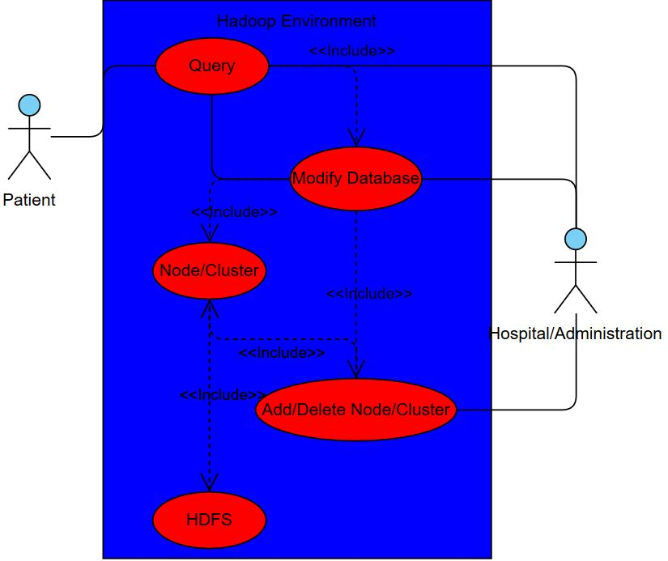
Use Case Diagram

Slide 6
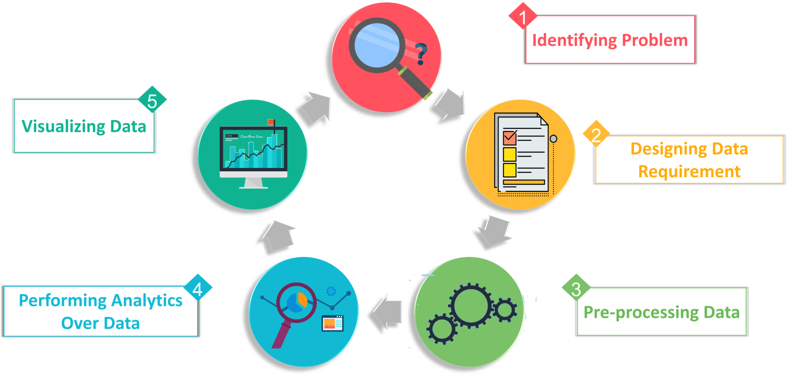
Implementation Methods

