Slide 1
E-Health - Image Preparation for Machine Learning
Students: Vu Hoang Minh, Yeman Brhane Hagos
Supervisors: Prof. Robert Martí, Prof. Oliver Díaz

Slide 2
Outline
Introduction
Objective
Dataset
Our Software
Libraries Used
Software Components
Result and Discussion
Conclusion
Demo

Slide 3
Introduction
Machine learning (ML) applies algorithms to learn from data
Data quality is an important component of ML tools
The quality of our data should be carefully considered when developing and using these tools
The more well-prepared data, the better the results

Slide 4
Introduction
Getting data ready for a ML technique
Data collection and selection
Image preprocessing
Image augmentation
Data collection and selection
What data you need to tackle your problem?
What features you need to extract?
What data you have?
What data you don’t have and you want to have them?

Slide 5
Introduction
Image preprocessing
Histogram matching
Histogram equalization
Denoising
Normalization
Sampling
Patch extraction
Image Augmentation
Prevent overfitting and increase generalization
Rotation invariance
Rotation, scaling, zooming,…

Slide 6
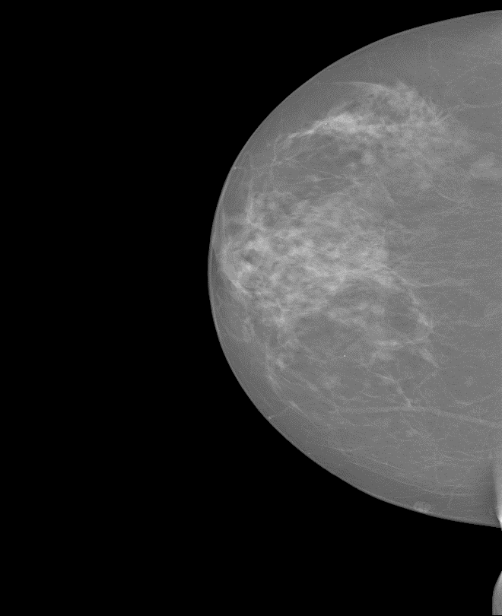

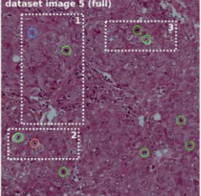

Objective
To develop a software that contains the most commonly used image preprocessing and augmentation techniques in ML and deep learning

Slide 7
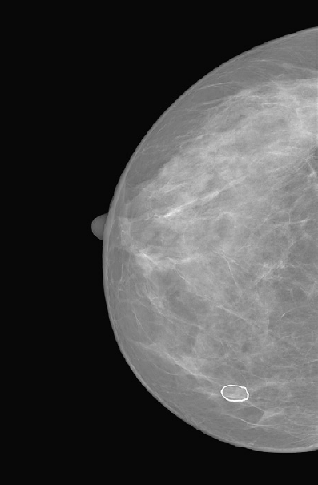
Dataset
INBREAST mammogram dataset
2D DICOM images
Normal mammograms and
Mammograms with
Masses
Calcifications
Architectural distortions
Asymmetries and
Images with multiple findings.
Groundtruth
Extensible Markup Language (XML) file: center + contour + other information

Slide 8
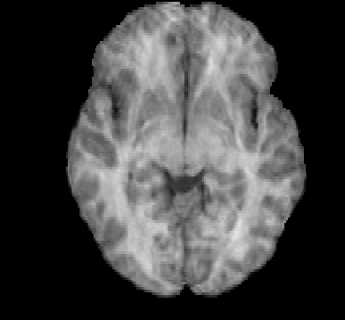
Dataset
IBSR18 dataset
Brain tissue segmentation
Groundtruth
Cerebrospinal fluid (CSF)
Gray matter (GM)
White matter (WM)

Slide 9
Libraries Used
Python libraries used
PyQt5: build GUI
NiBabel: read and write .nii file
Pydicom: read dicom files
OpenCV: image processing
Qimage2ndarray: Numpy array to Qimages
ElementTree XML API: parsing, modify and save XML data.

Slide 10
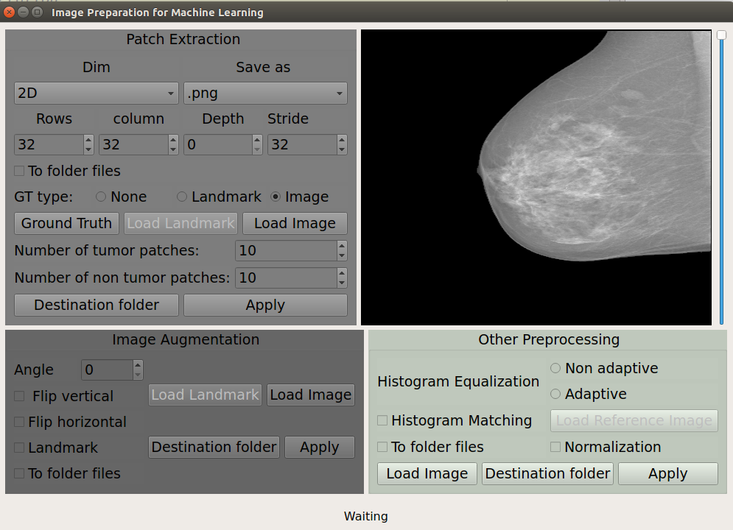
Software Components
Patch
Extraction
Visualizer
Contrast Enhancement
Augmentation
Status bar

Slide 11
Software Components : Patch Extraction
Patch Extraction
2D, 3D, 2.5D Patch
Patch dimension
Different ground truth types
Number of patches control
Batch processing

Slide 12
Software Components : Patch Extraction
Patch Extraction
2D, 3D, 2.5D Patch
Patch dimension
Different ground truth types
Number of patches control
Batch processing

Slide 13
Software Components: Patch Extraction
Patch Extraction
2D, 3D, 2.5D Patch
Patch dimension
Different ground truth types
Batch processing
Number of patches control

Slide 14
Software Components: Patch Extraction
Patch Extraction
2D, 3D, 2.5D Patch
Patch dimension
Different ground truth types
Batch processing
Number of patches control

Slide 15
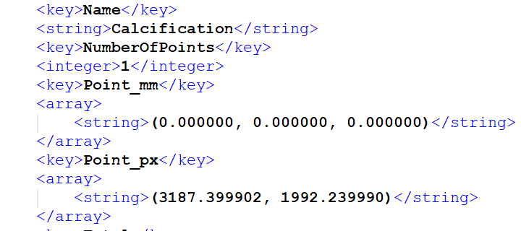
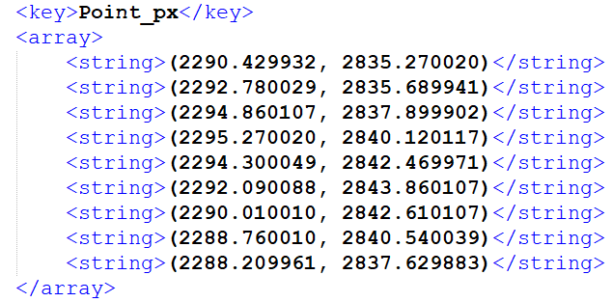
Software Components : Patch Extraction
Using XML data to extract patches

Slide 16

Software Components : Patch Extraction
Landmark groundtruth
Center of tumors
Contour of tumor
How to extract non tumor patches?
Euclidean distance
P is a point in side ROI part of the image and L is a set of landmark points

Slide 17
Software Components: Visualizer
Visualization:
QLable
+
Slider

Slide 18
Software Components: Contrast Enhancement
Histogram equalization
Histogram Matching
Normalization
Batch processing
Contrast Enhancement

Slide 19
Software Components : Image Augmentation
Rotation and Flipping
Image and landmarks
Batch processing
Image Augmentation

Slide 20
Software Components: Image Augmentation
Rotation and Flipping
Image and landmarks
Batch processing
Image Augmentation

Slide 21
Software Components: Image Augmentation
Transformation of image and landmark
Center of tumors
Contour of tumor
Angle
T
T(Image)
Augmented Image
L?
T - Transformation Matrix
L - Landmark
T(L)
Augmented Landmark

Slide 22




Results and Discussion: Patch Extraction
Patches with Calcification
Patches with Mass
Normal patches
Original image

Slide 23
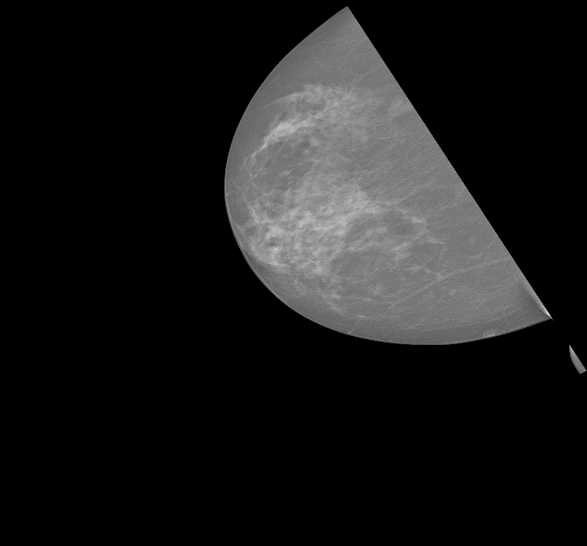
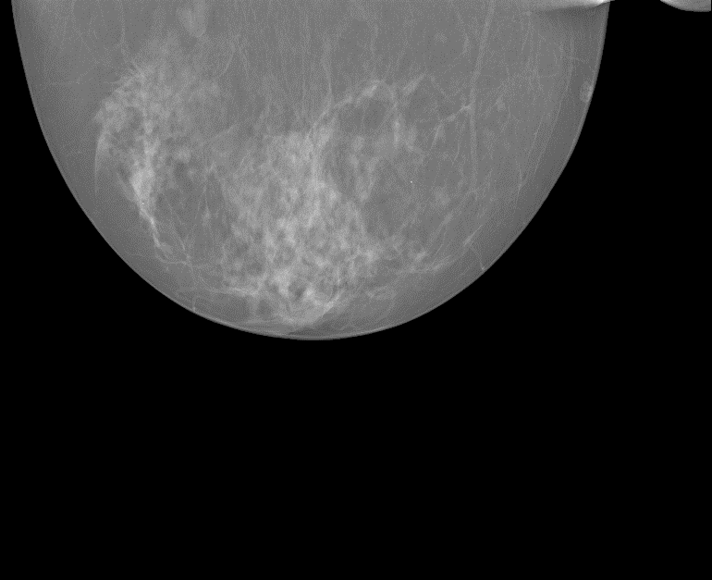
Results and Discussion: Image Augmentation
Rotated Images
Original image

Slide 24
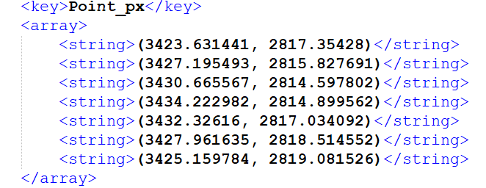
Results and Discussion: Image Augmentation
Original
Rotation by 30⁰
Augmented

Slide 25

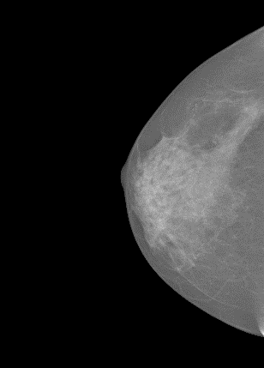
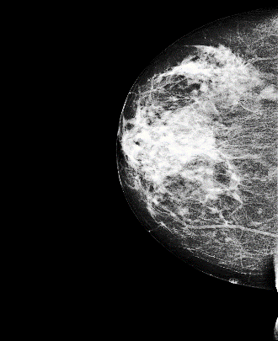
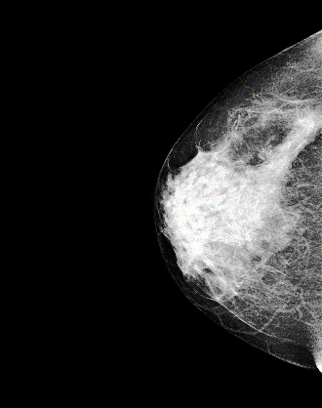
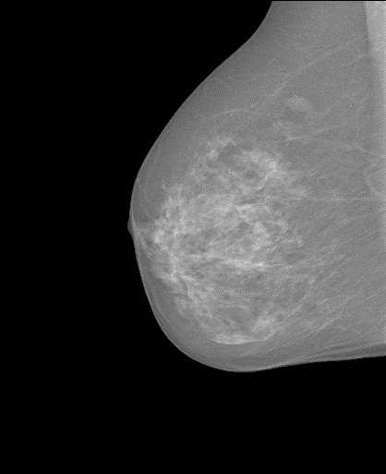
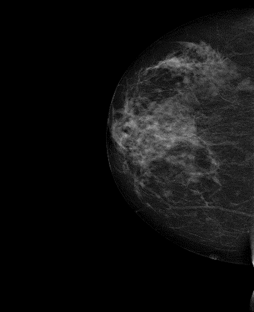
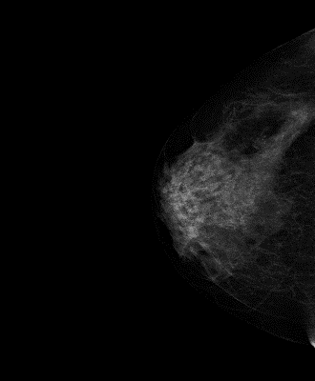
Results and Discussion: Contrast Enhancement
Original
Template image
Hist Eq
Hist match

Slide 26
Conclusion
We have developed a software that contains patch extraction, image augmentation, and image contrast enhancement techniques
Tested on 2D, 3D images and images with landmark
Modular python object oriented is developed and easy to continue the work to include more functionalities

Slide 27
Questions?

Slide 28
Thank you for listening!

