Slide 1
Pectoral Muscle Segmentation in Digital Mammograms
University of Cassino and Southern Lazio
Medical Imaging and Application (MAIA)
Advanced Image Analysis
Yeman Brhane
Vu Hoang Minh
Tajwar Abrar Aleef
Professor: Alessandro Bria

Slide 2
Implementation: Approach
Matlab
Prototype
Opencv
Final Implementation

Slide 3
Implementation: Flowchart
Input Images
ROI extraction
Gaussian smoothing
Canny edge detection
Segmented Image
Triangular Filter
Curve fitting

Slide 4

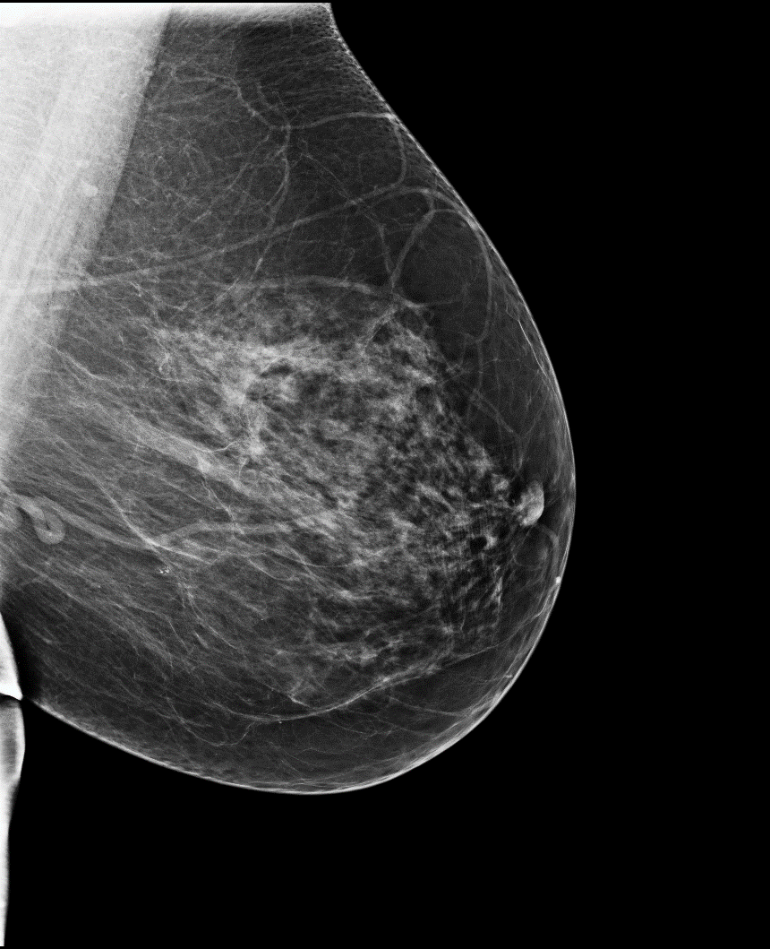
…Implementation
C
C
0.65R
ROI
R

Slide 5
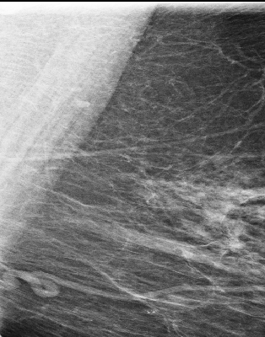

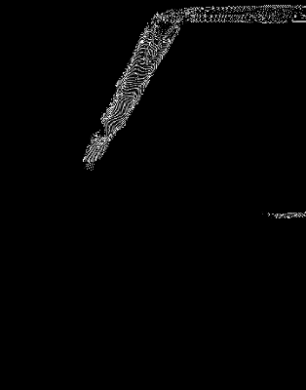
…Implementation
Canny edge
detection
lowThresh= 2.2
ROI
Gaussian
Smoothing
Sigma = 54

Slide 6
…Implementation
Triangular Filter
Suppress lower right triangle
Trace every column of the image and take the last row non zero pixel value

Slide 7
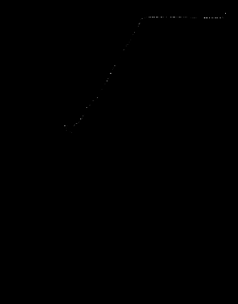
…Implementation

Slide 8
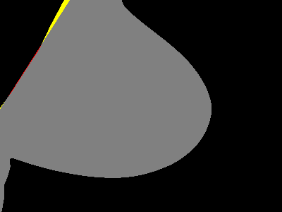

…Implementation
Apply curve fitting on the previous detected points

Slide 9
…Implementation
Average accuracy is 98.277%

