Slide 1
project-machine
Matt K, Adeyemi T, Colin C

Slide 2
Motivation and Summary
Cryptocurrency prices have been notoriously hard to predict. Since humans have struggled, we were curious if machines would have better success.
Our project was to evaluate if we could use machine learning to profit from trading Ethereum using three different models: a Prophet forecast model; a Support Vector Machine model; and a Long Short-Term Memory network (a type of recurrent neural network).

Slide 3
Model Summary
Prophet Forecast
Prophet is fairly simple to use when working with time series data, it is easily interpreted with simple visualizations and picks up on trends while handling outliers well.
SVM Model
Using an SVM model allowed us to use moving averages to generate buy/sell signals since SVM models can handle multiple features.
LSTM Model
Long Short-Term models can be used for time series forecasting and are particularly good with volatile series as they can capture short-term patterns but also long-term relationships.

Slide 4
Pre-Processing
Exploration and cleanup process
Selecting the right date range and source for data (with recent prices)
For SVM, calculate returns, SMAs, shift the data, scale the data
For LSTM, had to create window size, scale and reshape the data
Problems that arose
Date range: couldn’t use data too far back
Trickier preparing the data for LSTM
Items of interest
All three models took under a minute to train
SVM was the most complex in determining the inputs
Somewhat of a struggle knowing what the exact application would be

Slide 5
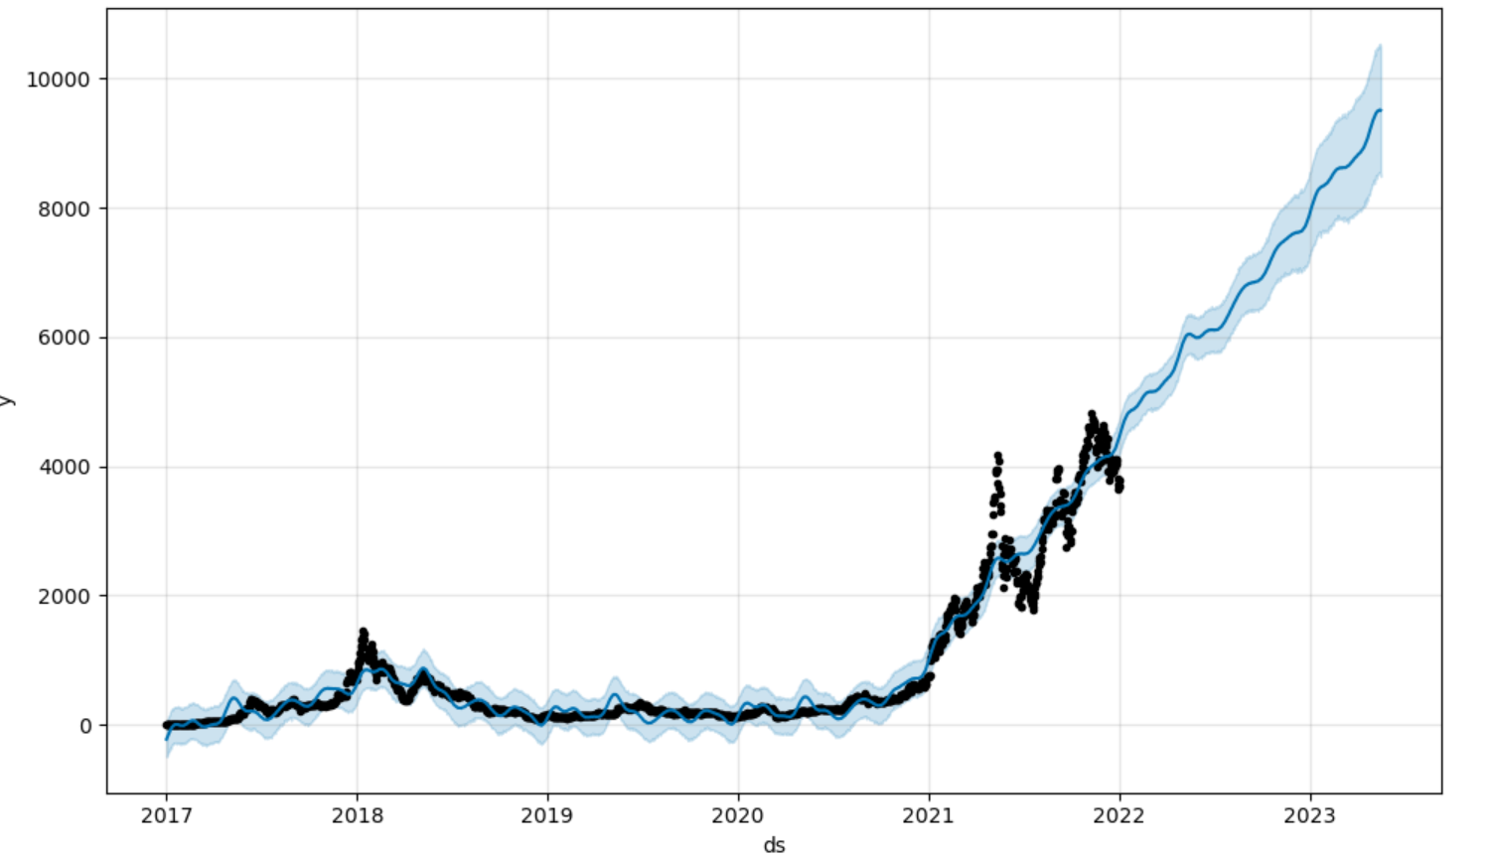
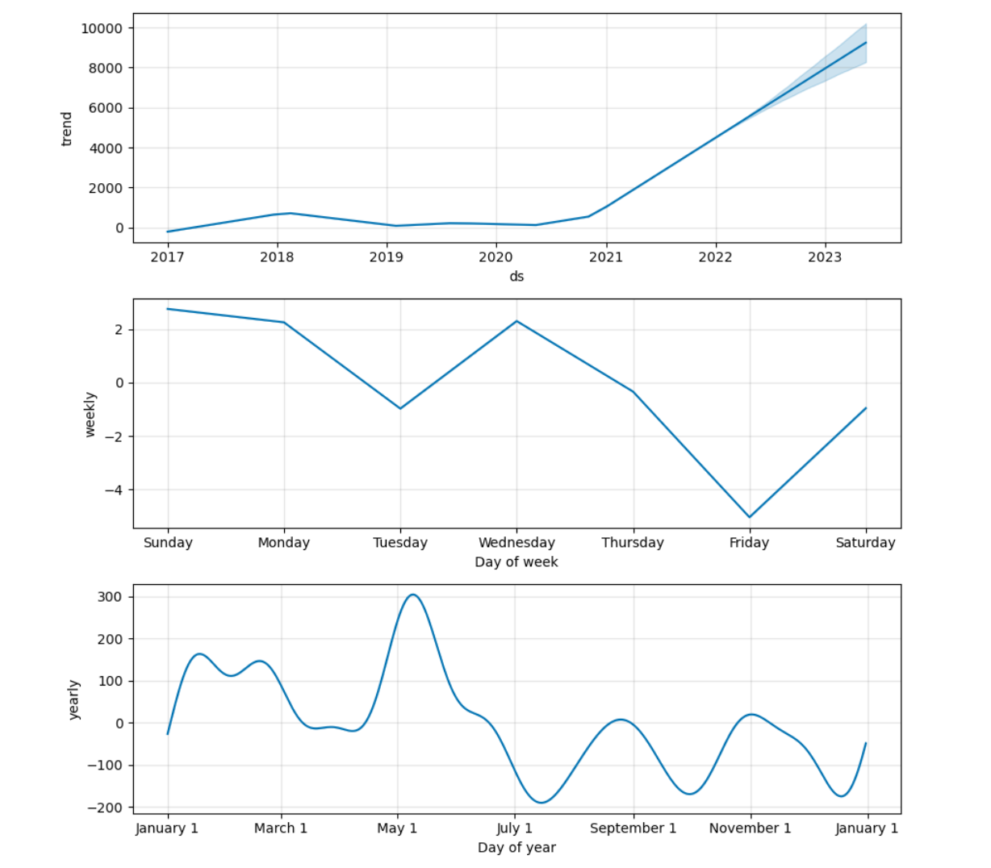
PROPHET

Slide 6
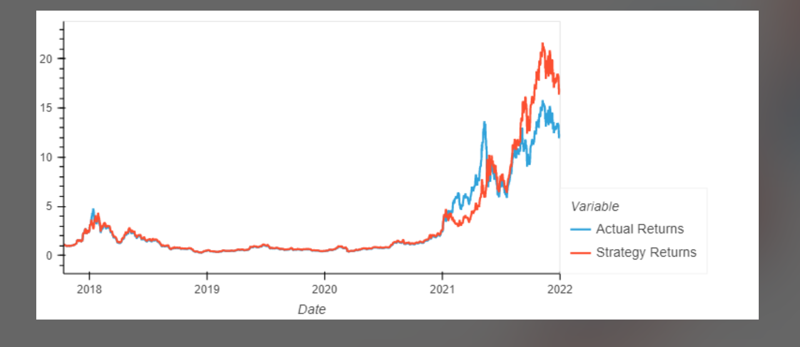
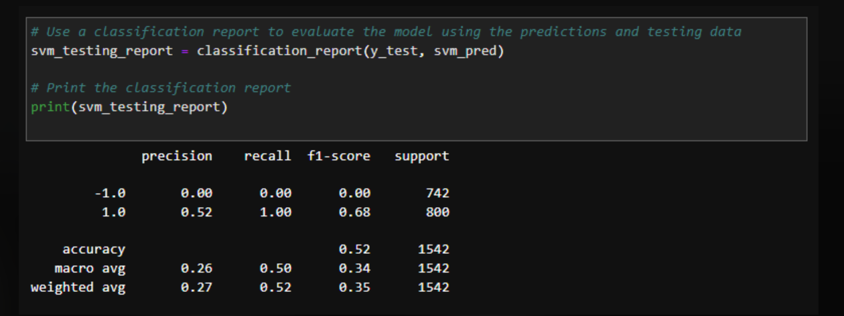
SVM

Slide 7
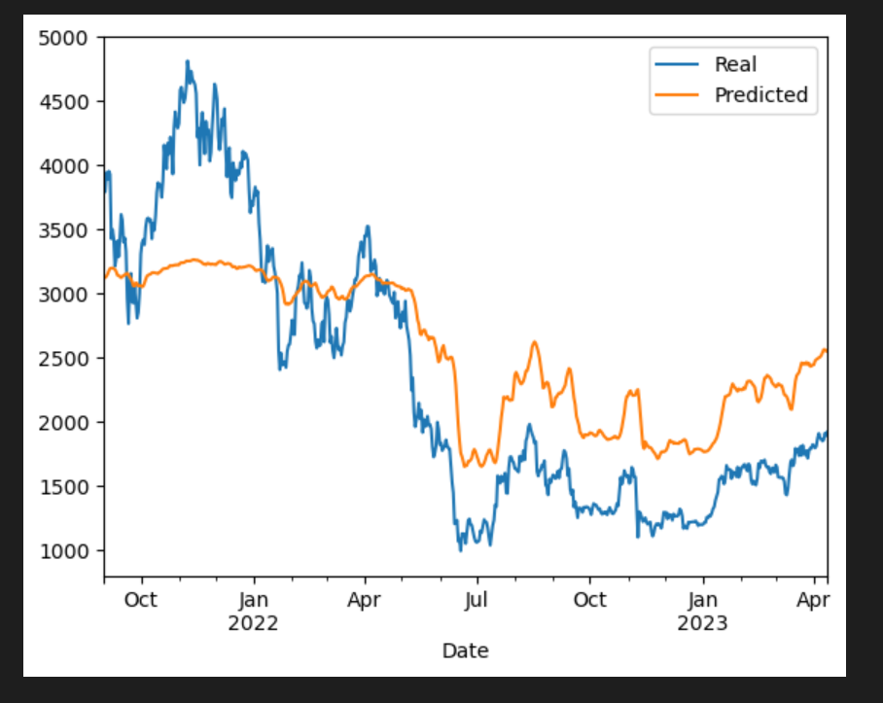
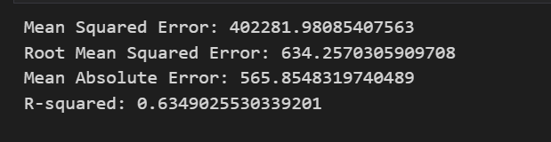
LSTM

Slide 8
Conclusion
Click for the project repo!
All three models are informative but each have their own flaws to consider before trading with real money. The Prophet model produced a tight fit, but its future prediction is questionable. The SVM produced a profitable strategy but it is unclear how sustainable it would be. The LSTM produced a respectable R^2, but it didn’t do well during periods of high volatility.

Slide 9
Postmortem
Difficulties that arose
Determining which models would be best suited for our purposes
Determining the appropriate time range
Determining the right inputs for new models (LSTM)
What we would research next
Using hourly data
Playing with different inputs to predict Ethereum prices (beyond SMAs and time series)
Exploring other models

Slide 10
Questions?

