Slide 1
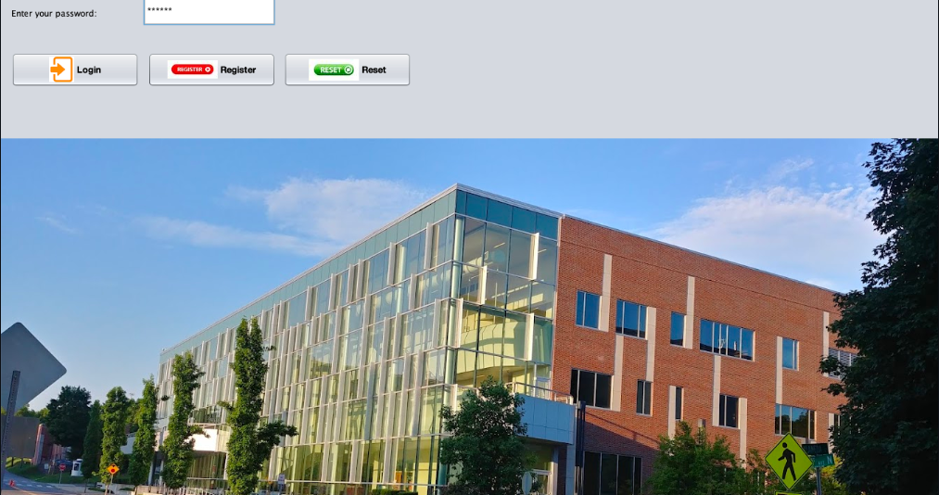

End-to-end analytics workflow
FINAL PROJECT PRESENTATION
Java Swing client for login, registration, upload, and analysis requests
Java socket server to receive CSV files and load MySQL tables
Python analytics engine to generate charts and a PDF report
GitHub submission repository for final deliverables
Distributed Aviation
Disruption Analytics System
Presentation focus: architecture, workflow, results, and roadblocks resolved
Meharry Medical College
MSDS535 • Further Programming Languages for Data Science
Student: Opeyemi Omotosho
Major: Masters of Science in Artificial Intelligence
Notes:
Open by framing the project as a distributed data application that integrates Java, MySQL, Python, and reporting. Mention that the screenshots come from the final working system and that the presentation will cover architecture, workflow, findings, and debugging lessons. [Sources] - User-provided screenshots and report text from this conversation. [/Sources]

Slide 2
System Architecture
How data moves from the desktop UI to the final analytics report
Java Client UI
Socket Server
MySQL
Python Analytics
PDF Report
Login • Register
Upload CSV • Analyze
Receives files
Handles commands
aviationDB
6 tables
pandas • matplotlib
fpdf
Insights + charts
Download to client
Why this architecture worked
Core artifacts
Clear separation of concerns across UI, transport, storage, analytics, and reporting
CSV uploads populate the exact database tables expected by the analytics script
The server coordinates Java + Python execution while keeping the workflow simple
Java source: Login.java, Register.java, AviationClientApp.java, AviationServerApp.java, Conn.java
Python: aviation_analysis.py
SQL: my_aviationDB.sql
Output: aviation_report.pdf
Notes:
Explain the sequence from client to server to database to Python and finally back to the client as a report. Emphasize that the architecture kept each layer focused on a single responsibility, which made debugging easier when issues appeared. [Sources] - User-provided screenshots and report text from this conversation. [/Sources]

Slide 3
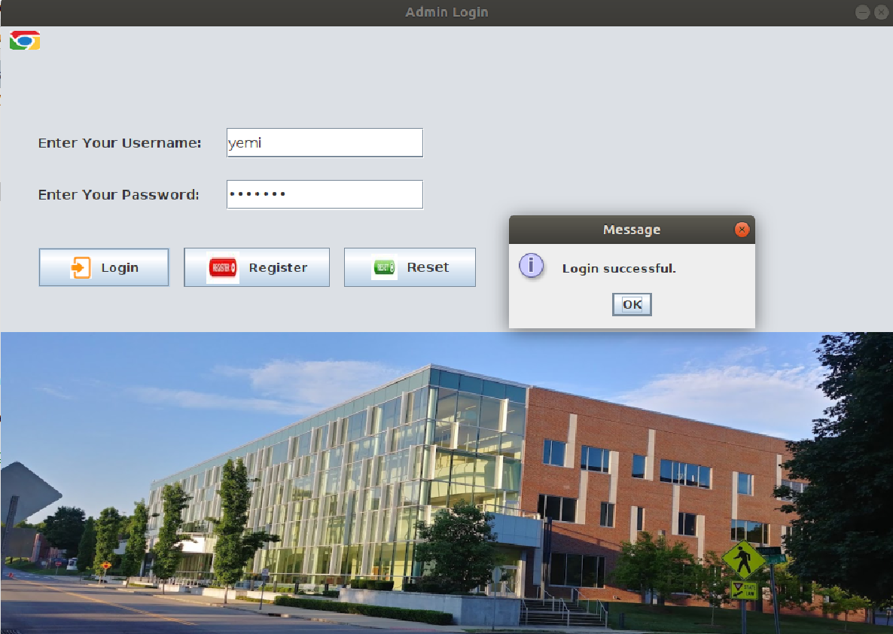
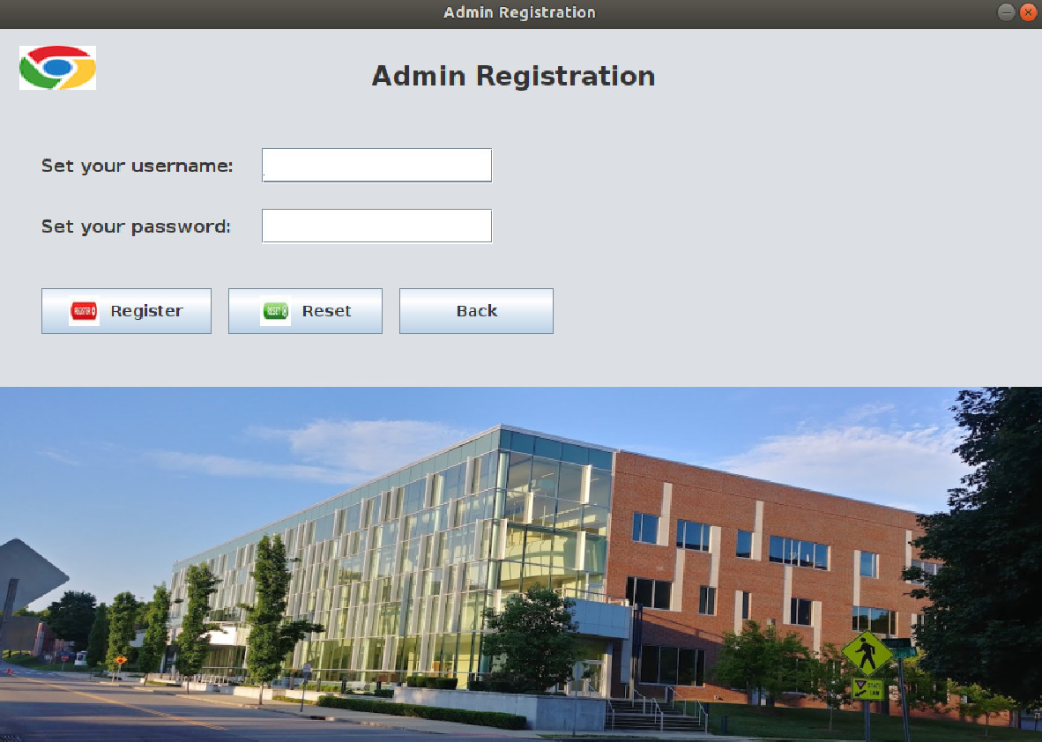
Desktop UI walkthrough
Login and registration screens built in Java Swing
Login screen
Registration screen
Users can create credentials, then log in and access the client workflow.
Notes:
Walk through the entry point of the system. Mention that both screens were implemented in Java Swing, and that registration had to be debugged early because the client database connection initially returned null before the connector and connection logic were corrected. [Sources] - User-provided screenshots and report text from this conversation. [/Sources]

Slide 4
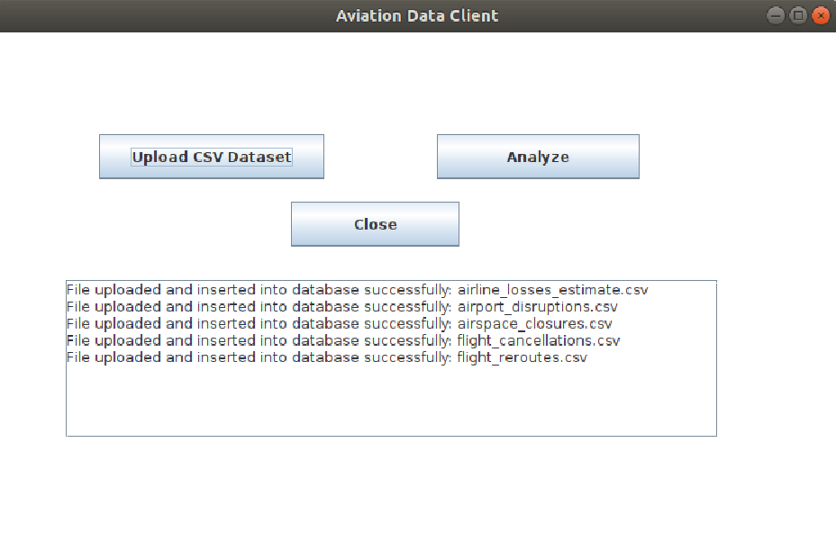
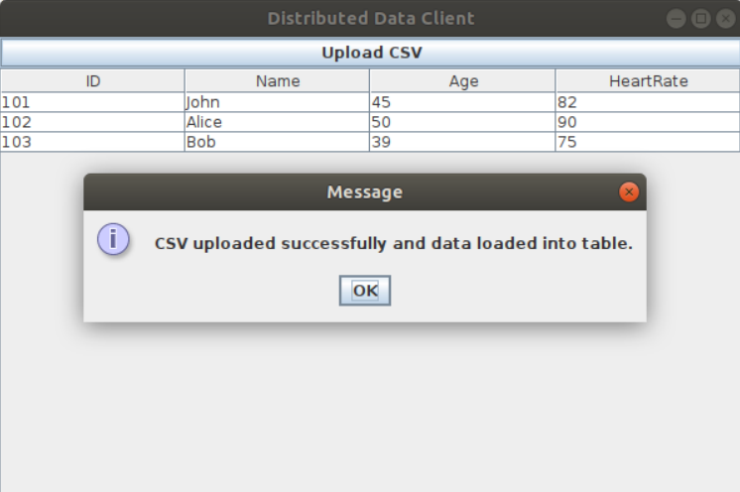
Operational workflow
From CSV upload to report download
1
2
3
4
5
Authenticate
Upload datasets
Load MySQL tables
Run Python analysis
Download report
Upload stage
Client success state
All five datasets loaded and the report path returned to the client.
Notes:
Describe the happy-path workflow. After login, the user uploads the five CSV files one at a time, the server inserts rows into MySQL, the Analyze button triggers Python, and the completed PDF report is returned to the client. [Sources] - User-provided screenshots and report text from this conversation. [/Sources]

Slide 5
Key analytics findings
Summary metrics pulled from the final PDF report
Total flight cancellations
Top airline by cancellations
Top airport by cancellations
50
Emirates (6)
Dubai International
(DXB) (10)
Top cancellation reason
Average reroute delay
Estimated daily loss
Airspace closure –
Iranian FIR (4)
65.47 minutes
$48.84M
Interpretation: Disruptions were concentrated around a small set of airlines and major hubs, with airspace closures and precautionary restrictions driving the largest share of cancellations.
Notes:
Present the report summary as the project’s business insight. Emphasize that the report quantified both operational disruption and financial impact, which is why the combined Java-MySQL-Python pipeline matters. [Sources] - User-provided report text in the conversation, including the executive summary values and findings. [/Sources]

Slide 6
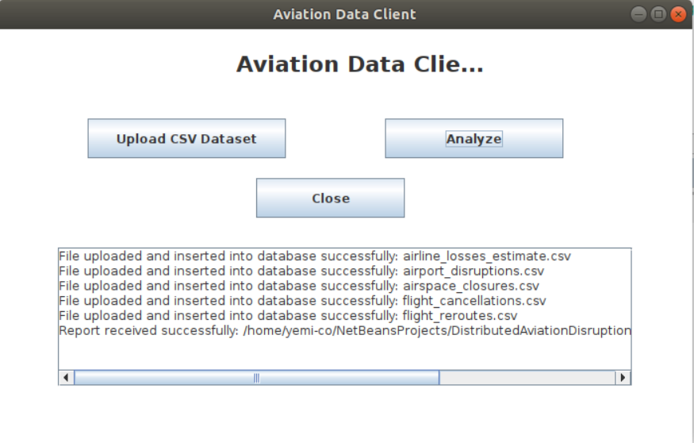
Roadblocks and how they were resolved
The biggest issues were environment alignment, data handling, and repo workflow
1) Registration failed (null DB connection)
Other blockers and fixes
CSV upload produced EOFException when the server crashed before sending a reply. Fixed by validating files and returning readable upload errors.
One CSV upload failed because the file was empty. Replaced the bad file and kept the server-side empty-file check.
Python analysis failed because mysql.connector and the Ubuntu/Python version were incompatible. Switched to a pure-Python driver approach and stabilized the runtime.
GitHub updates were confusing because pushes were happening from the wrong folder. Fixed by identifying the correct Git-connected folder and updating that repository path.
Fix: corrected JDBC connector setup, aligned the password in Conn.java, and added null-checks before prepared statements.
Notes:
This is the debugging slide. Explain that most of the effort went into integration issues rather than business logic. The key lesson was to test each layer separately: database, Java connection, upload flow, Python analytics, and Git repository state. [Sources] - User-provided screenshots and report text from this conversation. [/Sources]

Slide 7
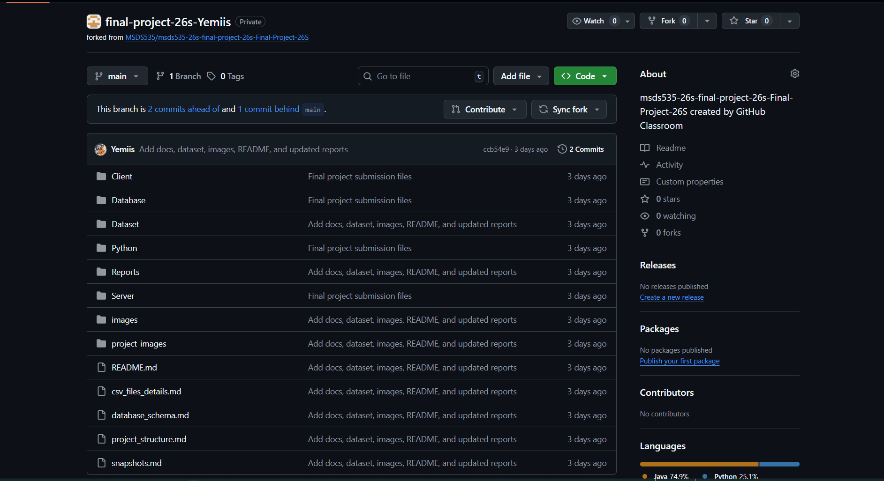
Deliverables and submission status
The final project artifacts are packaged for class submission and presentation
Final deliverables
Submission repository snapshot
Java source code: Login.java, Register.java, AviationClientApp.java, AviationServerApp.java, Conn.java
Python analytics script: aviation_analysis.py
SQL schema: my_aviationDB.sql
Generated report: aviation_report.pdf
Supporting assets: Dataset, images, project-images, docs, README
Repository update lesson:
The correct approach was to update the Git-connected submission folder first, then commit and push that folder to GitHub.
Notes:
Close the implementation story by showing the deliverables and the GitHub submission target. Mention that repository synchronization itself was one of the roadblocks, and that the final solution was to update the already connected submission folder before pushing. [Sources] - User-provided screenshots and report text from this conversation. [/Sources]

Slide 8
Conclusion and next improvements
What this project demonstrates and how it could be extended
What the project demonstrates
Next improvements
Integration of Java, MySQL, Python, and GitHub into one distributed workflow
A practical client/server pattern for ingesting and analyzing tabular data
A complete pipeline from raw CSVs to an executive-style PDF report
Real debugging experience across UI, database, runtime, and deployment layers
Package the app with clearer installation/setup instructions
Add stronger logging and exception reporting across Java and Python
Improve the UI polish and automate multi-file uploads
Extend analytics with trend analysis and dashboard-style views
Final Outcome: the system successfully uploads datasets, loads MySQL, runs analytics, generates a PDF, and returns the report to the client.
Notes:
End by emphasizing that the project is successful not just because the final output works, but because the full pipeline was debugged and stabilized. If time allows, mention one or two future improvements that would make the system more production-ready. [Sources] - User-provided screenshots and report text from this conversation. [/Sources]

