Slide 1
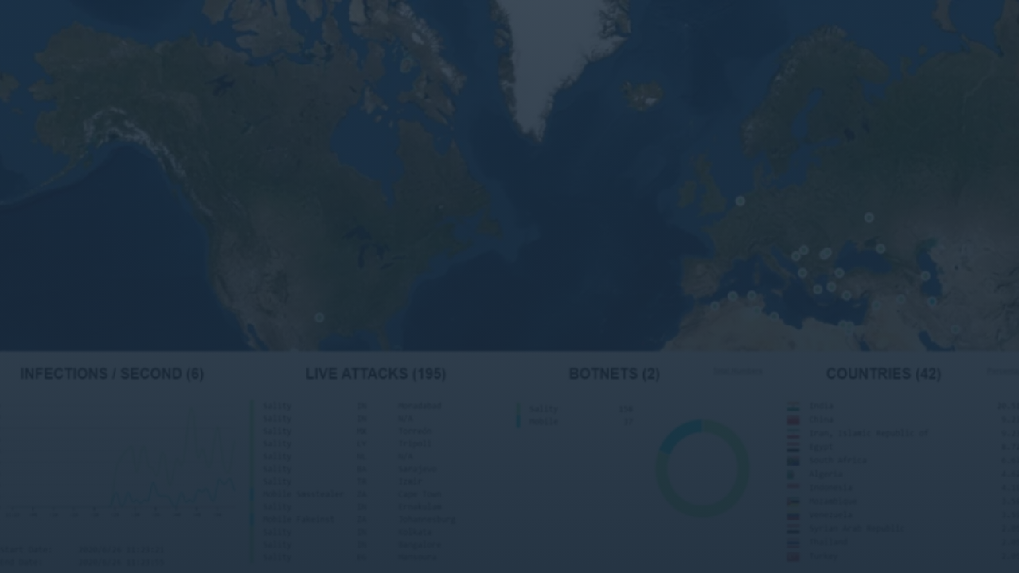
SOC Analysis Capstone Project Report
Simulating Attacks and Writing a SOC Report for MMCTech
Prepared by: Yemisi M. Adeleye
July 11, 2025

Slide 2


Executive Summary
MMCTech
is a mid-sized technology consulting firm providing
cloud services, web hosting, and IT support to small
businesses across Africa.
Network login irregularities
were detected within the Local
Area Network (LAN), prompting a formal investigation and
analysis.
Simulations were conducted to understand attack patterns
and test security controls using
Windows 10
and
Ubuntu
as
endpoints,
Kali Linux
as the attacking device, and
Wazuh
SIEM
for monitoring.
Key findings:
Successful detection of reconnaissance and
brute-force attempts, implementation of blocking measures,
and identification of security improvement opportunities.

Slide 3










Project Objectives
Simulate cyberattacks to analyze behavior patterns and understand attack methodologies
Primary Tools Used
Identify vulnerabilities in network infrastructure and endpoint security
Kali Linux
Windows 10
Attack simulation
Target endpoint
Ubuntu Linux
Wazuh SIEM
Test detection capabilities of security monitoring tools in a controlled environment
Target endpoint
Security monitoring
pfSense
Nmap & Hydra
Network segmentation
Scanning & brute-force
Develop and recommend protections and security improvements based on findings

Slide 4








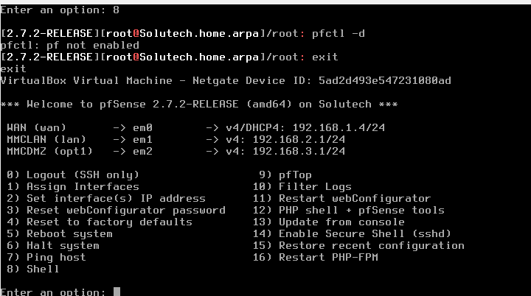

Case Study Overview & Problem Statement
Company Profile
MMCTech is a mid-sized technology consulting firm providing cloud services, web hosting, and IT support to small businesses across Africa. With recent growth in remote access, the company has become increasingly concerned about cyberattacks.
Security Concerns
MMCtech must ensure the continuous availability, integrity, and
confidentiality of its internal services and client data by
Problem Statement
monitoring:
Internal and external login attempts
MMCtech's Wazuh dashboard has detected irregular behavior on several endpoints, including failed login attempts and unusual traffic from an internal IP address.
Exploitable web servers
Brute-force attacks
Unauthorized access to shared resources
Pfsense Network Segmentation
Project Rationale
This project strengthens MMCtech's cybersecurity posture by developing practical skills of SOC Analysts in a controlled environment, supporting the business's ability to detect and mitigate real-world incidents.
Pfsense image of network segementation

Slide 5





Tools and Technologies Used
Kali Linux
Ubuntu Linux
Penetration testing distribution with pre-installed security tools for ethical hacking and security assessments.
Linux distribution serving as a target endpoint with various services installed for testing.
Used for: Attack simulation, port scanning, brute-force attempts
Used for: Target endpoint with Apache, SSH services
Windows 10
Wazuh SIEM
Microsoft operating system serving as a target endpoint with various services for testing.
Security Information and Event Management solution for real-time monitoring and alert detection.
Common Cybersecurity Tool Logos
Used for: Target endpoint with FileZilla services
Used for: Log analysis, alert generation, security monitoring

Slide 6
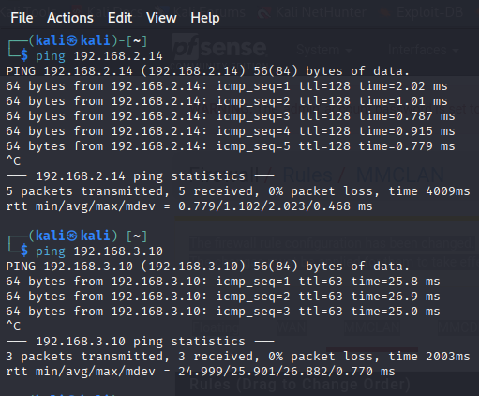
Network Setup & Simulation Environment
IP Address Configuration
Network Communication
Machine
IP Address
Role
Windows
192.168.2.14
Target Endpoint
Ubuntu
192.168.3.10
Target Endpoint
Wazuh
192.168.2.10
SIEM Server
Kali
192.168.2.11
Attack Machine
Connection Type
Local Area Network (LAN) with network segmentation via pfSense

Slide 7



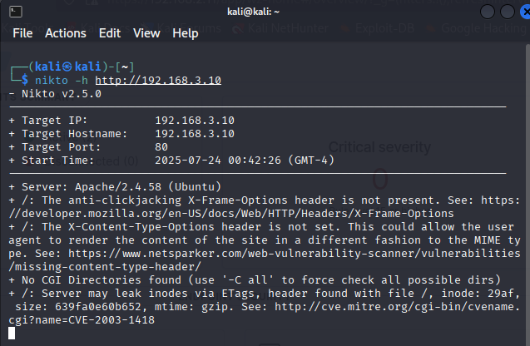

Attack Simulation & Scanning Summary
Nmap Scanning
Windows Endpoint Scanning:
Server scanning using Nikto
nmap 192.168.30.1
nmap 192.168.30.11
Ubuntu Endpoint Scanning:
nmap 192.168.3.1
nmap 192.168.3.10
Hydra Brute-Force Attacks
Windows SSH Brute-Force:
hydra -l <user> -P /usr/share/wordlists/rockyou.txt ssh 192.168.2.14
Linux SSH Brute-Force:
hydra -l ubuntu -P /usr/share/wordlists/rockyou.txt ssh 192.168.3.10
Port Services Installation
Ubuntu Linux Services:
sudo apt-get install apache2 -y
sudo apt-get install openssh-server -y
Windows Services:
FileZilla installation

Slide 8




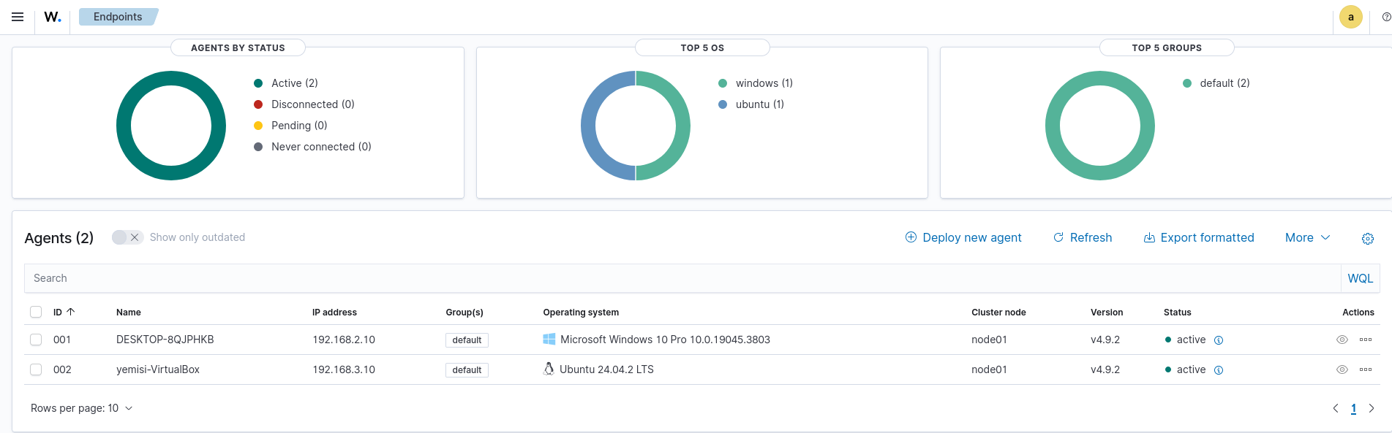
Monitoring & Detection (Wazuh)
Wazuh SIEM Features
Detected Alert Types
Real-time Visibility
High Severity
Brute-force attempts, Authentication failures
Continuous monitoring of endpoint activities and network traffic
Log Capture
Medium Severity
Port scanning, Unusual network connections
Collection and centralization of system and application logs
Alert Generation
Low Severity
Automated detection and alerting of suspicious activities
Service installations, Configuration changes
Wazuh Dashboard

Slide 9

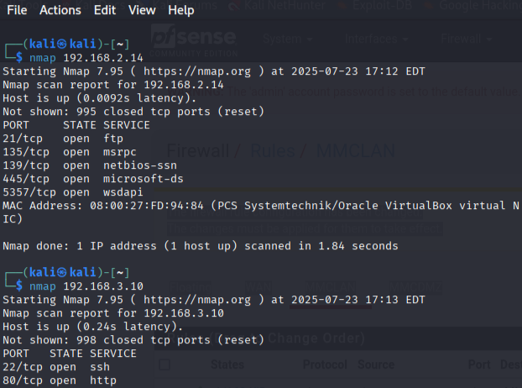
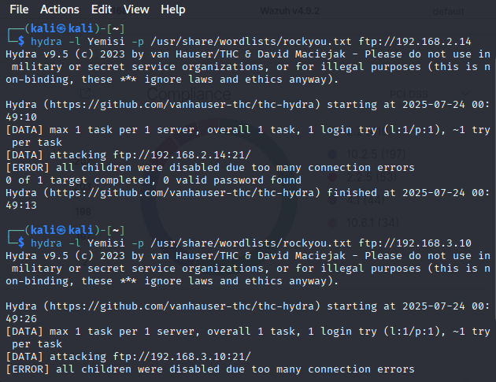
Attack Detection Timeline
1. Reconnaissance
2. Exploitation
3. Detection
4. Response
09:15 AM
09:45 AM
09:47 AM
10:05 AM
Nmap scanning from Kali
Hydra brute-force
Wazuh alerts triggered
IP 192.168.30.12 blocked
IP: 192.168.30.12
SSH service targeted
Failed login attempts
pfSense rules applied
Nmap Scanning Evidence
Hydra Brute-Force Evidence

Slide 10
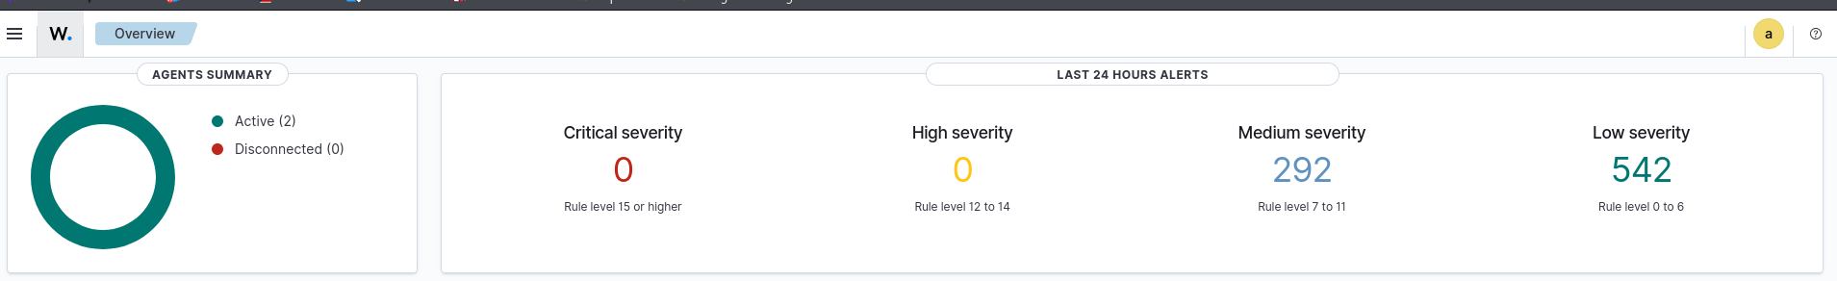
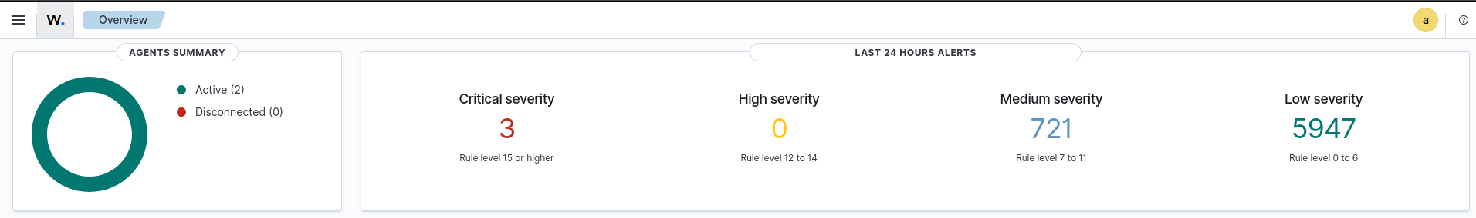
Attack Detection Timeline cont’d
1. Reconnaissance
2. Exploitation
3. Detection
4. Response
09:15 AM
09:45 AM
09:47 AM
10:05 AM
Nmap scanning from Kali
Hydra brute-force
Wazuh alerts triggered
IP 192.168.30.12 blocked
IP: 192.168.30.12
SSH service targeted
Failed login attempts
pfSense rules applied
Wazuh Alert Evidence Before Attack
Wazuh Alert Evidence After Attack

Slide 11


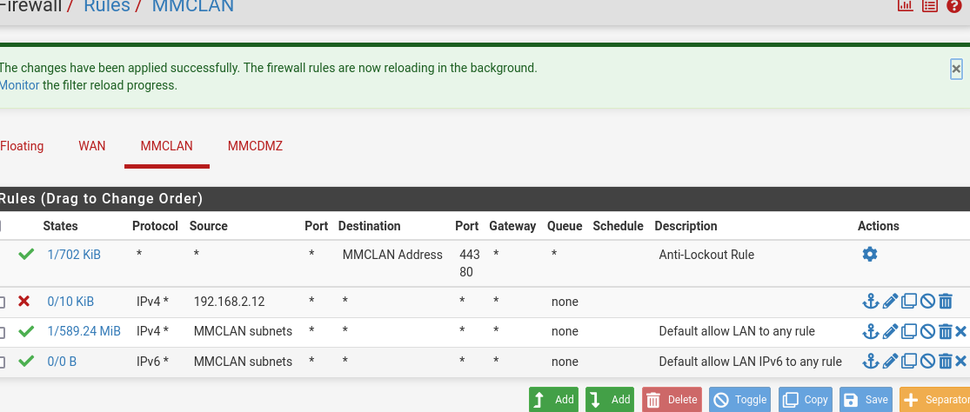





Mitigation Measures & Response
pfSense Firewall Rule
Implemented Mitigations
IP Blocking
Attacker IP address (192.168.30.12) was blocked using pfSense firewall rules to prevent further access attempts.
Service Hardening
Disabled unnecessary open ports and services on both Windows and Ubuntu endpoints to reduce attack surface.
Credential Enforcement
Implemented stronger password policies and account lockout thresholds to prevent brute-force attacks.
pfSense firewall configuration showing rule to block the attacker IP address (192.168.2.12)
Response Metrics
Detection & Response Time
Initial detection: 2 minutes after attack initiation
Full response implementation: 18 minutes from detection
Total incident resolution time: 20 minutes

Slide 12







Recommendations for Improvement
Strengthen Endpoint Security
Security Control Effectiveness
Implement host-based firewalls, keep systems patched with the latest security updates, and deploy endpoint detection and response (EDR) solutions for enhanced protection.
Disable Unnecessary Services
Conduct regular port scans to identify and disable unnecessary open ports and services. Implement the principle of least privilege to minimize attack surface.
Implement Multi-Factor Authentication
Deploy MFA for all critical systems and remote access points to prevent unauthorized access even if credentials are compromised through brute-force attacks.
Regular SIEM Tuning
Continuously tune Wazuh SIEM rules to reduce false positives and ensure critical alerts are properly prioritized. Implement automated response playbooks for common attack scenarios.
SOC Training Drills
Conduct regular incident response simulation exercises to maintain SOC analyst readiness and improve response times for real-world attacks.

Slide 13








Self-Reflection
What Was Easy
Key Takeaways
Network segmentation and interface configuration
Attacker Perspective
Setting up and executing basic scanning tools
Vulnerabilities must exist for attacks to succeed. The ease of finding open services demonstrates the importance of minimizing attack surface.
Identifying open ports and services on targets
What Was Challenging
Defender Perspective
Wazuh agent installation and configuration
Continuous monitoring is essential. The ability to detect, analyze, and respond to suspicious activities in real-time is critical.
Tuning alerts to reduce false positives
Creating effective firewall rules
Overall Learning
Security is a continuous process requiring both technical controls and human expertise. Regular training and simulation exercises are vital.
Skills Developed
Attack simulation and detection techniques
SIEM configuration and alert analysis
Incident response and documentation

