Slide 1
Topwater Ethiopia | Fleet Operations Presentation | July 30, 2026
TOP Fleet Intelligence Platform
Live Odoo trips, Mayet GPS tracking, payment control, and AI-style fleet decision support
423
Trips
134
Vehicles
117
Journeys
166
Mayet GPS
Live operations deck

Slide 2
What The Application Solves
Fleet data was spread across Odoo trips, payment requests, driver assignments, and Mayet GPS.
Managers needed a single place to see vehicle status, current location, trip progress, and payment risk.
The system now turns operational data into decisions: what to dispatch, what to collect, and what risk to fix first.
Main screen
Overview, map, payments, detail, reports, and Fleet Agent are connected through the same live data model.
Operator action
Use the page to decide what to check, assign, collect, or escalate next.
Goal: move from manual checking to live control and faster revenue decisions.
TOP Fleet | Topwater Ethiopia
2

Slide 3
Live Data Foundation
423
Trips
134
Vehicles
117
Journeys
166
Mayet GPS vehicles
Vehicles come from Odoo fleet_vehicle.
Trips come from Odoo trip records and are grouped into journeys for route workflow views.
Mayet GPS provides live vehicle current-location overlays when the vehicle exists in the Mayet cache.
TOP Fleet | Topwater Ethiopia
3

Slide 4
System Architecture
Odoo DB
FastAPI Backend
Redis GPS Cache
Next.js Dashboard
Fleet Users
Backend reads Odoo trips, vehicles, payments, expenses, and supervisors.
Mayet worker stores latest GPS catalog and selected vehicle GPS lookups in Redis.
Frontend uses cached live dashboard data for fast page loads and focused detail views.
TOP Fleet | Topwater Ethiopia
4

Slide 5
Overview Dashboard
Shows high-level fleet totals, active journeys, revenue, expenses, payment state, and recent journeys.
Separates user-friendly concepts: Trips are Odoo records; Journeys are grouped route workflows.
Driver Assignment Conflicts are shown at the bottom so managers can resolve duplicate active driver usage.
Main screen
Overview, map, payments, detail, reports, and Fleet Agent are connected through the same live data model.
Operator action
Use the page to decide what to check, assign, collect, or escalate next.
Current verified status: 423 trips, 134 vehicles, 3 driver conflicts.
TOP Fleet | Topwater Ethiopia
5

Slide 6
Fleet Live Map
Shows active orders, selected journey details, unassigned orders, and Mayet GPS vehicle markers.
Selected vehicle uses live Mayet GPS first, then falls back to dashboard route data if no Mayet match exists.
Vehicle plate search/copy uses the main number only, so inconsistent plate formats still match Mayet.
Mayet marker popups show readable location and telemetry when available, not raw coordinates as the main label.
Main screen
Overview, map, payments, detail, reports, and Fleet Agent are connected through the same live data model.
Operator action
Use the page to decide what to check, assign, collect, or escalate next.
Map value: dispatchers can see where vehicles actually are before assigning work.
TOP Fleet | Topwater Ethiopia
6

Slide 7
Payment Control
Payment Requests page organizes customer, route, vehicle, supervisor, request lines, state, and total amount.
Long text is collapsed for readability, with expandable details when needed.
Payment Status with Customer Name summarizes customers, order trips, request total, paid, partial, pending, and pending ETB.
Main screen
Overview, map, payments, detail, reports, and Fleet Agent are connected through the same live data model.
Operator action
Use the page to decide what to check, assign, collect, or escalate next.
Business value: collect before dispatch and reduce unpaid-trip exposure.
TOP Fleet | Topwater Ethiopia
7

Slide 8
Journey Detail Page
Opens faster by using the same dashboard cache as the overview, then falls back to single journey fetch.
Top metrics include driver, speed, fuel, stop duration, revenue, paid, pending, expense, profit, and trip count.
Route trip legs and payment request lines are higher on the page; Timeline & Location is moved to the bottom.
Main screen
Overview, map, payments, detail, reports, and Fleet Agent are connected through the same live data model.
Operator action
Use the page to decide what to check, assign, collect, or escalate next.
TOP Fleet | Topwater Ethiopia
8

Slide 9
Fleet Agent & Logistics Plan
New page: /planner, also available from the sidebar as Fleet Agent.
Quick Teller answers questions by plate, driver, GPS, idle vehicles, driver conflicts, and revenue opportunity.
Logistics plan analyzes live journeys, Mayet GPS, payments, margins, and conflicts to suggest decisions.
Cluster analysis highlights when many Mayet vehicles are stacked in one area on the map.
Main screen
Overview, map, payments, detail, reports, and Fleet Agent are connected through the same live data model.
Operator action
Use the page to decide what to check, assign, collect, or escalate next.
This is the first operational decision layer on top of the fleet dashboard.
TOP Fleet | Topwater Ethiopia
9

Slide 10
Decision Model
Collect pending ETB
Assign available capacity
Protect high-value routes
Fix conflicts
Track GPS gaps
Collect before dispatch: payment-risk journeys are pushed into the action queue.
Assign available capacity: idle or draft vehicles are surfaced for next revenue work.
Protect top routes: high-net journeys are prioritized for follow-up and tracking.
Fix conflicts: same-driver/multiple-vehicle issues become visible before they damage execution.
TOP Fleet | Topwater Ethiopia
10

Slide 11
How It Improves Revenue
Collect
Cash flow
Assign
Utilization
Protect
Margin
Fix
Risk
Shortens the time from status check to dispatch decision.
Uses GPS clusters to choose nearby available vehicles instead of sending far vehicles.
Flags payment and assignment problems before a new trip creates more exposure.
Keeps profitable routes visible so operations protect the revenue already in motion.
TOP Fleet | Topwater Ethiopia
11

Slide 12
Demo Flow For Presentation
1. Start on Overview: show total trips, vehicles, active journeys, and real Odoo source.
2. Open Fleet Live Map: select a vehicle, show Mayet marker, Active Orders, and Selected Journey.
3. Open Detail: show revenue, pending payment, route legs, telemetry, and timeline at the bottom.
4. Open Payment Requests: show searchable request table and customer payment status summary.
5. Open Fleet Agent: ask about a plate, driver conflicts, idle vehicles, and revenue opportunities.
Main screen
Overview, map, payments, detail, reports, and Fleet Agent are connected through the same live data model.
Operator action
Use the page to decide what to check, assign, collect, or escalate next.
TOP Fleet | Topwater Ethiopia
12

Slide 13
Known Data Rules
If Mayet has no GPS record for an Odoo vehicle, the app clearly shows no Mayet match instead of pretending route data is GPS.
Speed, fuel, and stop duration show only when Mayet provides them; otherwise the UI shows N/A.
The app avoids exposing database model names to users: users see Trips and Journeys.
The API requires login, so live data is visible only after authentication.
Main screen
Overview, map, payments, detail, reports, and Fleet Agent are connected through the same live data model.
Operator action
Use the page to decide what to check, assign, collect, or escalate next.
TOP Fleet | Topwater Ethiopia
13

Slide 14
Next Improvements
Add automatic suggested dispatch assignments by nearest available GPS vehicle and destination demand.
Add daily operations report export from Fleet Agent recommendations.
Add alerts for long stop duration, stale GPS, duplicate driver assignment, and unpaid high-value trips.
Add manager approval workflow for dispatch suggestions before assignment changes are pushed back to Odoo.
Main screen
Overview, map, payments, detail, reports, and Fleet Agent are connected through the same live data model.
Operator action
Use the page to decide what to check, assign, collect, or escalate next.
Recommended next step: convert Fleet Agent suggestions into approved dispatch actions.
TOP Fleet | Topwater Ethiopia
14

Slide 15
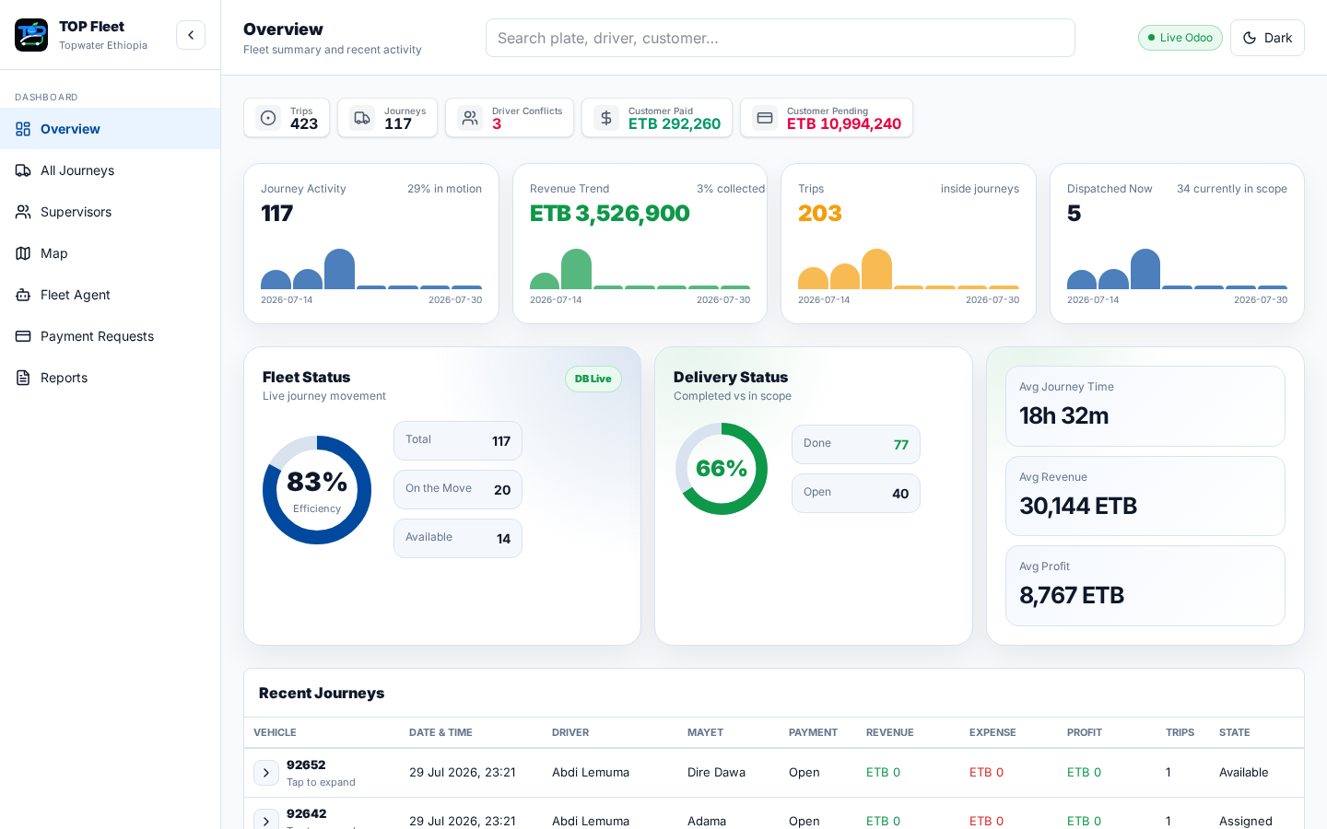
Live Application View - Overview Dashboard
Real Odoo trip and vehicle summary, recent journeys, Mayet current locations, and conflict visibility.
TOP Fleet | Live application screenshot
15

Slide 16
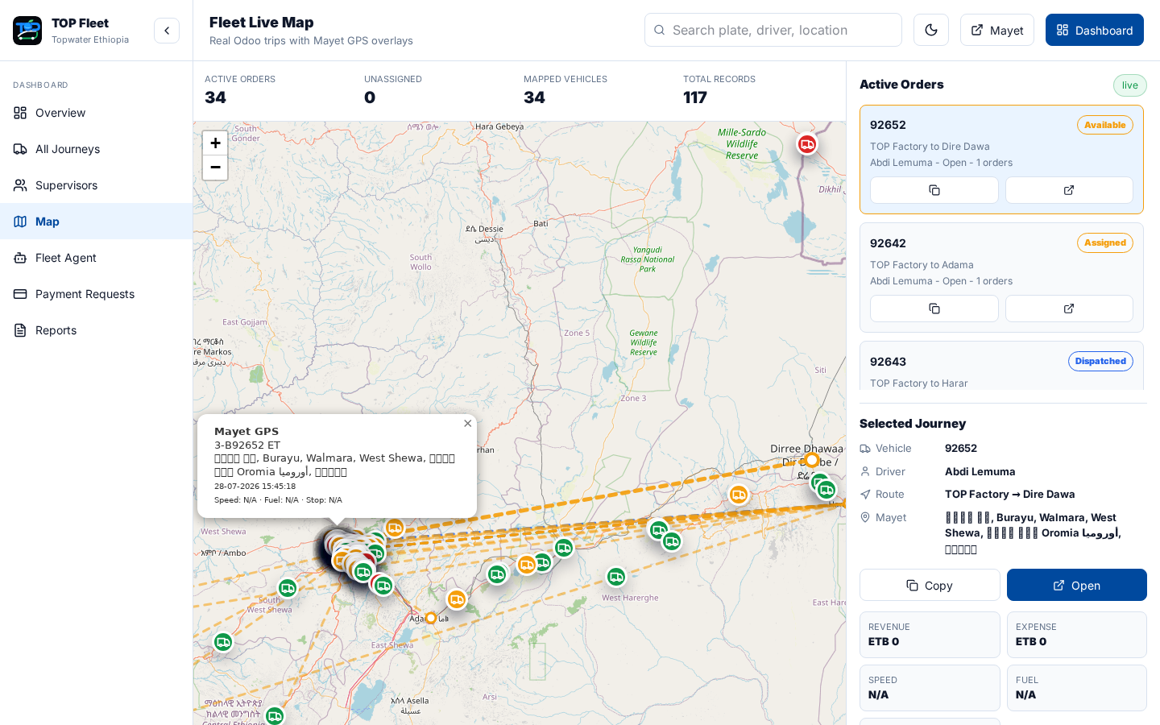
Live Application View - Fleet Live Map
Mayet GPS vehicle markers, active orders, selected journey, and live location popup.
TOP Fleet | Live application screenshot
16

Slide 17
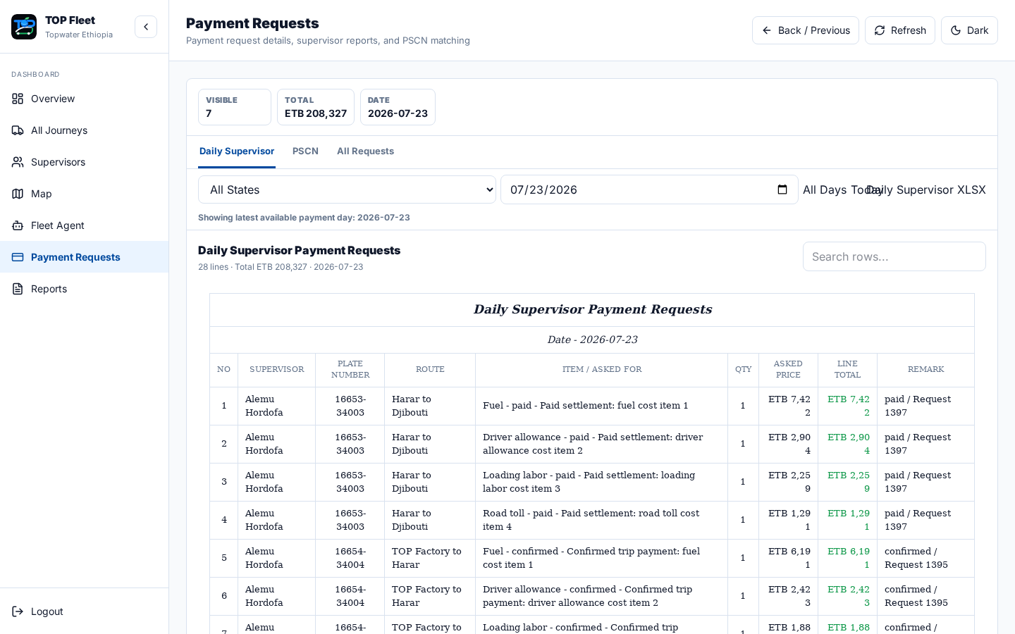
Live Application View - Payment Requests
Payment request table, customer payment status, searchable rows, and collection follow-up view.
TOP Fleet | Live application screenshot
17

Slide 18
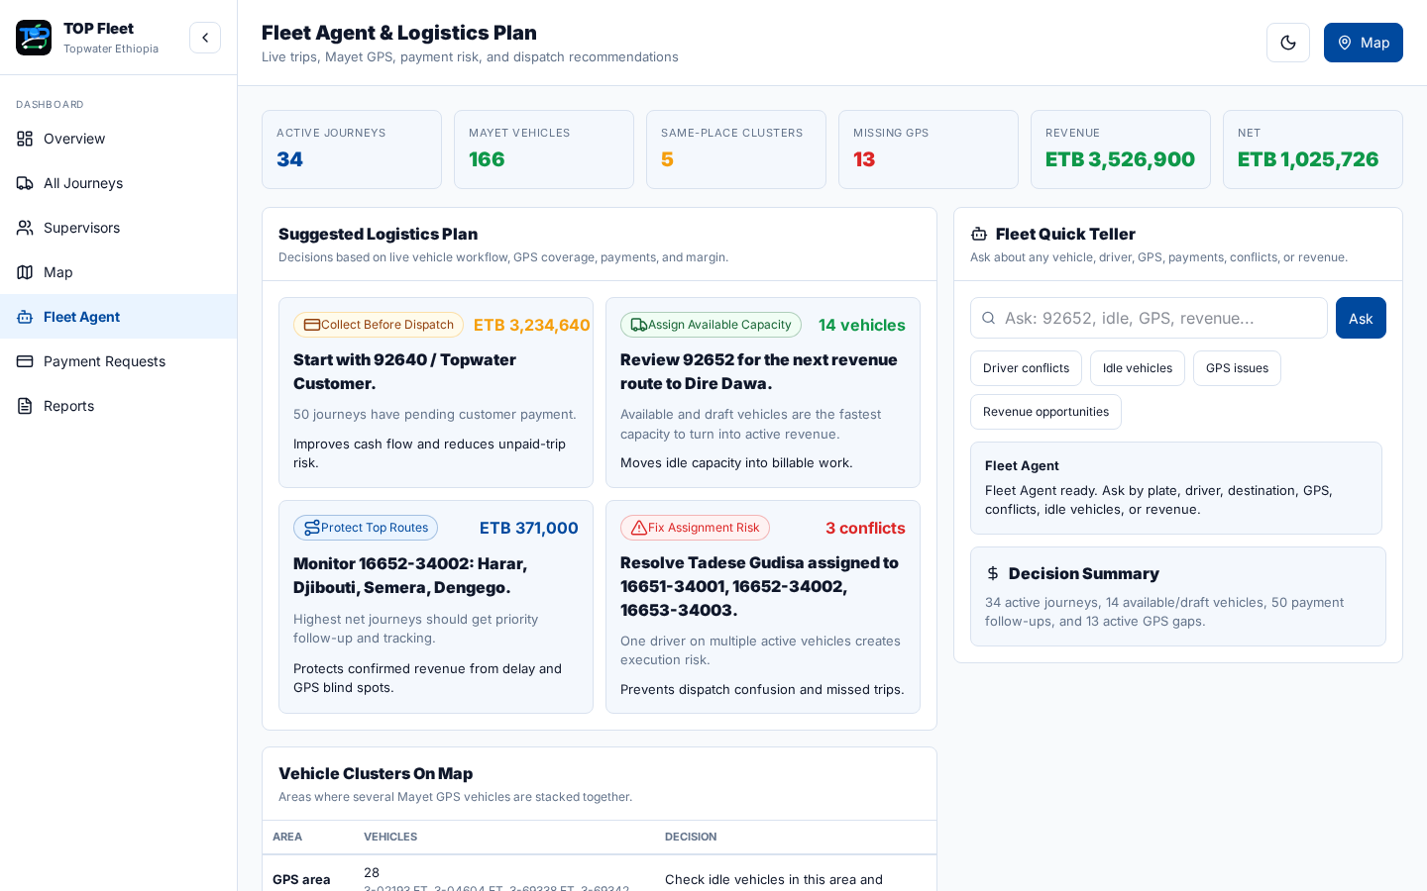
Live Application View - Fleet Agent
Suggested logistics plan, GPS clusters, revenue decision queue, and quick vehicle-status teller.
TOP Fleet | Live application screenshot
18

Slide 19
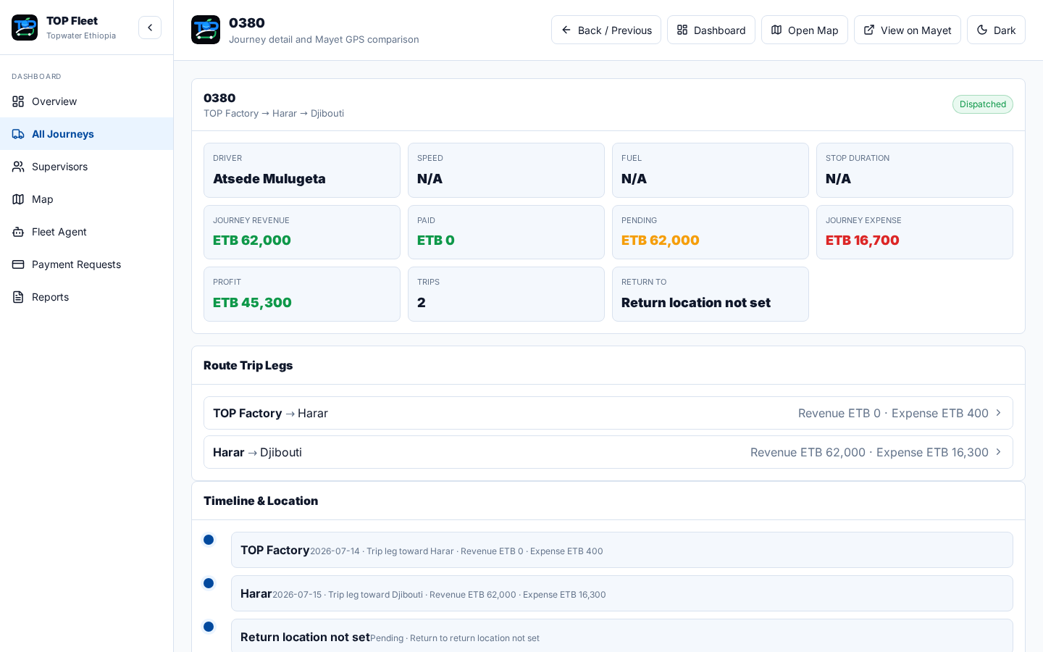
Live Application View - Journey Detail
Journey metrics, telemetry placeholders, route trip legs, payment lines, and timeline/location detail.
TOP Fleet | Live application screenshot
19

