Slide 1



The Smart Mobile Messenger.

Slide 2

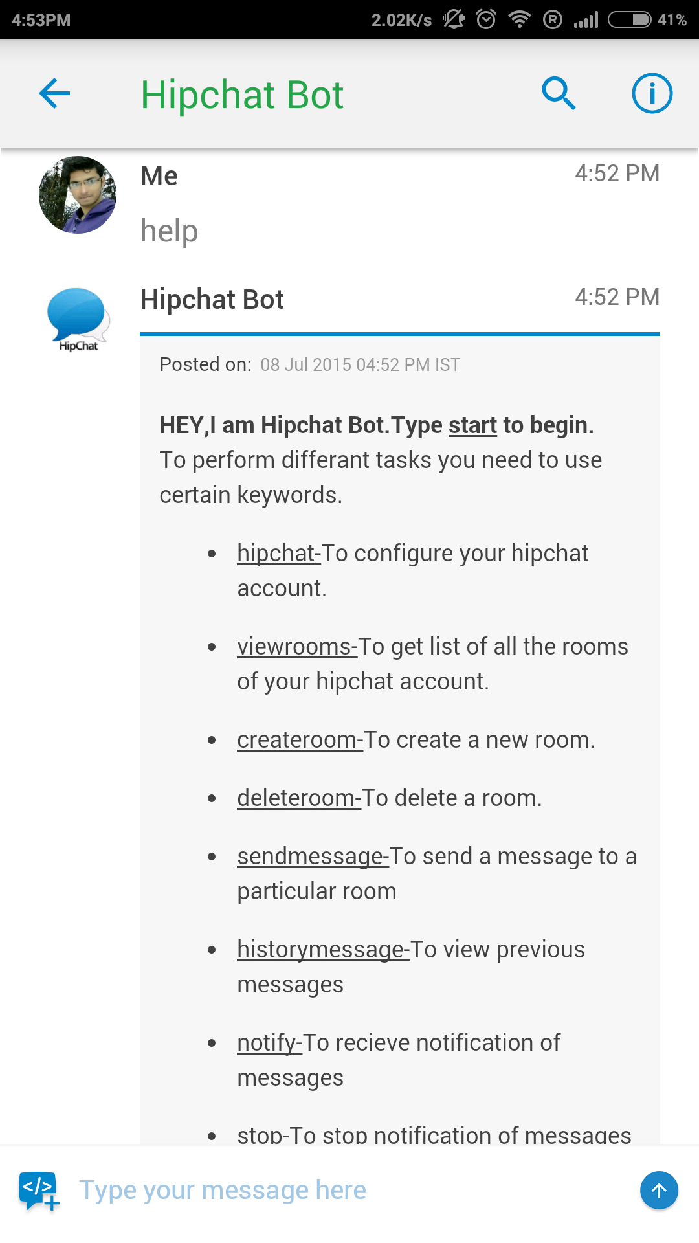
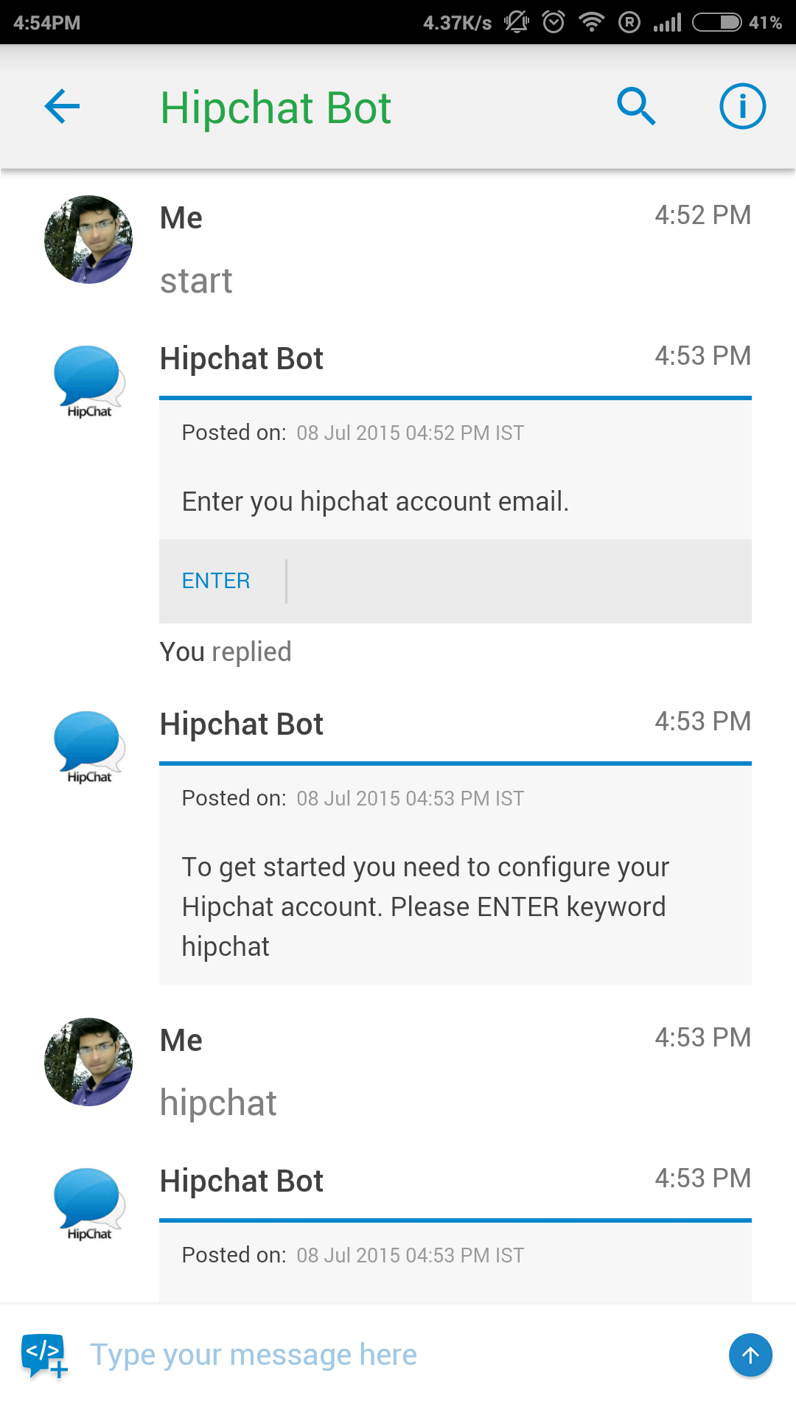

Teamchat App introduces "Hipchat" integration
Type the keyword “help” to view all the commands available in the room.
Enter the email ID of your hipchat account.

Slide 3
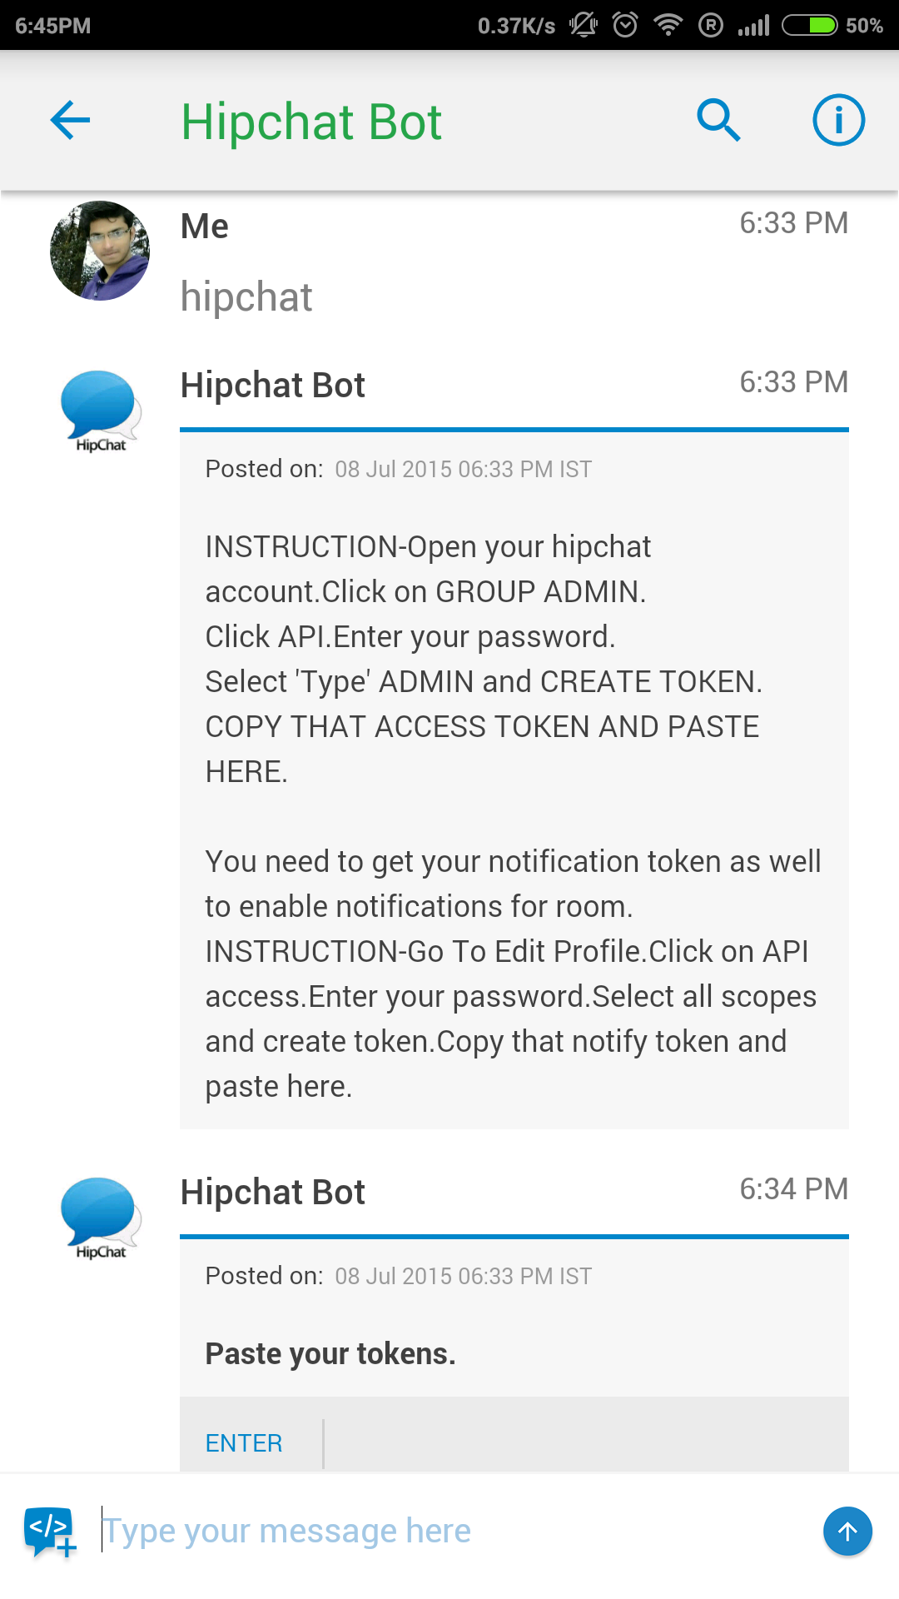
Teamchat App introduces "Hipchat" integration
Enter the api and notify token to get started

Slide 4
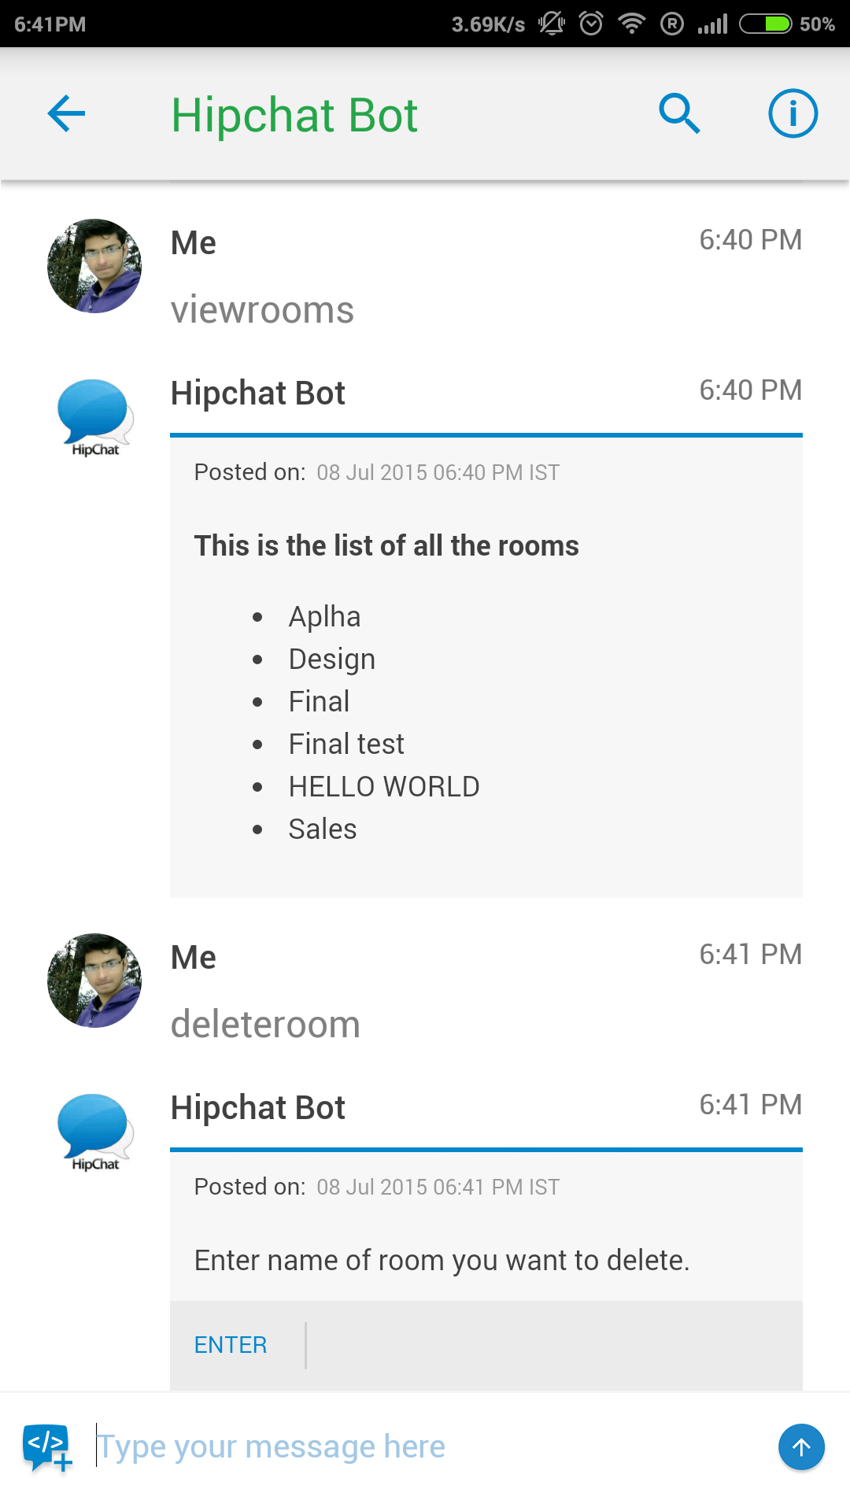
Teamchat App introduces "Hipchat" integration
To view all the rooms present in your hipchat account type keyword “viewrooms”.

Slide 5
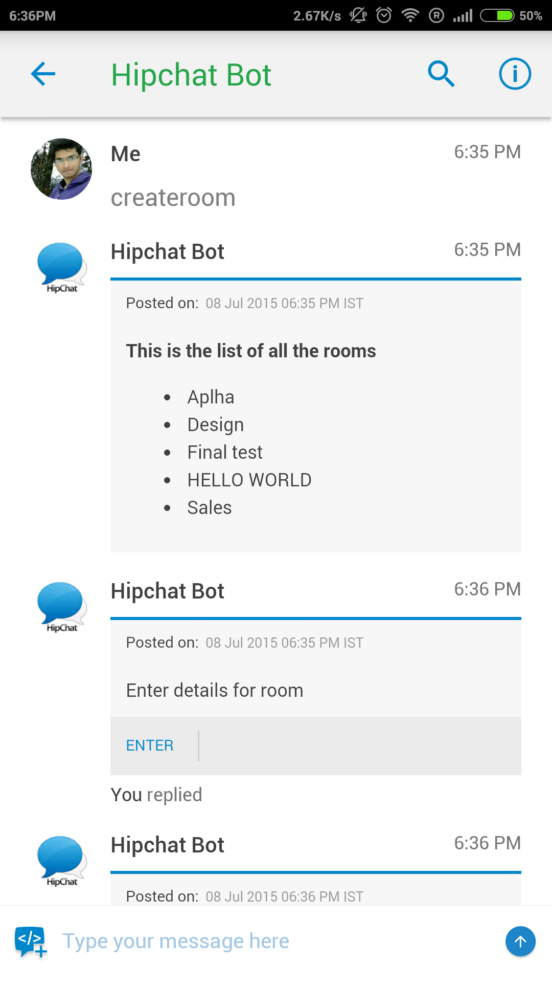
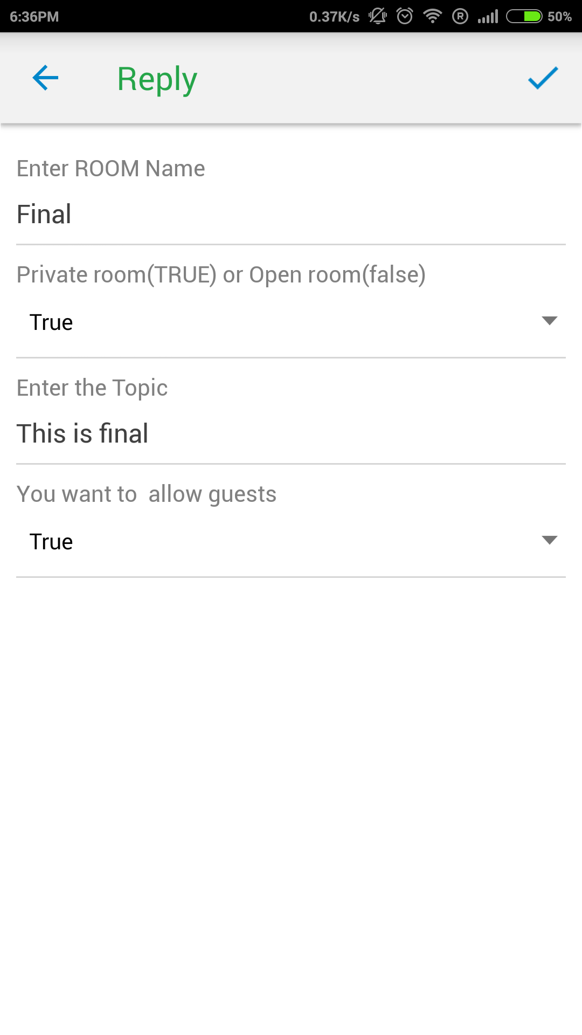
Teamchat App introduces "Hipchat" integration
To create rooms on your hipchat account type keyword “createroom”.

Slide 6
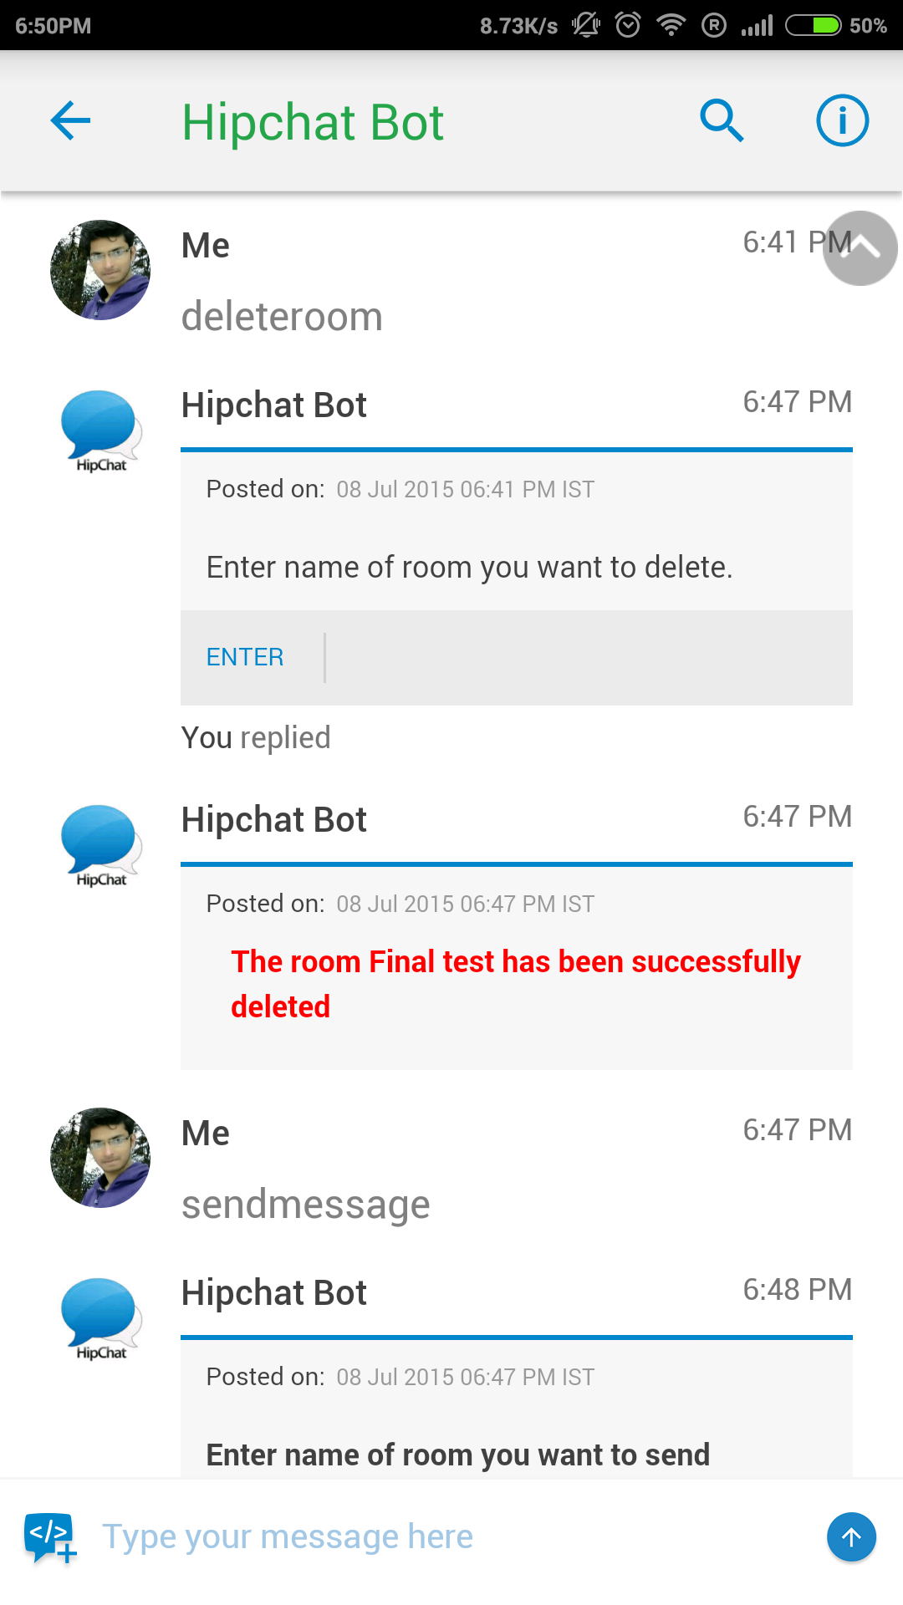
Teamchat App introduces "Hipchat" integration
To delete rooms on your hipchat account type keyword “deleteroom”.

Slide 7
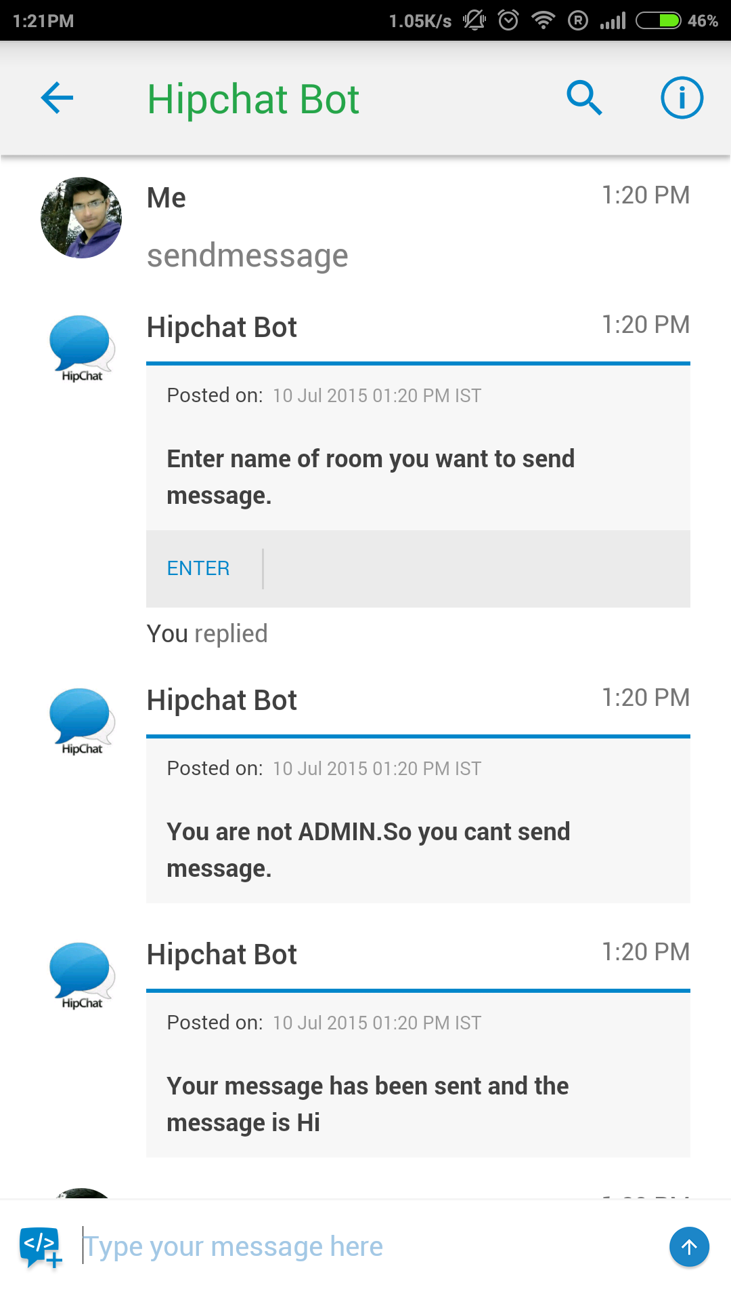
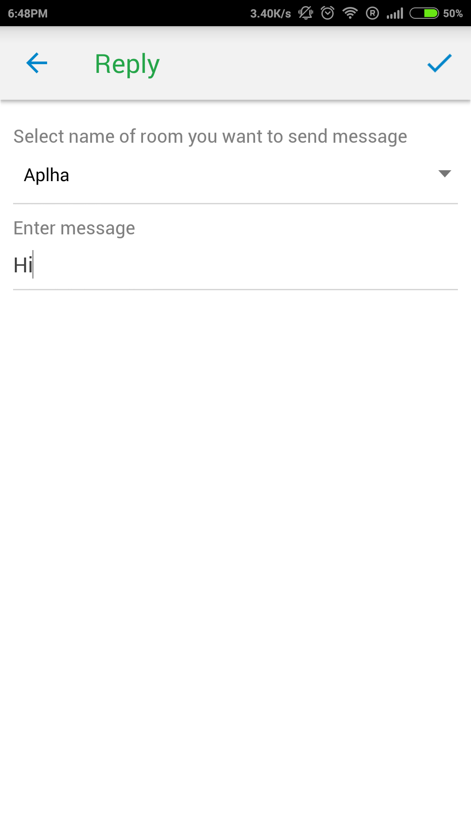
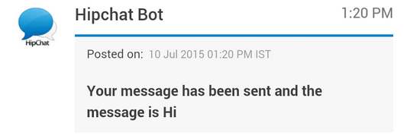
Teamchat App introduces "Hipchat" integration
To send message to a particular rooms on your hipchat account type keyword “sendmessage”. Select the room from dropdown button and type the message.

Slide 8
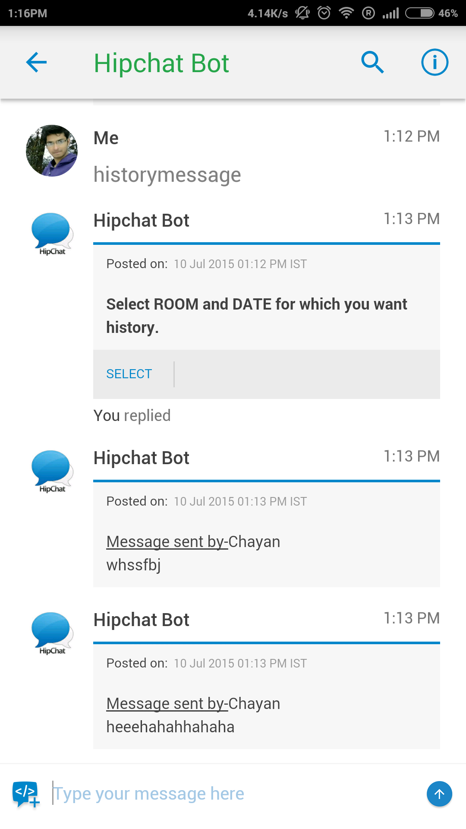
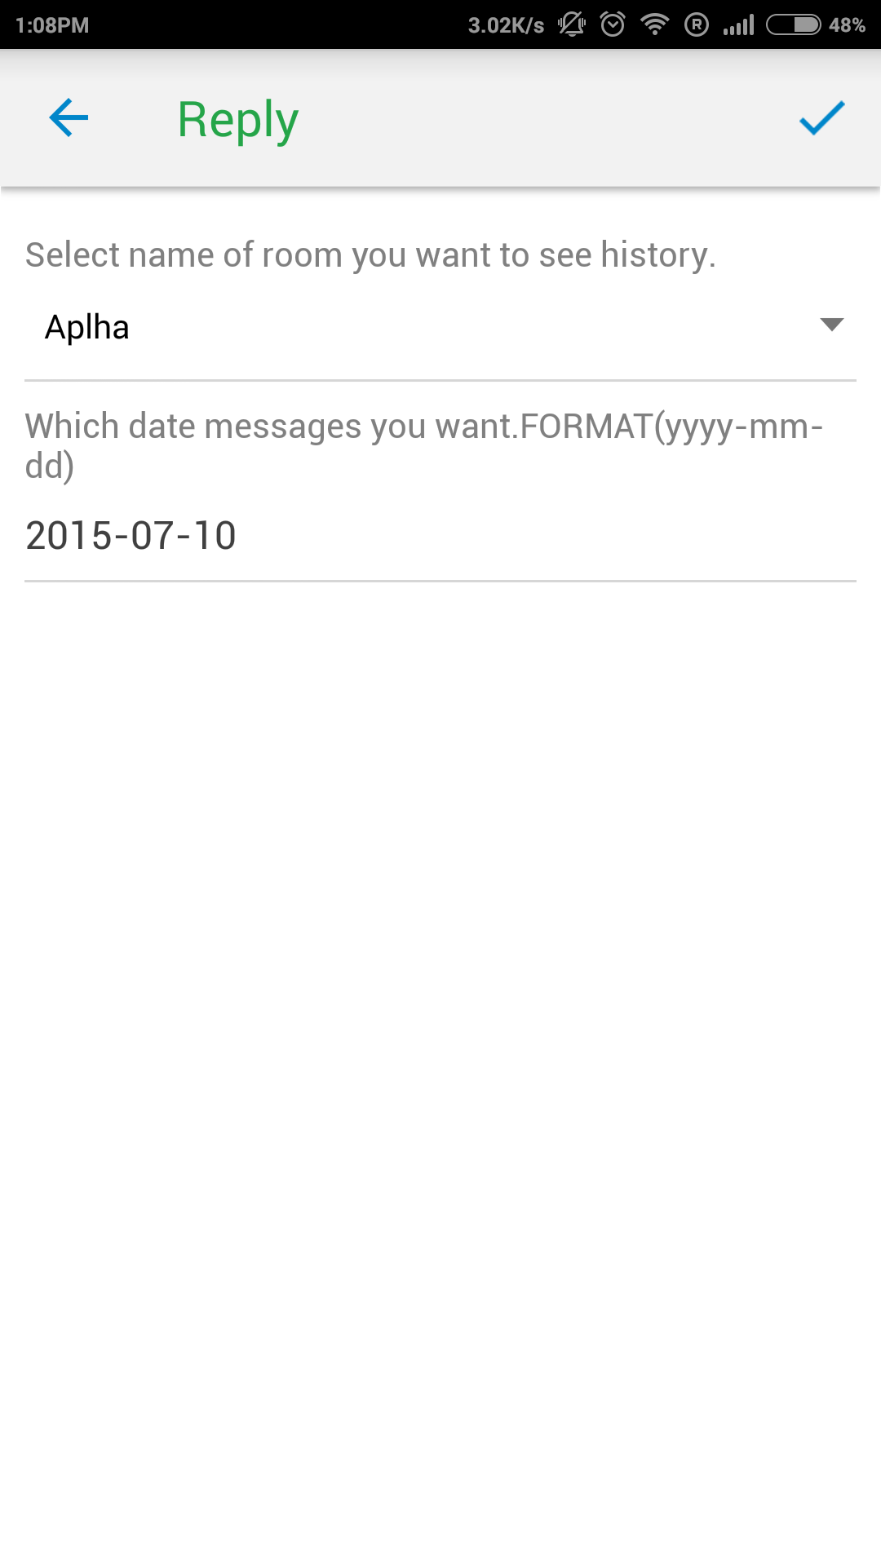
Teamchat App introduces "Hipchat" integration
To view messages of a particular rooms date-wise type keyword “historymessage”. message.

Slide 9
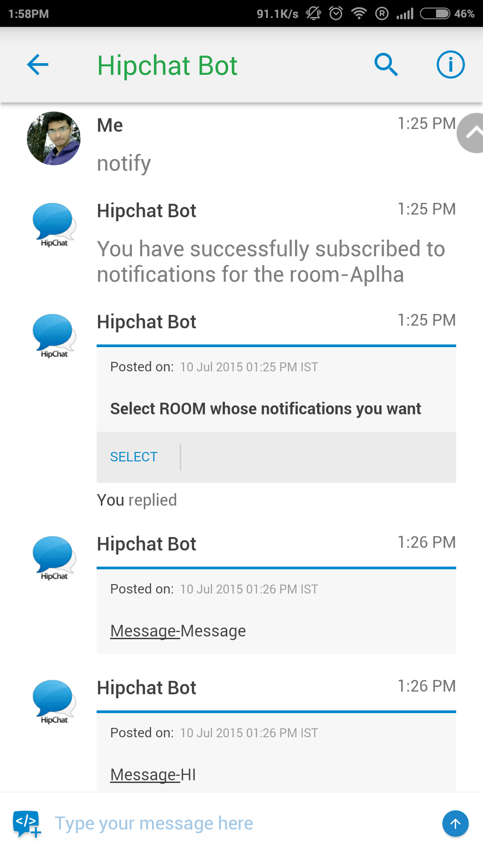
Teamchat App introduces "Hipchat" integration
To receive hipchat messages of a particular room on teamchat type keyword “notify”.

Slide 10

Thank You

