Slide 1



The Smart Mobile Messenger.

Slide 2

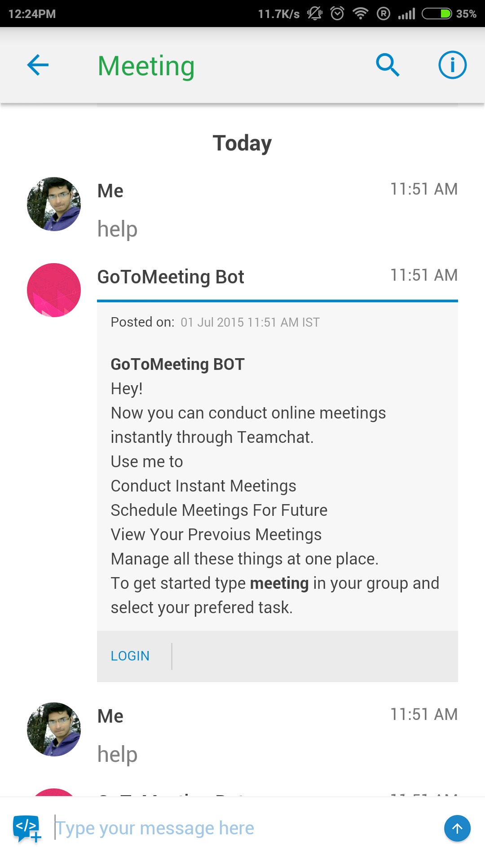

Teamchat App introduces "Gotomeeting" integration
Now with "Gotomeeting" integration on Teamchat be more connected and engaged in your meetings than ever before.
User has to type “help” to get started.

Slide 3
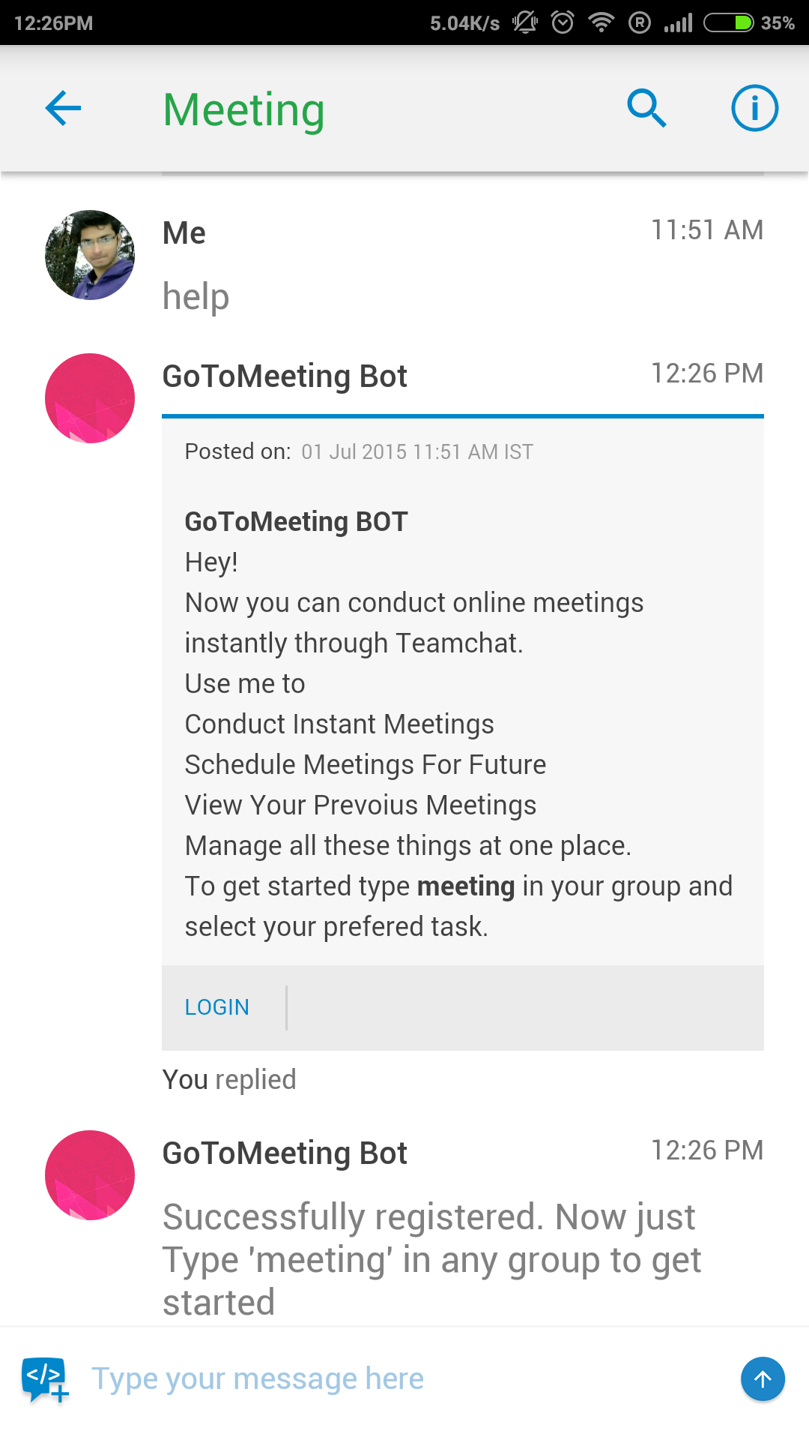
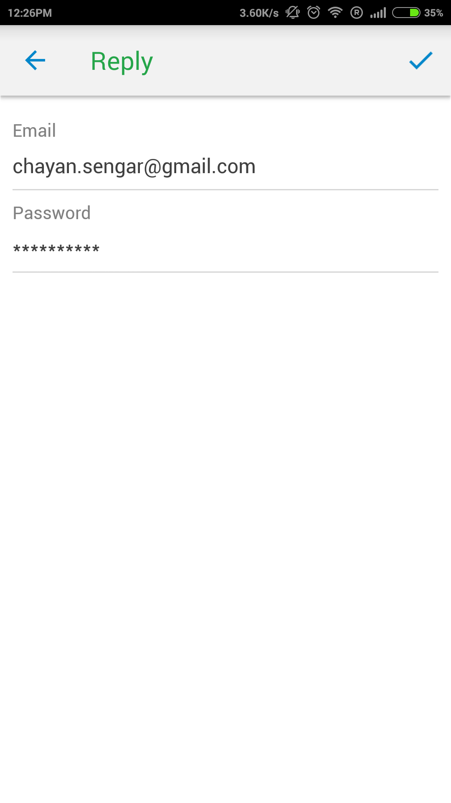
Teamchat App introduces "Gotomeeting" integration

Slide 4
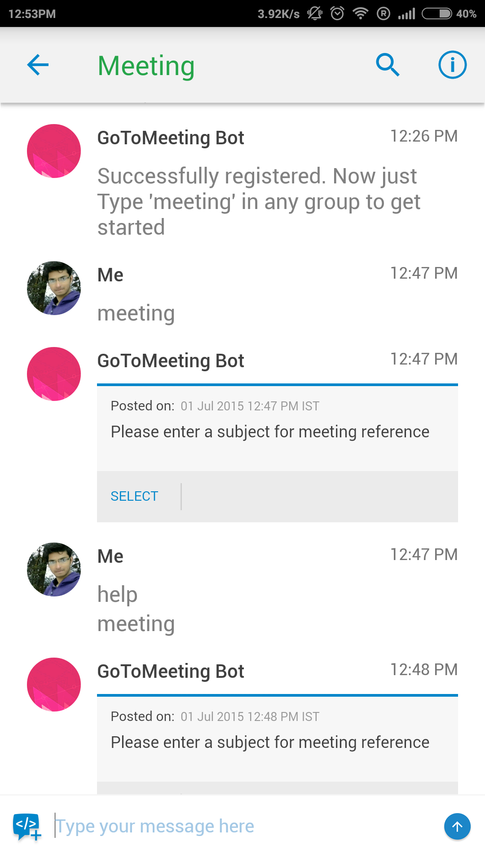
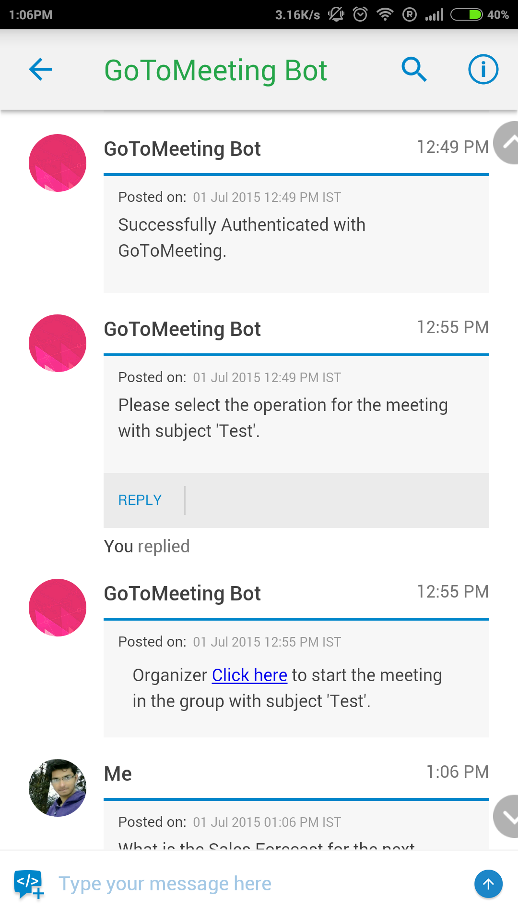
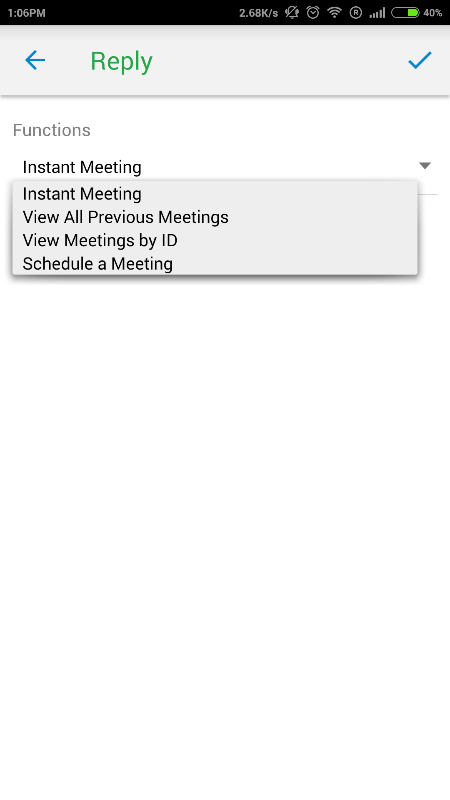
Teamchat App introduces "Gotomeeting" integration
After entering the subject a personal message from the bot asks user to select the operation to be performed.
Correct login credential leads to successful registration.

Slide 5
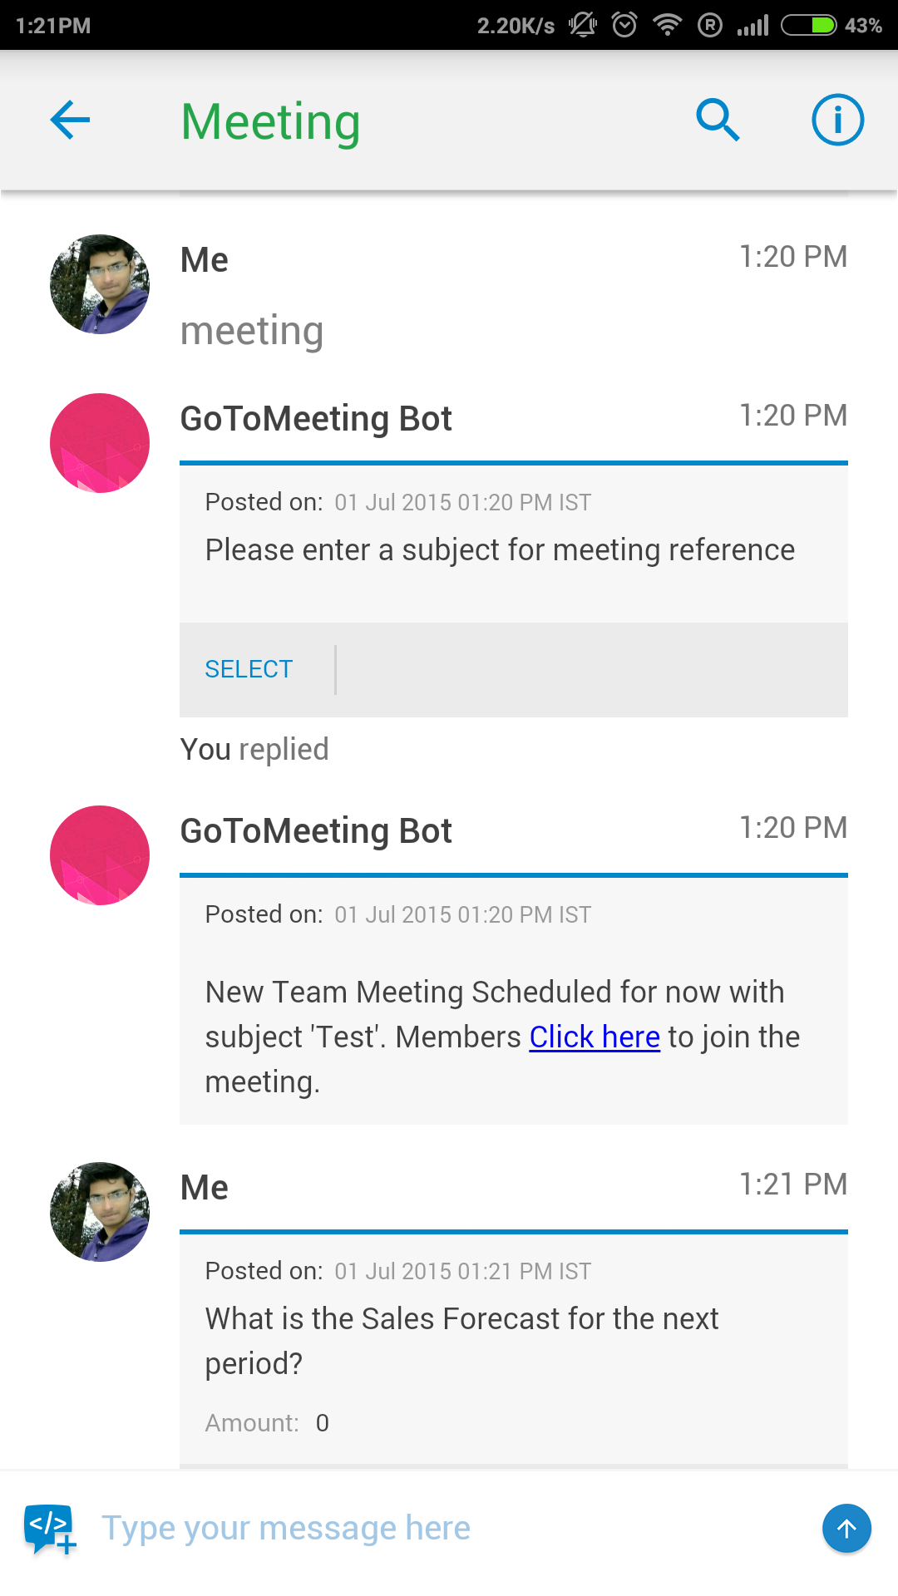
Teamchat App introduces "Gotomeeting" integration
As well as a link to join meeting is posted in the group.
By selecting ‘instant meeting’ a personal message from bot ask the organiser to start the meeting.

Slide 6
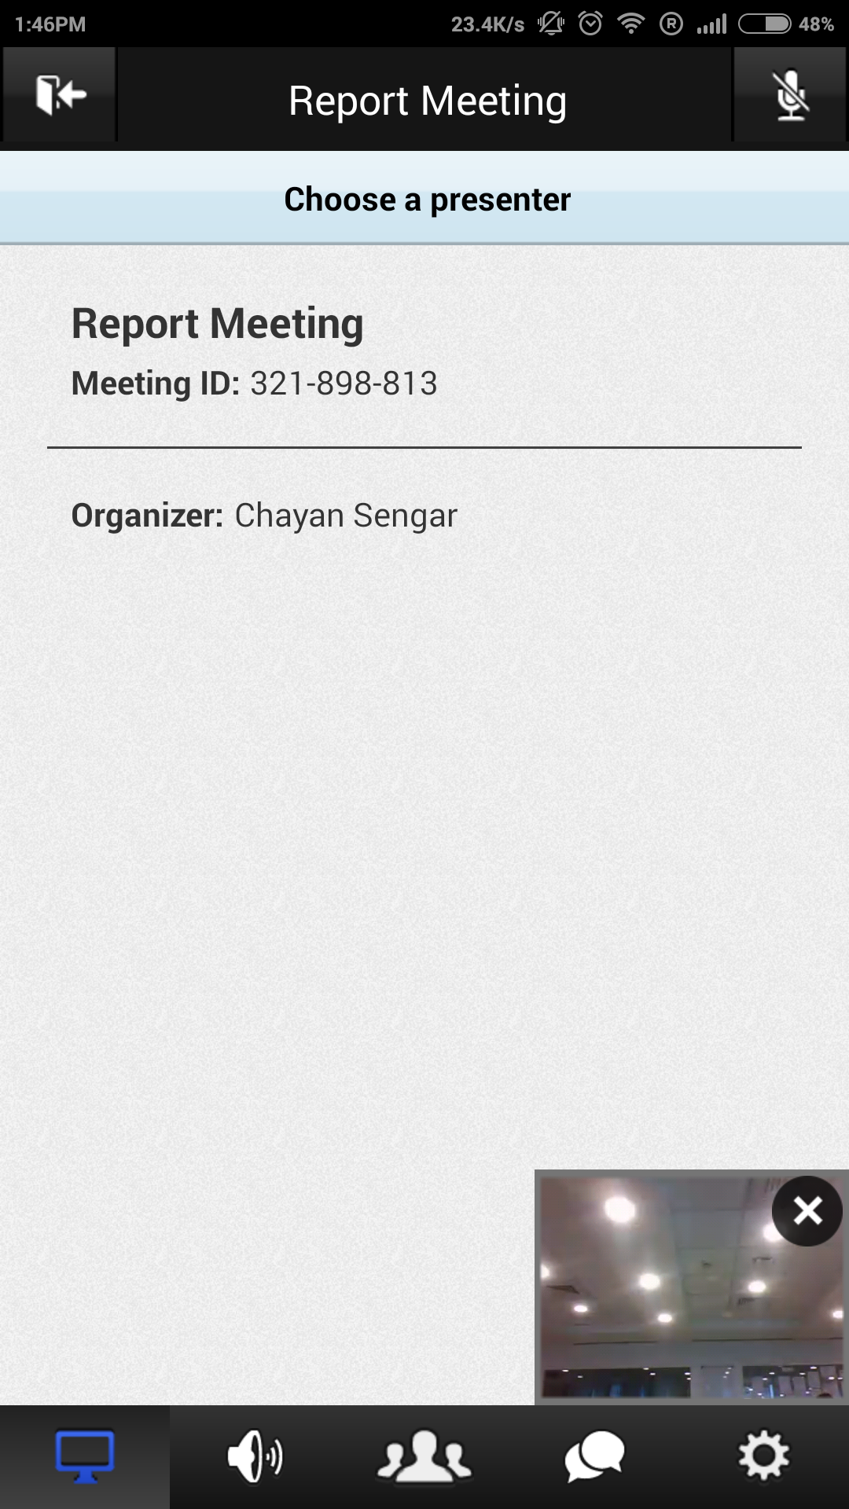
Teamchat App introduces "Gotomeeting" integration
Clicking on the link takes you to GoToMeeting app

Slide 7
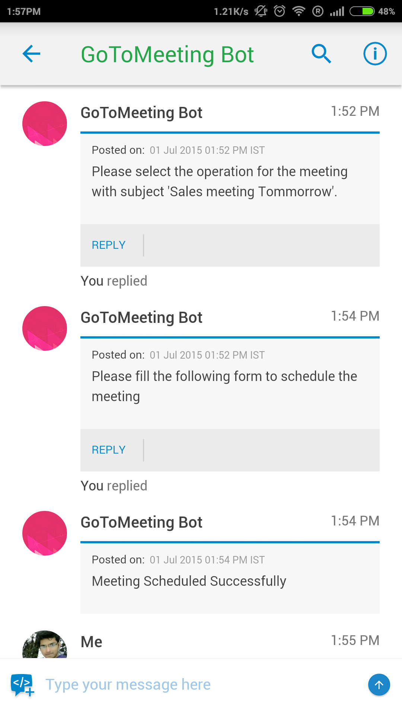
To schedule a meeting
The bot ask the operation to be performed via a personal message.
Select schedule meeting from the dropdown.

Slide 8
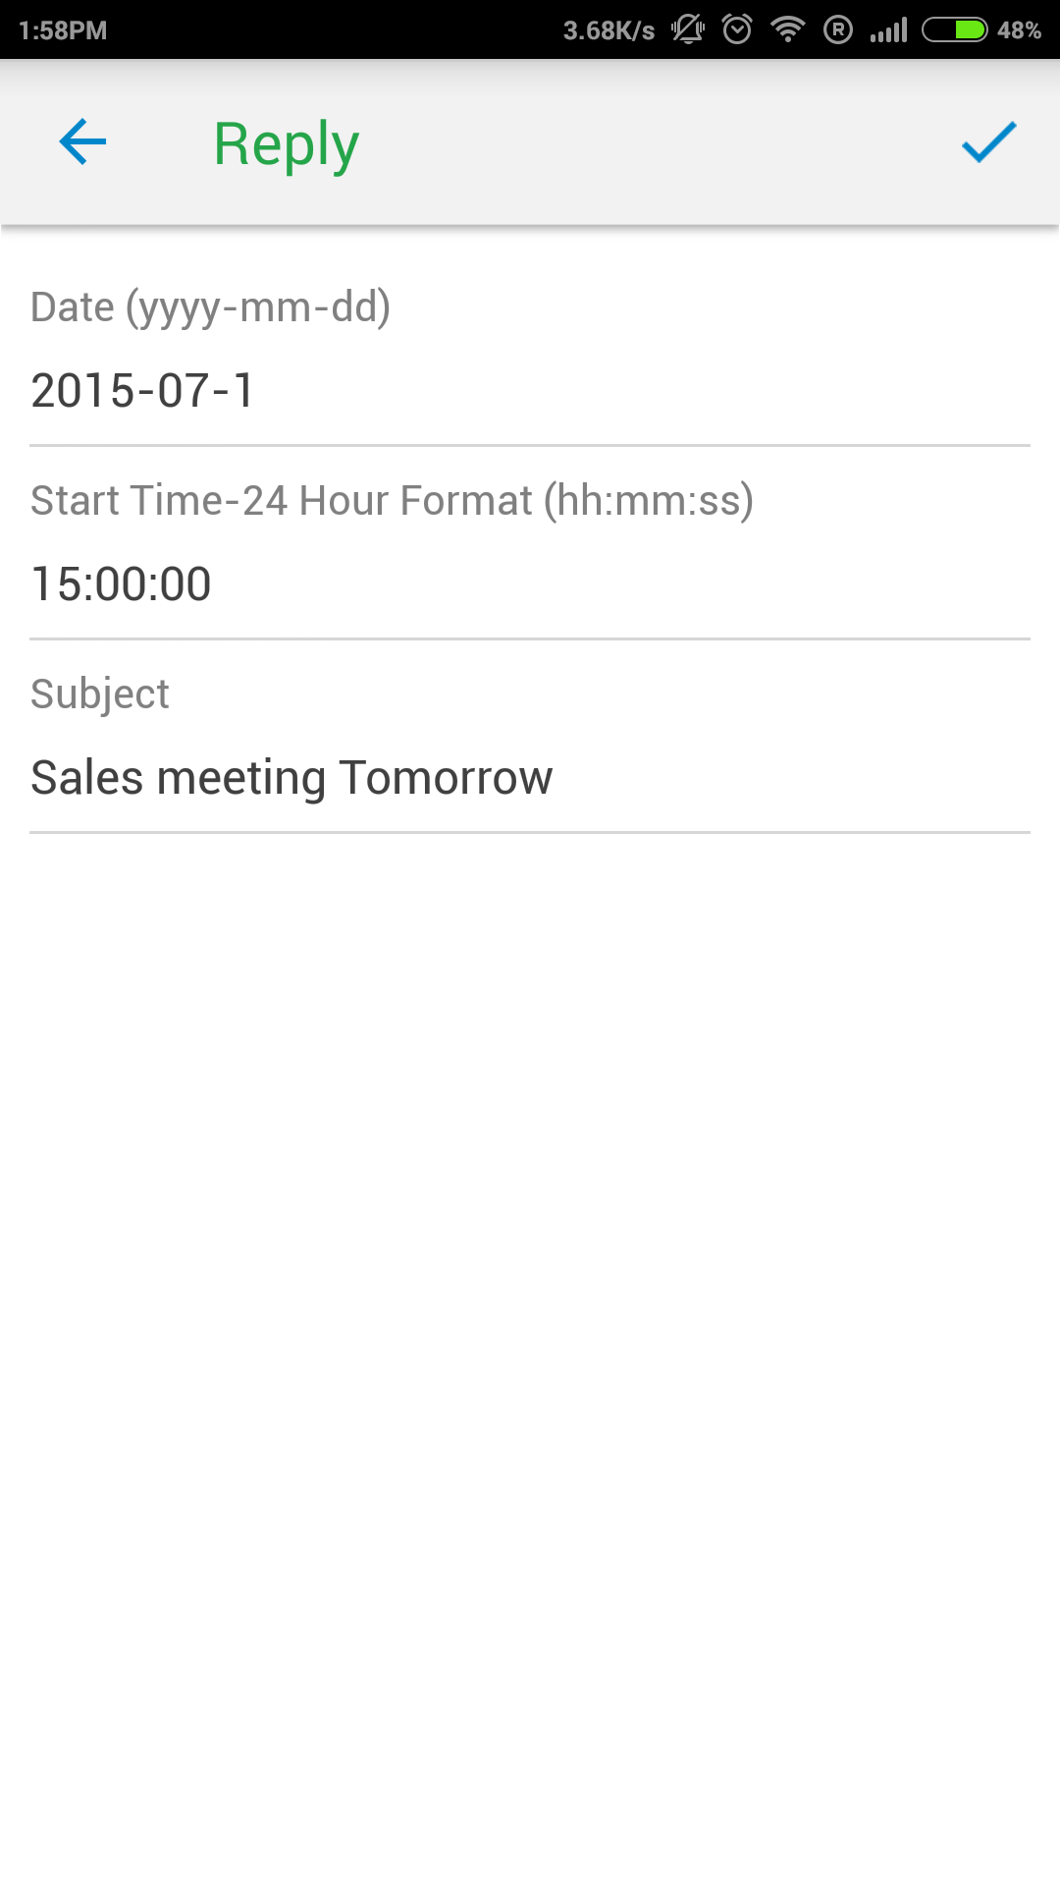
To schedule a meeting

Slide 9
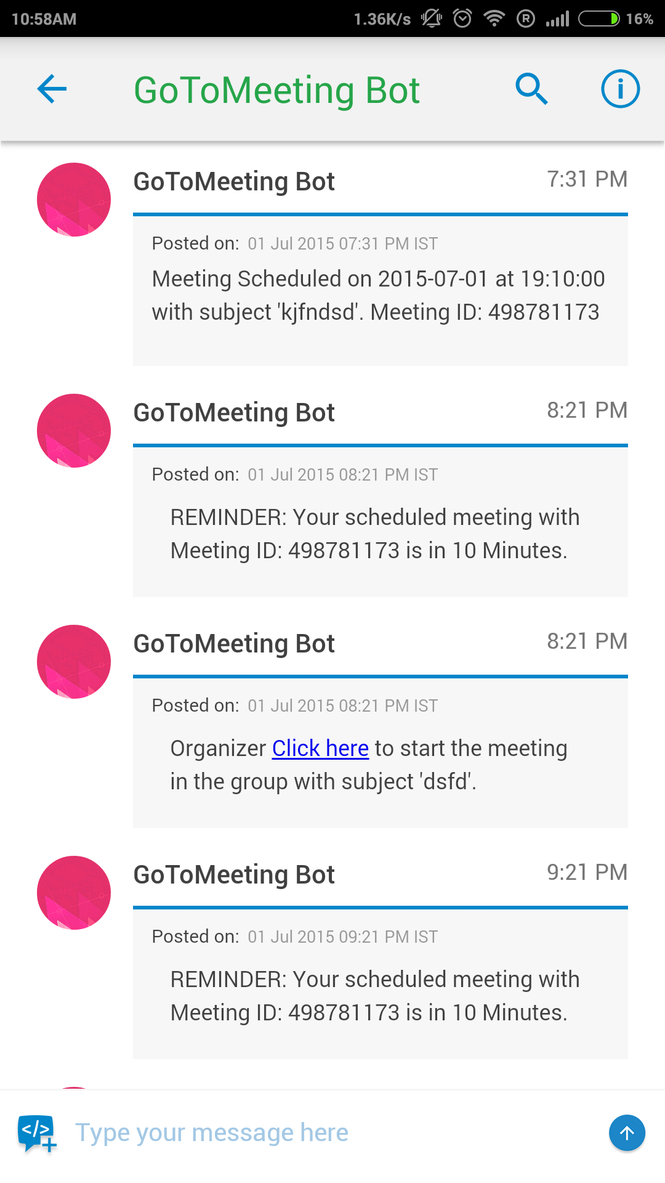
To schedule a meeting
‘Sales meeting Tomorrow’.
Meeting ID :498781173
Once the meeting is scheduled user will get remainder for the meeting 10min and 2hrs before the set time.
‘‘Sales meeting
Tomorrow’.

Slide 10
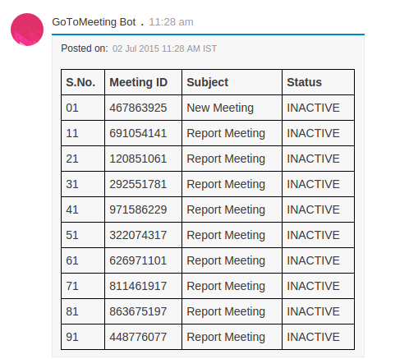
To view all previous meetings.
Select ‘View previous meeting’

Slide 11

Thank You

