Slide 1



The Smart Mobile Messenger.

Slide 2

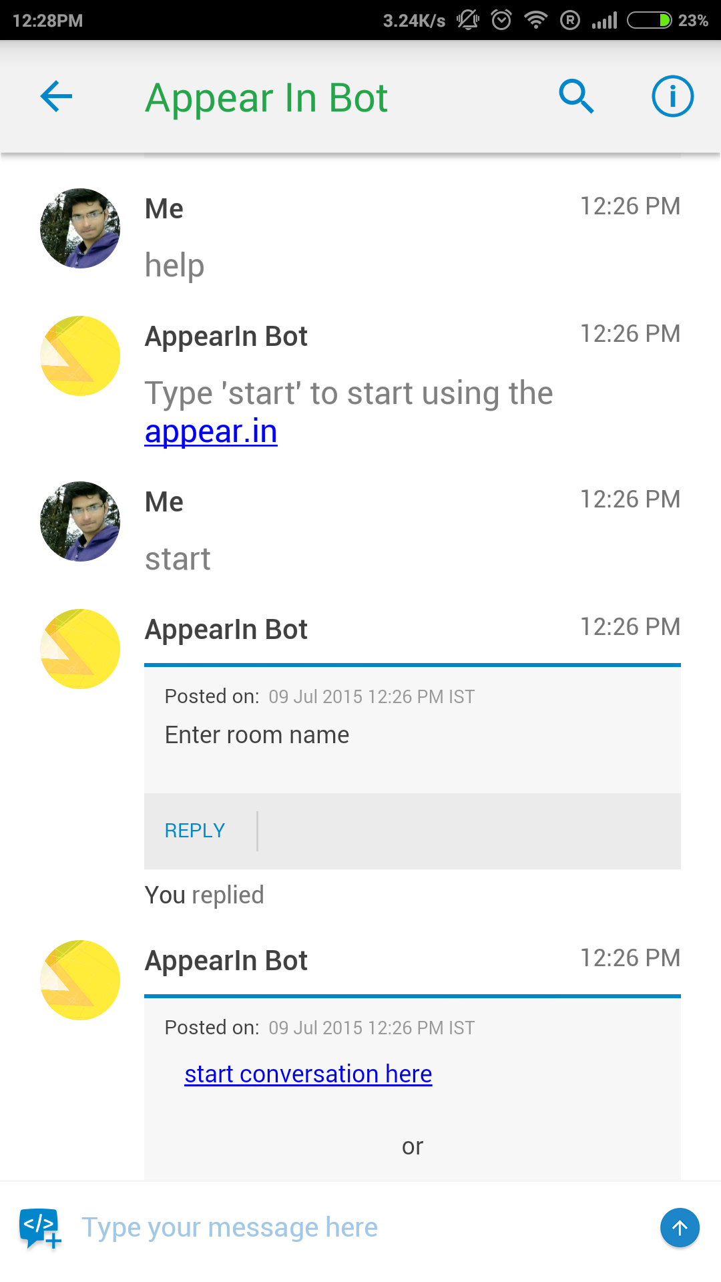

Teamchat App introduces "Appear.in" integration
Now with “apper.in" integration on Teamchat conduct online meeting instantly through teamchat.
Entering the keyword "help post a chatlet.

Slide 3
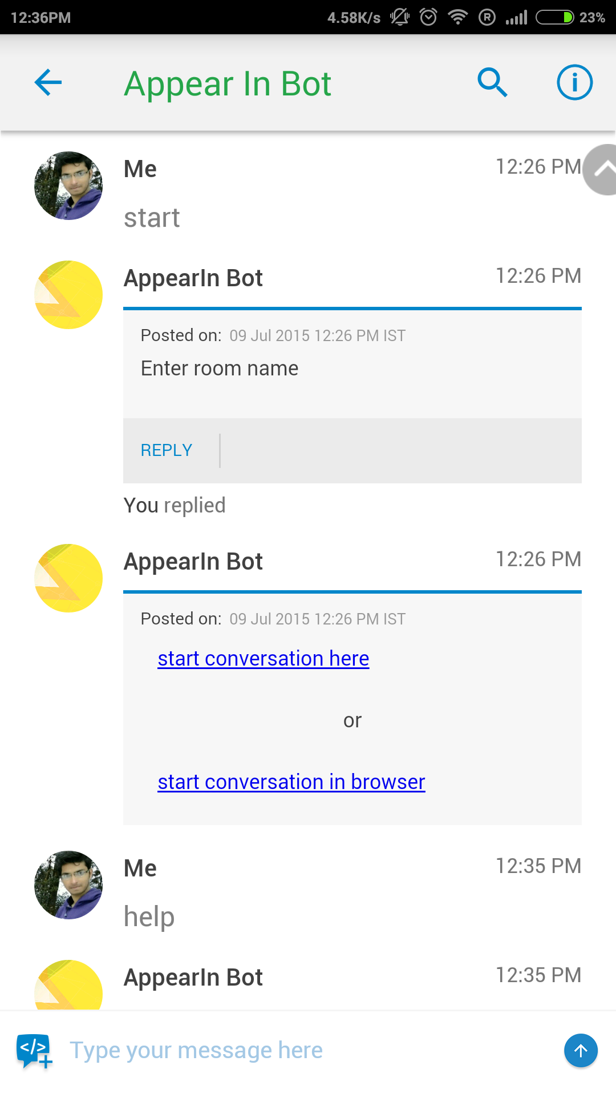
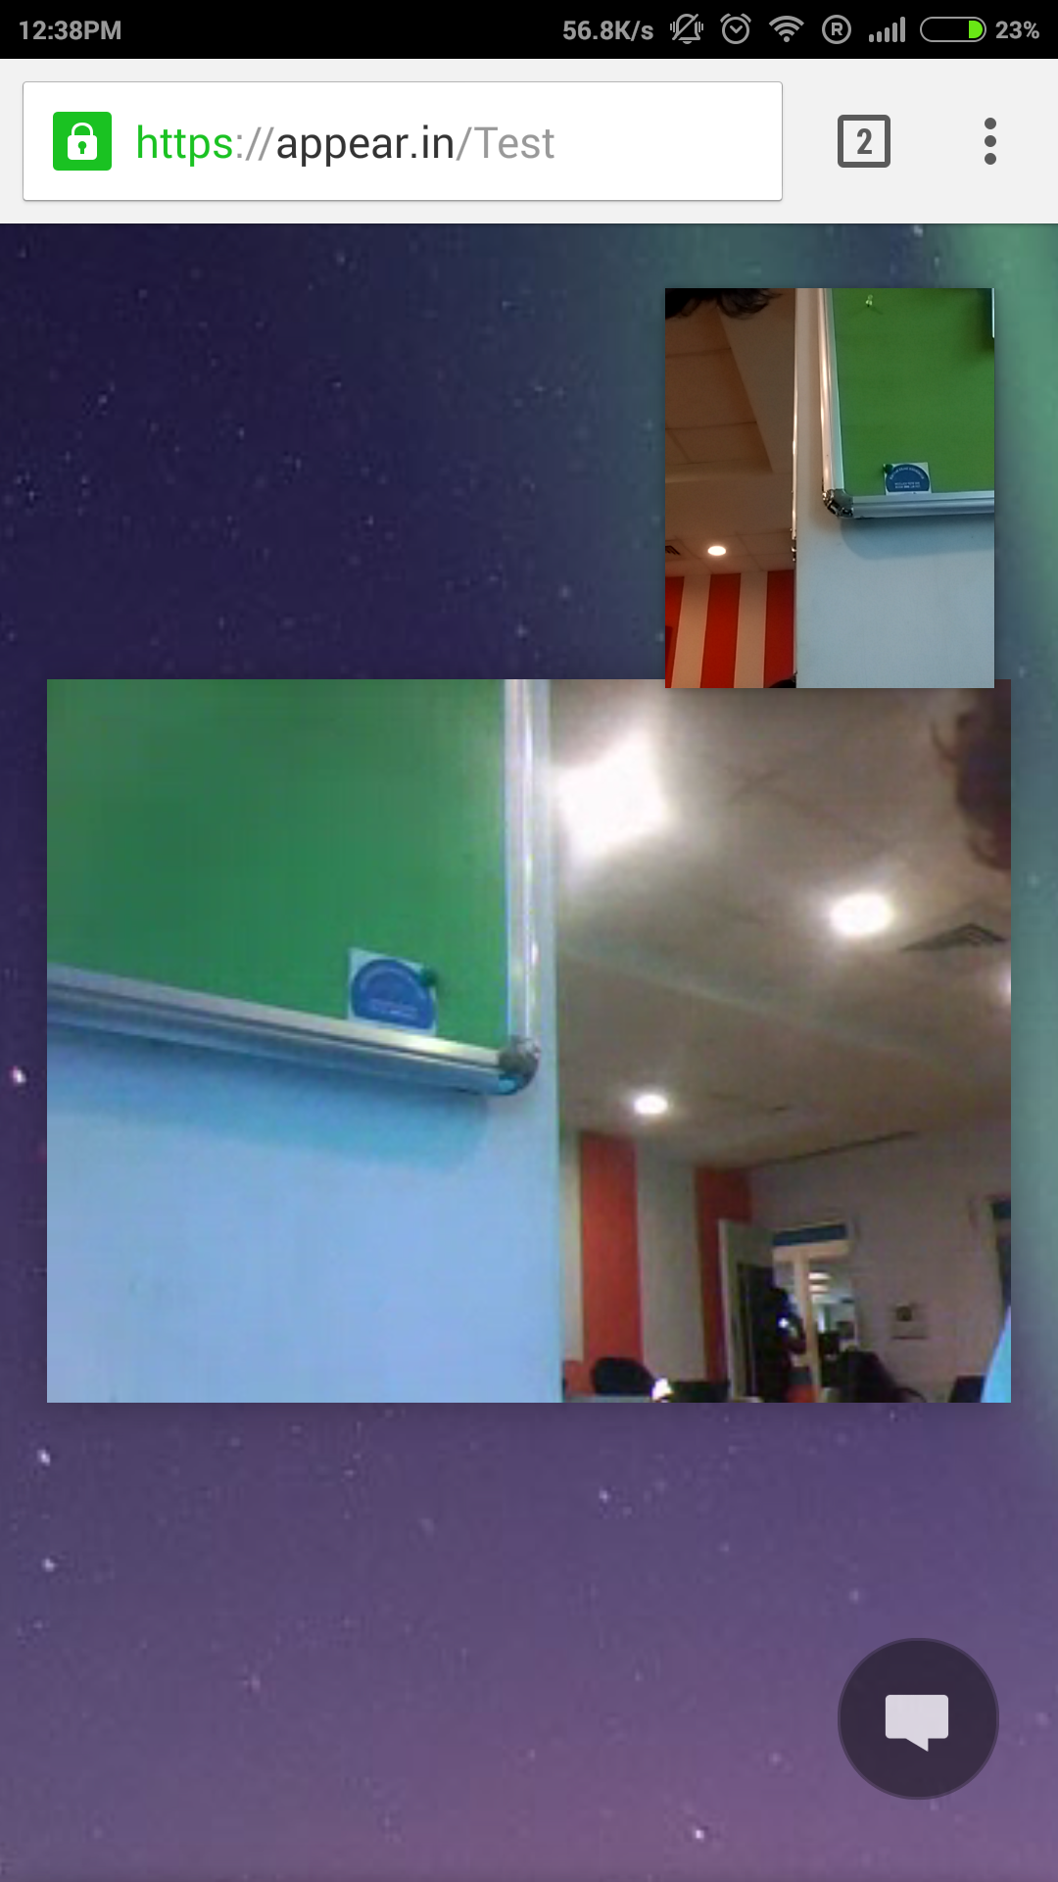
Teamchat App introduces "Appear.in" integration
Click on the links start video conferencing in the browser or on teamchat.
Entering the keyword "help post a chatlet.

Slide 4

Thank You

